Slide 1
RMO Public Lighting Energy Efficiency Projects
Brian Bourke A/SEE, RMO

Slide 2
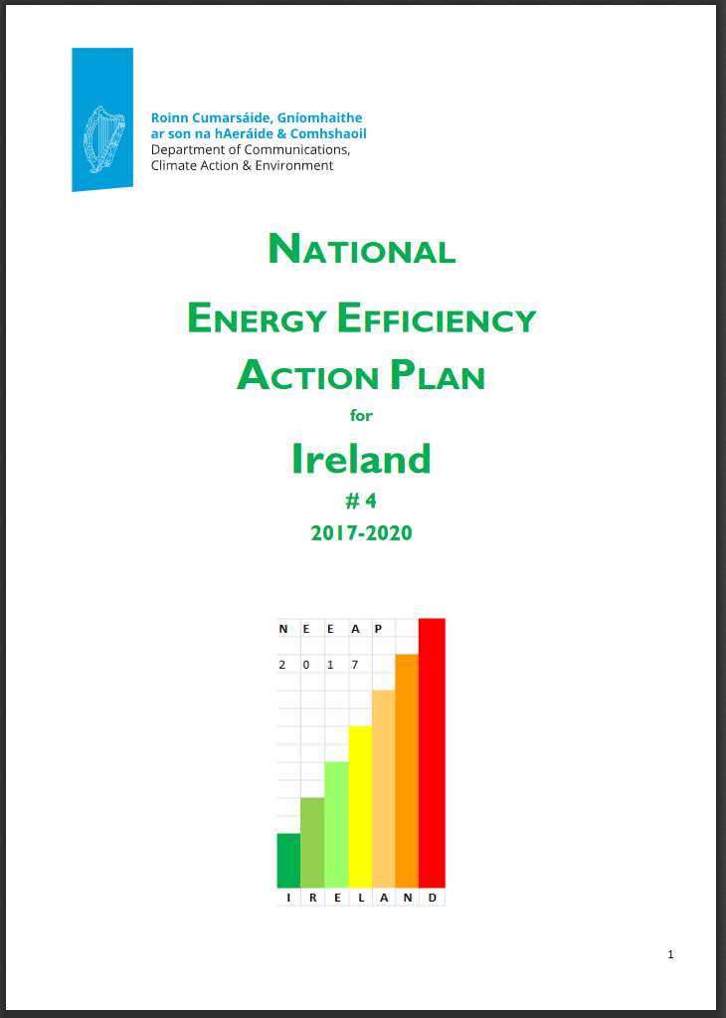
Local Authority Public Lighting
489,000 Public lights in Ireland, 240,000,000 kWh energy (45,000 average homes annual energy use)
9% are LED – circa. 40,000 - €20m
Public Lighting accounts for circa. 50% of Local Authority Energy use. Public sector to be 33% more energy efficient by 2020
“Public Lighting is one of a range of measures that are important to achieve Ireland’s energy efficiency objectives in the Public Sector.”……
“local authorities are co-operating and working on a co-ordinated basis through a National Steering Group whose objective is the upgrade of the public lighting stock to achieve the national public sector energy efficiency target.”

Slide 3
Public Sector Response
“The completion of this flagship national project is critical if the Local Authority sector is to meet its part of the public sector target in 2020”

Slide 4
Background of RMO Public Lighting
Public Lighting Steering Group Set up 2015 – participants on next slide
Primary Aim was to look at options for assisting Public Lighting Sector / Local Authorities reach 2020 targets
RMO PL Team was established as dedicated resource to develop Business Plan
RMO Team Leader Daragh Quill in place since 2016 followed by Team Members Brian Ahern & Brian Bourke in 2017
LUTS Sub Committee / CCMA
Completing Business Case was the principle priority in 2017

Slide 5
Project Drivers
2020 Energy Efficiency Targets
1
SOX lights phase out
2
Cost Savings (Energy & Maintenance)
3

Slide 6
The National Public Lighting Steering Group
Michael Walsh (Chair) - Waterford City & County Council
Marcus O’Connor – Tipperary County Council
Eddie Taaffe – Wexford County Council
Tim Butler - Kilkenny County Council
Tom Stritch – Cork County Council
John McCarthy – DTTAS
Albert Jordan – DCCAE
Rebecca Minch – DCENR
Geraldine Walsh – TII
Kevin O’Rourke – TII
Anne Mac Dermott – TII
Peter Burke – LGMA
Kevin O’Sullivan –ARUP
Alan Ryan – SEAI
Majella Kelleher – SEAI

Slide 7
The Technical Working Group
Darragh Quill Public Lighting RMO
Brian Bourke Public Lighting RMO
Brian Ahern Public Lighting RMO
Kevin O’Sullivan ARUP
Chris Corr ARUP
Mark Reilly ARUP
Susan Cogan MCO
Geraldine Walsh TII
Anne MacDermott TII
Farham Naseim Laois Co. Co.
Maura Gilchrist Longford Co. Co.
Willie Ryan Offaly Co. Co.
Grainne Mowlds South Dublin Co. Co.
Aidan Mahony Cork City Council
Brendan Fitzsimons Westmeath Co. Co.
Alan Hall Monaghan Co. Co.
Declan Keogh Carlow Kilkenny Energy Agency
Paddy Phelan Carlow Kilkenny Energy Agency
Triona Casey Midlands Energy Agency
Alan Ryan SEAI
Richard Morton SEAI

Slide 8
Regionalised Structure and Contract Options
Energy Performance Contracts (EPC/ESCO) LA’s to hand over economic ownership of PL to ESCO for 15 years +
Procure Lights directly on a framework At least 10% more expensive due to VAT rules
Traditional client designed project extremely complex scheduling of designs with contractor, also possibly more expensive re: consultants
Maintenance Contractors put up LED’s Procurement issues, less economies of scale, extended delivery time
Design & Build (Design / Build / Maintain) Design Approval Protocol to be agreed.
Design & Build & Condition Rate

Slide 9
Proposed Implementation Model
Housing Financing Agency (HFA)
RMO Public Lighting
RMO Provide Business Case & CBA to HFA for Loan
RMO Tendering for Consultant for Contract 1
LA’s apply to HFA for loan
Consultant
Local Authority No 1
Local Authority No 2
Lead Local Authority
Retrofit Contract
Design & Build Contactor
Local Authority No 3
Local Authority No 4
Lead LA tenders for Contract through S85 Process

Slide 10
Progress so far
Business Case / Cost Benefit Analysis completed and peer review process is ongoing
Economic Assessment strongly positive
IRR 13.1%, Benefit Cost Ratio 1.7
NPV €68m (20 years)
Financial Appraisal shows a surplus of savings over debt service
Total energy saving of 200 GWh TPER & 43,000 tonnes CO₂ per year
RMO currently engaging one-to-one with Local Authorities

Slide 11
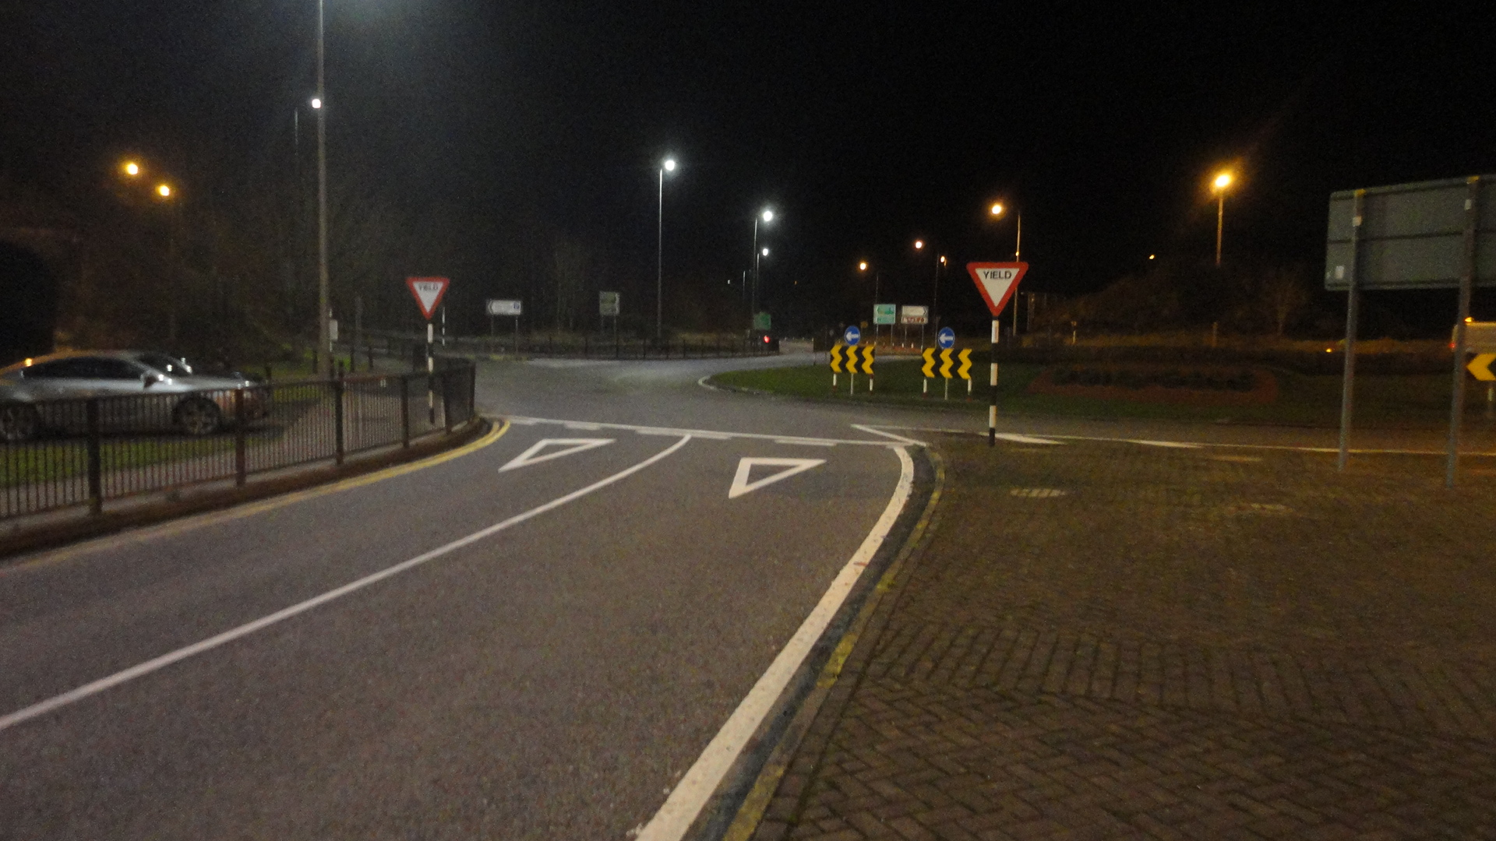
Before & After

Slide 12
Cork County Council
Project Costs = €48.5K
45 x 250W & 3 x 150W
36 x 90W & 6 x 130W & 6 x 235W
Annual Financial Savings = €4.5K, €90 per light
Payback Period (using energy savings only) = 11 years, 65% Energy Savings

Slide 13
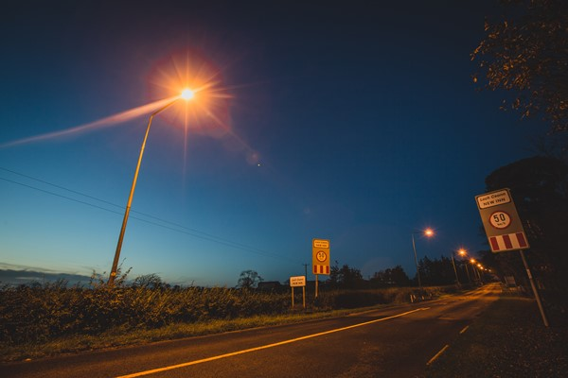
Tipperary County Council
Some Key facts:
The New Inn Installation will save approx. €2,564 per year in energy costs.
This equates to a 53% reduction in annual energy consumption
8 year return on investment / 4 year return on investment including grant
Summary:
Annual Electrical Consumption in kWh 28,116
Annual Operational Cost €4,779
New Electrical Consumption in kWh 13,031
New Operational Cost €2,215
Capital Cost €18,828
SEAI BEC Grant €9,417
CO2 Saving in Tonnes 8
Key Innovation:
Design & build contract
LED technology

Slide 14
Kilkenny County Council
Carlow Kilkenny Energy Agency and Kilkenny County Council with assistance from SEAI
Total Project Cost = €592,000: Grant Amount = €200,000 (approx.)
Expected annual electricity saving to be €100,000 / €77 on average per light
6 years payback @ 0% Interest

Slide 15
Non-Energy Related Benefits
It reduces the number and severity of night time road accidents
It increases evening activity and promotes the evening economy
Provides a safer environment
Reduces carbon emissions
Reduces Maintenance Costs (LED have a lifetime of 100,000 hours or 20 years)
Compatible with Trimming and Dimming burn profiles
Reduces street crime and fear of crime
Assists the emergency services and Gardaí (CCTV)

Slide 16
Advantages of Utilising the RMO Service for LA’s
Achieve your Energy Efficiency Targets!
Economies of scale of a 100,000+ LED project
Business Case and Cost Benefit Analysis Completed
Tendering and Procurement done
Design and Build Project
Consultant Resources - Audit and Check Designs
HFA Loan Facility at a very competitive rate
Energy and Maintenance Cost Savings
Asset Condition survey completed to allow Public Lighting Management to progress to an efficient and effective asset management regime

Slide 17
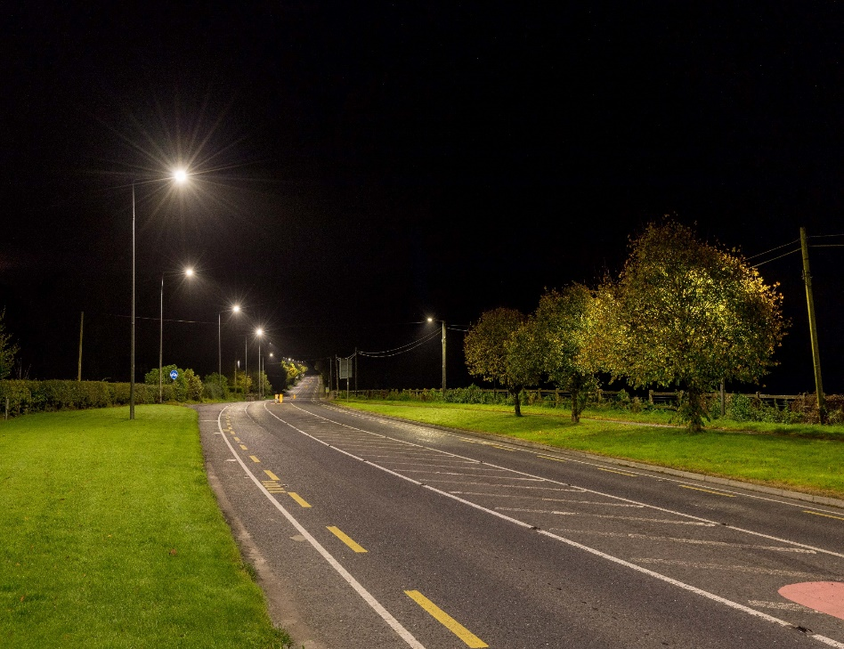
After The project is completed?
…… after the retrofit
LA Maintenance & Energy Costs will dramatically decrease
Possible Regionalised Maintenance Contracts
Strategic planning of infrastructure upgrades using asset condition data
Preventative/proactive maintenance of PL asset

Slide 18
Thank you for your kind attention
RMO Public Lighting Team
Daragh Quill, A/Senior Engineer daragh.quill@rmo.ie
Brian Ahern A/Senior Executive Engineer brian.ahern@rmo.ie
Brian Bourke A/Senior Executive Engineer brian.bourke@rmo.ie

