Slide 1
TII
Lighting Standards & Specification Updates
Chris Corr BSc CEng MIET MILP MCIHT

Slide 2
Updating TII Road Lighting
Standards & Specifications
Notes:
Key Message:
TII standards and specifications for road lighting in process of being updated.
Expected to be published in coming months.

Slide 3
Reasons for the Updates
Notes:
Why the change?
Last update (early 2000s or 1990s in some cases)!
Obvious reasons are changes in the referencing of standards.
More importantly standards have changed and the existing ones do not currently match the approach taken for designing and implementing current lighting installations
A lot of the lighting information now conflicts given how much things have evolved in more recent times
Lamp technology and method of control have changed!
A move to LED from HID
Application of Dimming – the right light in the right place at the right time.
Drawing on best practice from organisations such as the ILP
Improved technology requiring less visits to the roadside should minimise operatives visiting site and setting out TM which in turn should lead to a safer road!
Also a more formal and structured approach in terms of the design process and handover into maintenance.

Slide 4
DN-LHT-03038 – Design of Road Lighting on the National Network
Bringing all lighting requirements together in one place
Sets out TII lighting policies
Uses Industry Best Practice
A balanced approach when considering lighting
Notes:
One of the lighting documents nearing completion and to be hopefully issued soon following completion of stakeholder consultation is:
DN-LHT-03038 – TD 34 in the old DMRB speak
This proposed document is a significant re-write to the current one.
It brings all of the lighting requirements together – at present requirements are littered across many documents that have inconsistent requirements
It captures current TII lighting policies
Safety, Environmental Impact, Energy Conservation and Good practice have all been considered

Slide 5
A Balanced Approach
Landscape
Journey Ambience
Security
Severance
Government Policy
Townscape
Safety
Biodiversity
Physical Fitness
Notes:
The application of road lighting needs a balanced approach.
Not 30% of nigh time collisions any more on the rural high speed network. More like 10%
HE undertook research in mid 2000s and this was conclusion reached.

Slide 6
Selection of the Lighting Class
Parameters for the selection of M/ME lighting class.
Parameter | Options | Weighting Value V_{W} | V_{W} Selected
Speed | Very High (>100 km/h) | 2
 | High (70 km/h to 100 km/h) | 1
 | Moderate (40 km/h to 70 km/h) | -1
 | Low (< 40 Km/h) | -2
Traffic volume | Very High to High (ADT>40,000) | 1
 | Low to Moderate (ADT between 7,000 and 40,000) | 0
 | Very low (ADT <7000) | -1
Traffic Composition (Note 1) | Mixed with high % of non-motorised | 2
 | Mixed | 1
 | Motorised only | 0
Separation of carriageways | No | 1
 | Yes | 0
Junction Spacing (Note 2) | High (<3km) | 1
 | Moderate (>3km) | 0
Parked Vehicles | Present | 1
 | Not present | 0
Ambient Luminance | High | 1
 | Moderate | 0
 | Low | -1
Visual guidance/ traffic control | Poor | 1
 | Moderate or Good | 0
Sum of Weighting Values
M - Lighting Class |  |  | M-
Notes:
Lighting Standards have moved on significantly in more recent years.
Once a upon a time there were limited number of lighting classes applied.
The range of lighting classes was restricted and I would say this meant that part of the road network may have been either over-lit or under-lit.
A more considered approach is needed when selecting the right lighting parameters – fitting in with current standards that consider risks associated with safety and balanced with environmental setting.
A tool will be made available on the TII website to encourage designer to take a more considered approach to selection of lighting classes.

Slide 7
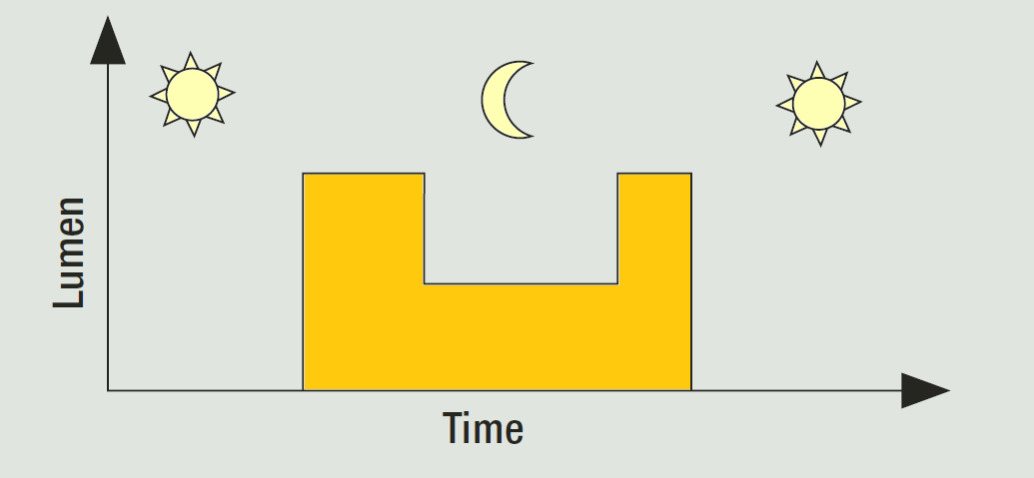
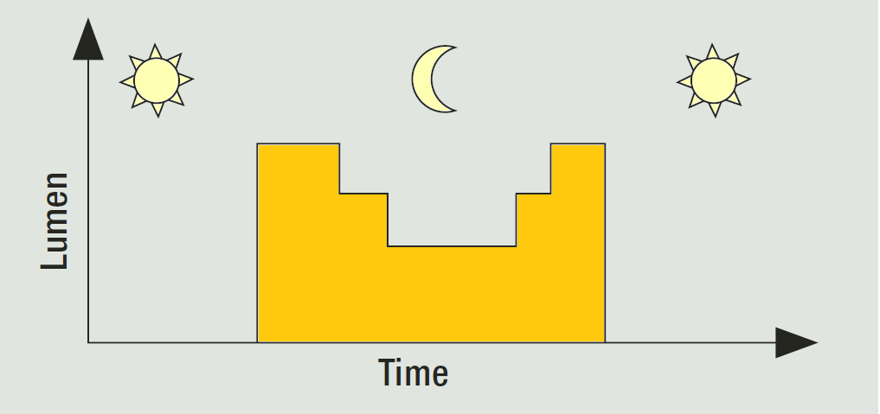
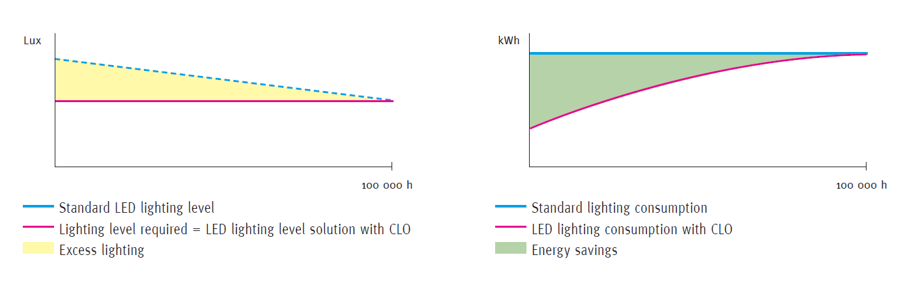
The Right Light at the Right Time
www.northcliff.org
www.northcliff.org
Notes:
New technologies permit the right light at the right time.
The new standard ensures the designer considers the application of dimming during the hours of darkness when there is little traffic usage on road.
Historically – we over light in early years to ensure a minimum maintained level of lighting as the light source depreciates – technologies such as Constant Lighting Output (CLO) ensure a smarter way of minimising energy consumption.

Slide 8
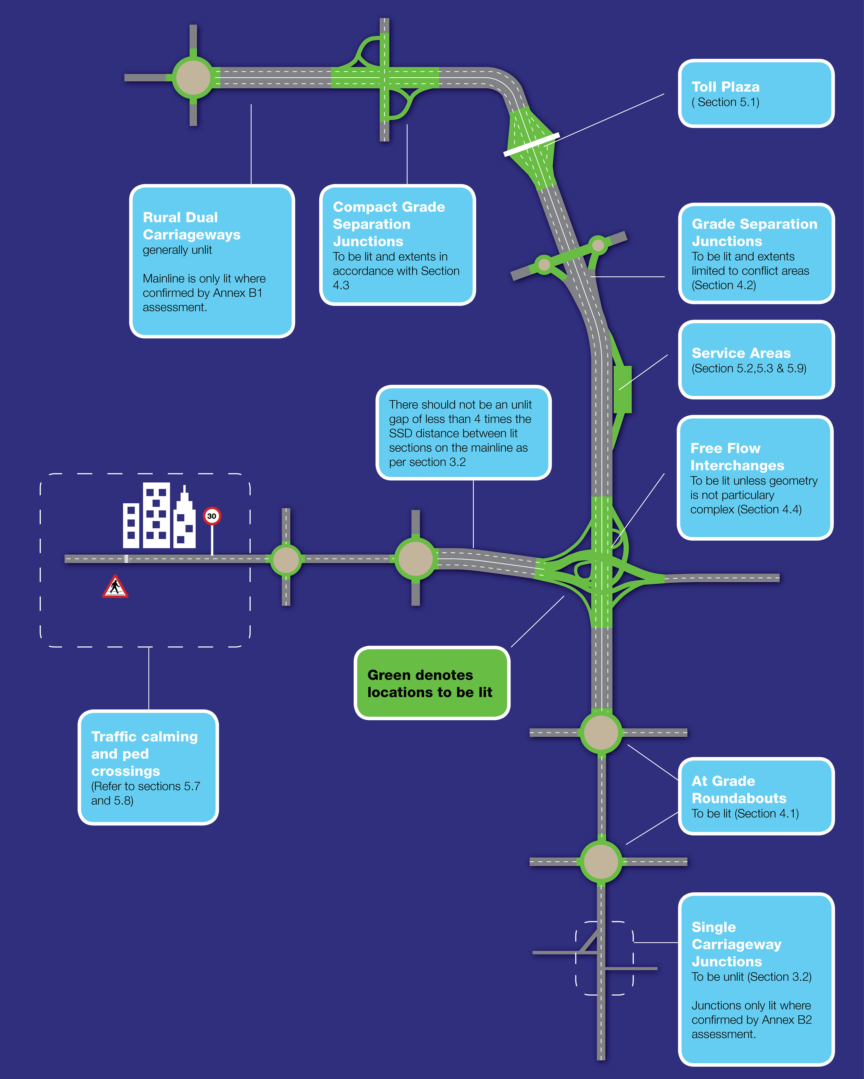
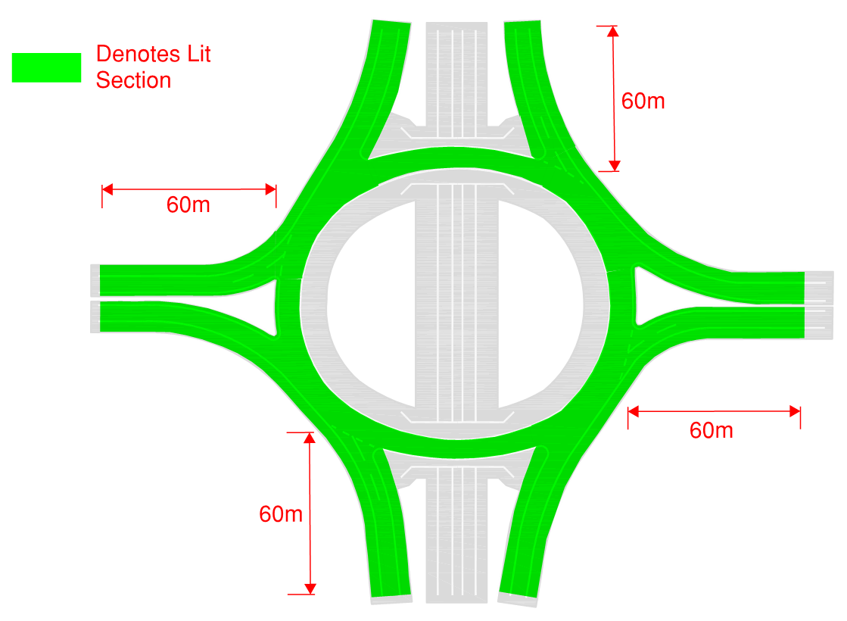
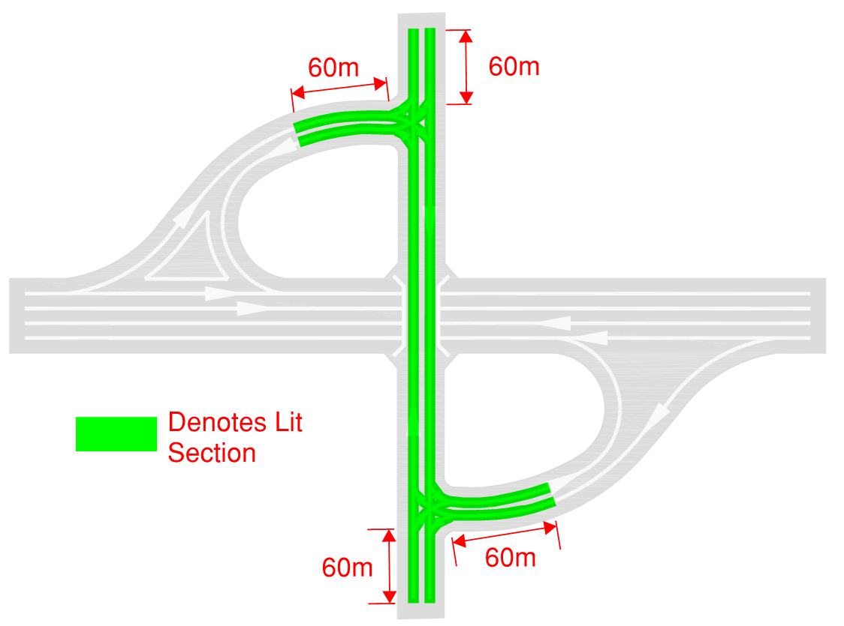
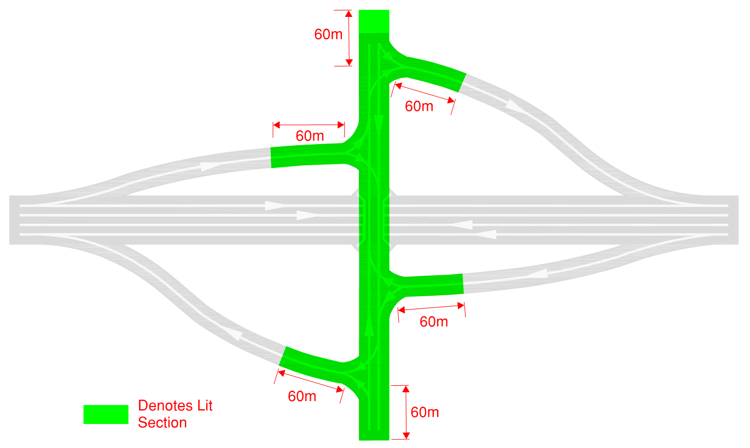
Lighting Extents
Notes:
Lighting on the Mainline is predominately unlit and lighting generally restricted to urban locations
Often much confusion in the lighting industry about determining where lights start and finish.
The new Standard helps clarifies this, outline TII policy in terms of the extents at junctions, roundabouts and interchanges and draws on best practice guidance (ILP) where appropriate

Slide 9
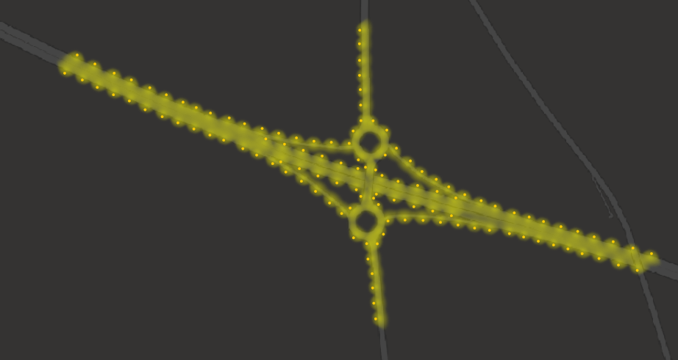

Reducing extents at Grade Separated Junctions
Notes:
Whilst there was limited data - Analysis of the Network Safety Ranking (Arup) indicated that junctions lit to a smaller foot print are no less safe
Lights switched off and extents cut back at four junctions in August of last year
M1 J6 (Balbriggan)
M6 J3 (Rochfortbridge)
M9 J3 (Athy)
M4 J9 (Enfield)
No safety or other issues have been identified in the pilots.
TII intend to roll out anther 15 junctions this summer.
If we go back to older lighting starts of 1992 and earlier – lighting extents at junctions for instance tended to be limited to just 1 or 2 columns past conflict points but the extents of the light has appeared to ‘sprawl’

Slide 10
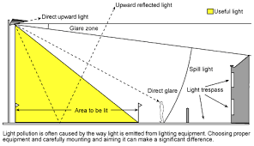
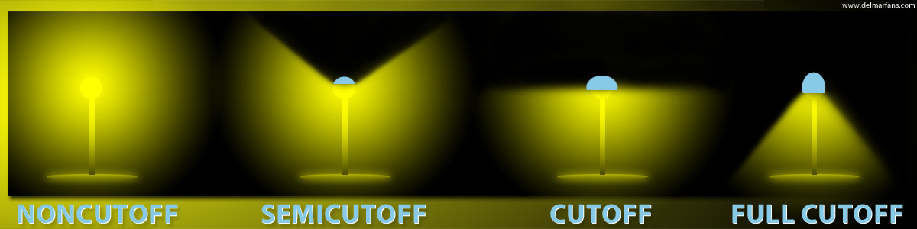
Environmental Control
Zone | Surrounding | Lighting Environment | Examples | Luminous Intensity Classes
E0 | Protected | Dark | UNESCO Starlight Reserves, IDA Dark Sky Parks | G6
E1 | Natural | Intrinsically Dark | National Parks, Areas of outstanding Beauty | G5 or higher
E2 | Rural | Low District Brightness | Villages or relatively dark outer suburban locations | G4 or higher
E3 | Suburban | Medium District Brightness | Small town centres or suburban locations | G3 or higher
E4 | Urban | High District Brightness | Town/city centres with high levels of night time activity | G2 or higher
www.delmarfins.com
Image from ILP GN 01
Notes:
Glare can be an issue and we need to restrict it.
The move to road lighting LED from HID perhaps compounds this issue for many although perhaps not as much as the glare from newer light technologies on cars.
A metric known as ‘Threshold Increment’ is used as one of the lighting parameters used to ensure discomfort or disability glare is restricted into the drivers eye. But light spill outside of the road surround and into adjacent properties need also to be considered.
Best practice and a restriction in luminous intensity class is stipulated and the surrounding environment is considered in terms limiting the light in rural areas where the surrounds are dark.

Slide 11
Lighting Design Process
Concept
Prelim
Detailed
Notes:
There has always been a lack of guidance in terms of what should be considered for the lighting at concept, preliminary and design stages.
Lighting should be undertaken by competent and experienced lighting designers.
The document helps set out the provision of information and aspects to be considered at various stages of design process.
A similar approach to the traffic signal design has been taken where designers should compile a design file that captures information.
Safety needs to be considered at all stages particularly - Forgiving Roadside, application of passive safe columns and electrical disconnection systems to ensure disconnection with 0.4 seconds

Slide 12
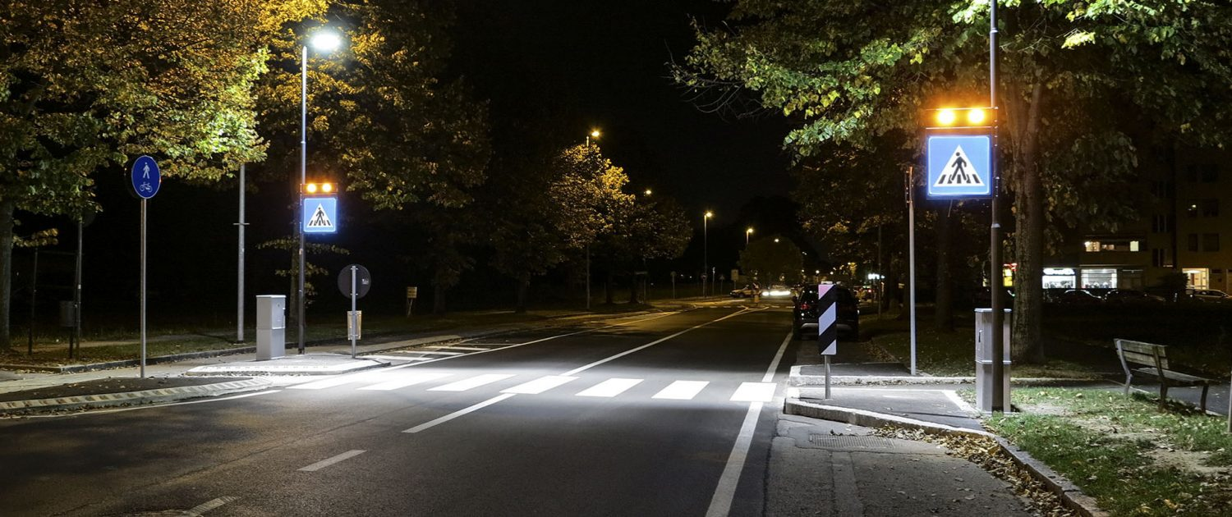
Lighting In Villages and Towns
Notes:
The standard does not stop at just lighting the mainline highspeed road network and junctions, roundabouts and interchanges.
The current version is very UK centric and was compiled by highways England in 2007 and really only geared towards strategic road network.
Guidance is given in the document to the lighting of other aspects such as Pedestrian Crossings and Traffic Calming Features.

Slide 13
Lighting Assessment Tools
Notes:
Lighting assessment tools will be provided and made available on the TII website.
The one depicted is to help understand cost associated with implementing lighting on the Mainline, understanding NPV and BCR figures over a 30 year assessment period along with sensitivity analysis for different night time accident saving figures, diming profiles and traffic growth factors.
Anther assessment tool will be available but a more simplified one for Local Authorities looking for funding for ad hoc lighting

Slide 14
Standardised Public Lighting Inventory
Notes:
Already we have seen publication of the Standardised Public Lighting Inventory
- The new standard links to this and provides a template in terms of the structure/format of lighting handover documentation.

Slide 15
Thank you

