Slide 1
TII Fencing Retrofit
Site Visit observation/Lessons learned
03-02-2022 john carton

Slide 2
Site Visit Observations/Lessons Learned
Inspected approximately 15km of fence retro fit sites on the single carriageway network in 7 counties in the South East Region from 2019 – present. Other regions may have unique challenges.
Common issues although the standard has improved as the amount of fencing completed has increased.
Early on, possible confusion between TII fencing standard and The Department of Agriculture S148 Minimum Specification for Farm Fencing –
- Example;
TII TPTM Fence Strainer Post diameter = 170mm +/- 3mm
S148 Mesh Type Fence Strainer Post diameter = Minimum 175mm.
The SCD’s are very detailed and the notes contain a high level of guidance.
Retro fit scenario, difficulties are commonplace.

Slide 3
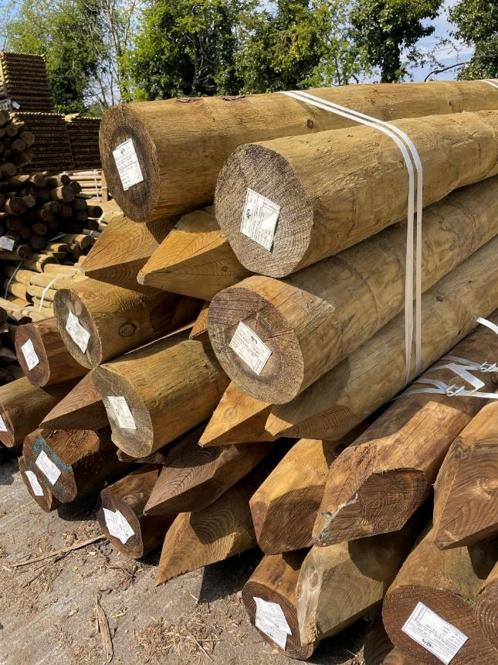
1.Incorrect Strainer Size
Rough cut straining post utilised
Diameter too large and not uniform
Very common in the early stages of the fence retro fit scheme
Less common now.

Slide 4
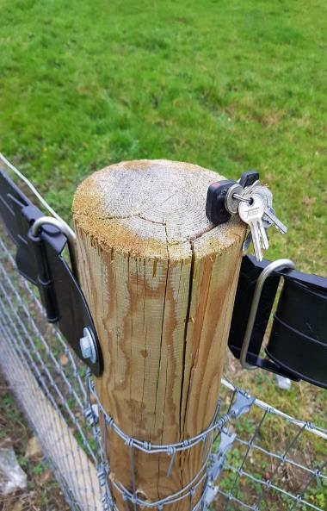
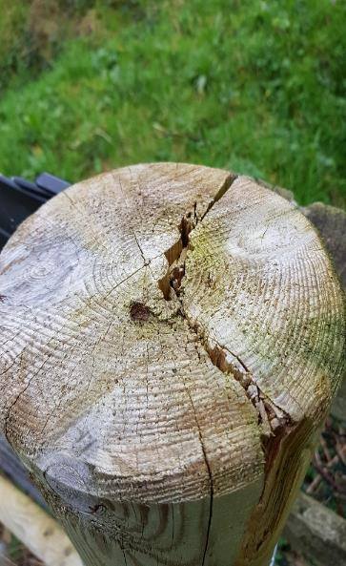
2. Damage to posts
Caused by excess driving force in hard/rocky ground.
Will substantially reduce the life span of the post/fence.
Hard ground conditions are dealt with under Note 4 of the SCD and there should be provision in the contract for this.
The contractor should consult with the Employers Rep, rather than continuing to damage posts.
Can also lead to a lack of embedment depth of posts and tops of posts should not be cut without approval.

Slide 5
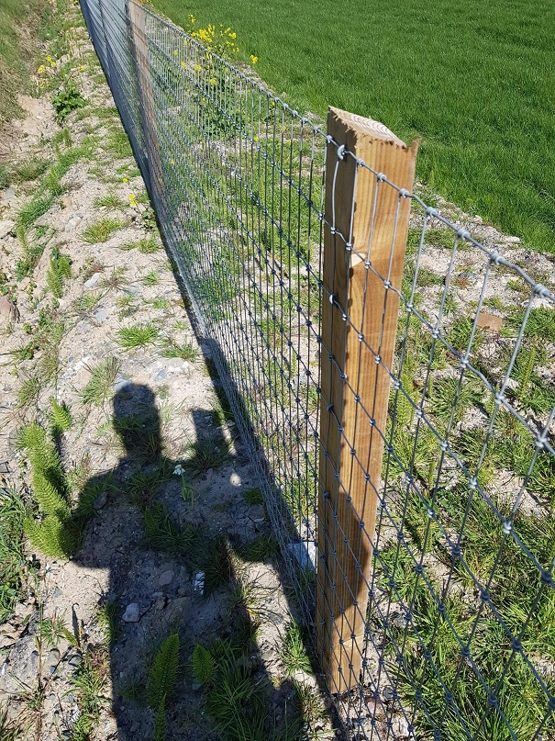
3. Mesh placement
Mesh should be on the field side of the fence
Consult note 11 on the SCD.
It can happen that it is placed on the road side and this is costly and time consuming to rectify.

Slide 6
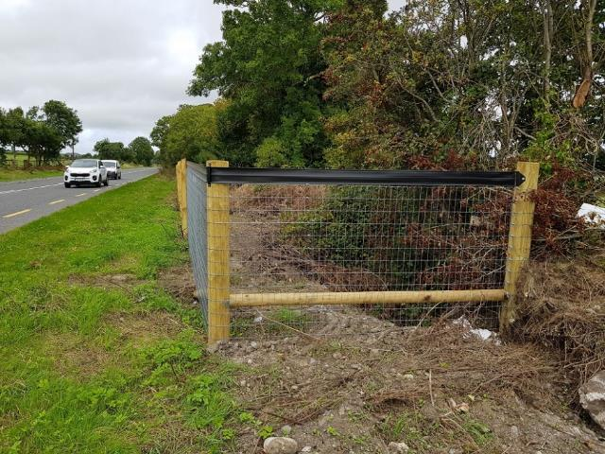
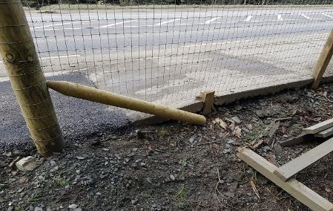
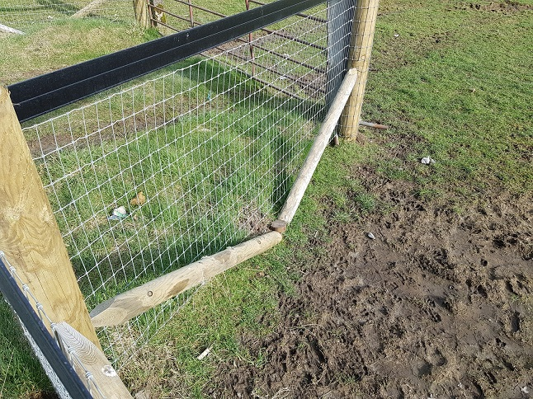
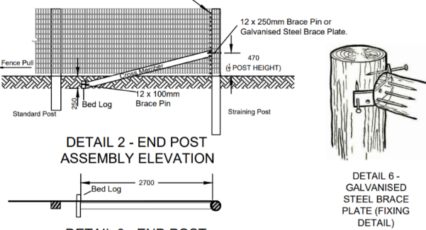
4. Cross members/ Diagonal Props
The SCD detail is very clear for the length, height, connection detail and all other dimensions
Cross members should not be horizontal or connected to the end posts by any other means than the brackets shown.
Tight spots do occur where if may be difficult to achieve the required length/angle and judgement should be utilised at these locations.
Again the cross members should never be horizontal.

Slide 7
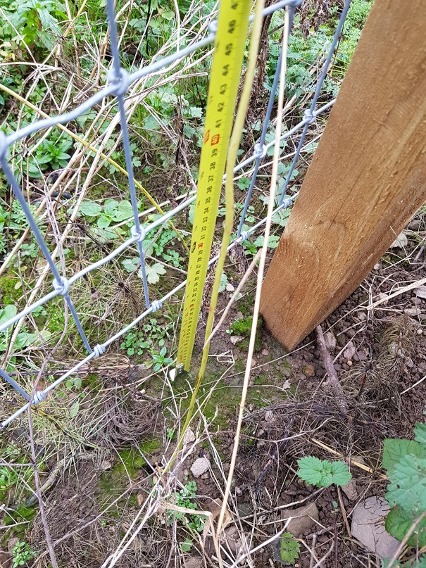
5. Site Preparation
Site preparation should be completed to allow the fence maintain a constraint clear gap of 50 – 100mm at the base between the ground and the bottom of the mesh.
Within reason in a retro fit scenario as substantial earthworks may be impractical/impossible. Note 15 SCD-00320/321
Too large a gap can result in a lack of post penetration and stability of the fence. It can also pose a hazard to livestock.

Slide 8
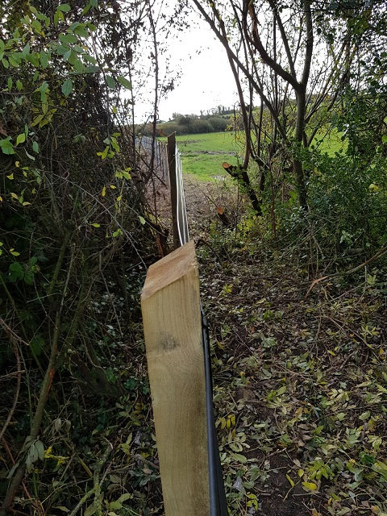
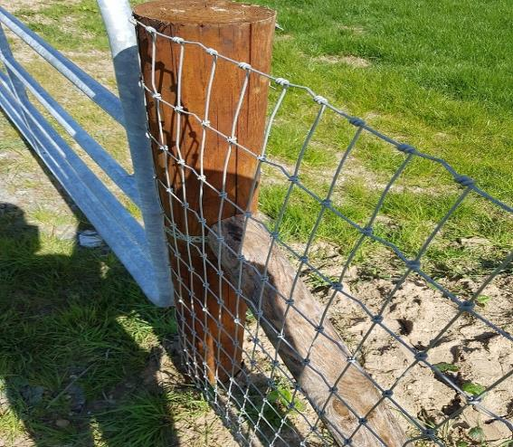
6. End Post Treatment
All fencing should start and end with an end post treatment.
SCD note 2 relates to starts and ends, changes in direction, crossing boundaries and maximum straining post spacing.
If in doubt, put in a Straining post
SCD note 10 details how to terminate the mesh at end posts. The mesh should be wrapped and not stapled. Over use of staples is frequently seen.

Slide 9
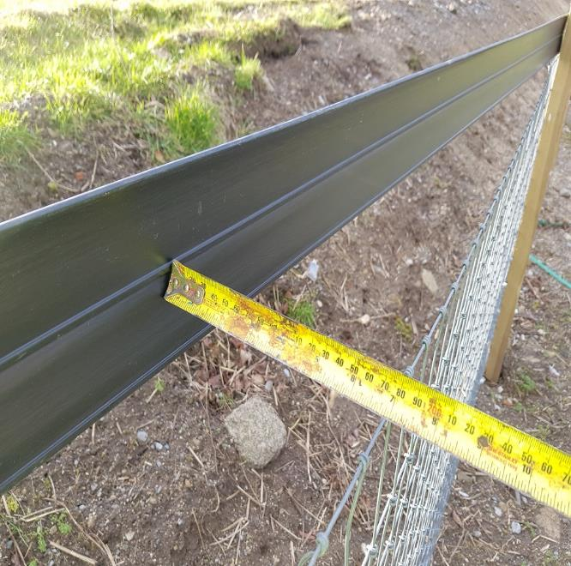
7. Tension
Tension on mesh should be 45kg/m. Note 13.
Visual check, V notches on wire should not be pulled straight.
The wire mesh is not supposed to be super tight.
Issue can be with SCD-00321.
The black band should be taut so as to not deflect excessively/blow in the wind but not so tight as to take tension away from the mesh.

Slide 10
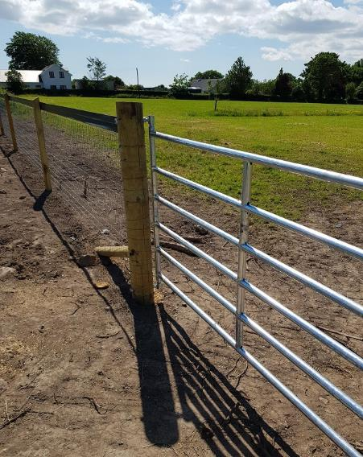
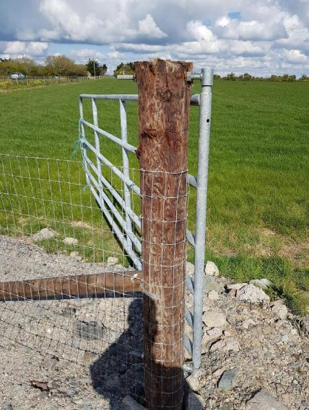
8. Gates
Gates should be to the TII standard – SCD-00310 or SCD-00309
TAMS II stickers on many gates. This is a Targeted Agriculture Modernisation Scheme grant specification.
Gates should only open inward.
Gates should be set back if possible. Requires landowner agreement
Gates should have separate hanger and receiver posts and should not be hung from the fence end posts.

Slide 11
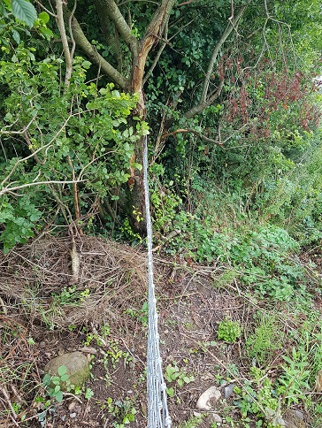
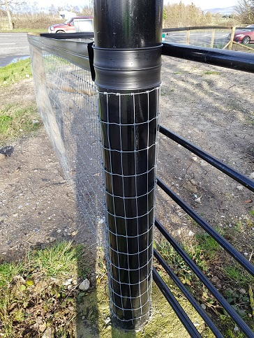
9. Terminations
Terminations or tie ins to existing boundaries can be a challenge
No perfect solution in a retro fit situation.
An end post should be placed at the very end where possible. Otherwise the tie in section should be as short as possible and infilled with a small section of mesh fence.
The mesh should not be terminated and tensioned off existing posts, trees etc.

Slide 12
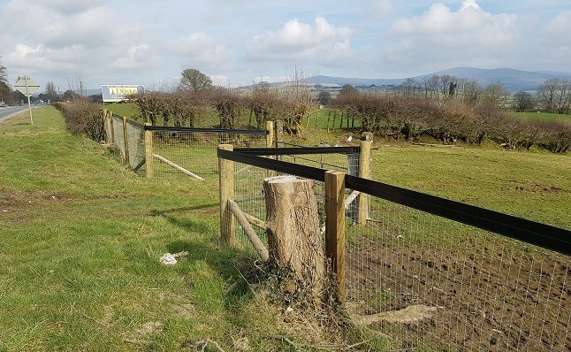
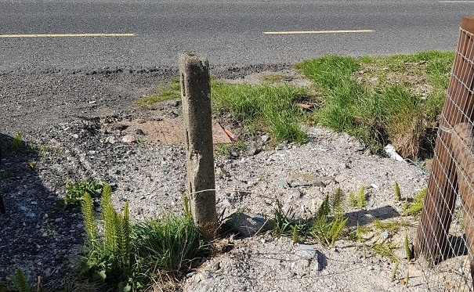
10. Removal of Other Hazards
It is encouraged to remove other road side hazards in conjunction with the fence construction where possible.
These are usually identified in Section 3 of the Assessment Report as discussed earlier.
Can include trees, rocks, poles, gates, open drains etc.
Items can be included in the tender and funding allocated with agreement from the RRSE.
Hazards should be removed completely, trees grubbed below ground level and topsoiled.

Slide 13
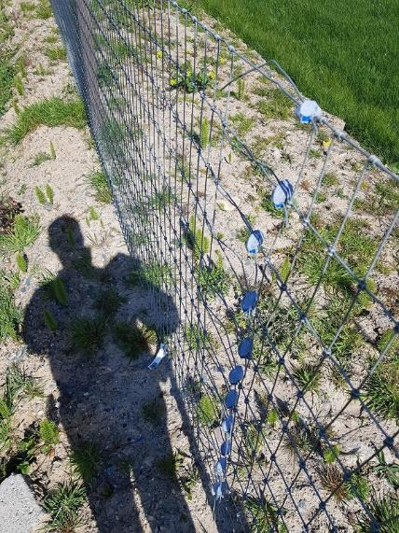
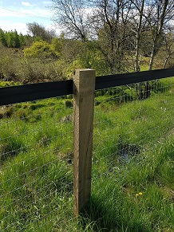
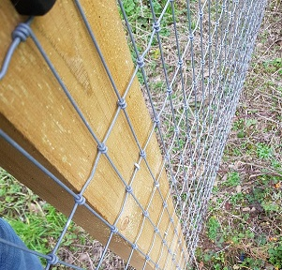
Other Issues
Long protruding wires at gripples/joiners (animals may harm themselves)
Flat top intermediate posts/incorrect weather detail. – Section 1 SCD.
Staple spacing and embedment. - Note 11 SCD
Landscaping of verges if required. The finished verge/fence line should be discussed with the landowner during the engagement process. Any minor seeding etc can then be included in the tender and funding allocated accordingly. Requests for significant planting etc should be discussed with TII Road Safety and can be assessed on a case by case basis.

Slide 14
Thank you for your attention
Any Questions?

