Slide 1
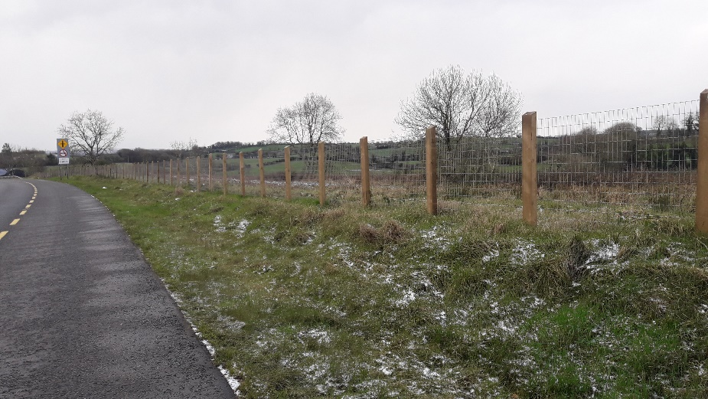
TII Fencing Retrofit Programme Monaghan County Council David Hamill Senior Executive Technician
TII Fencing Retrofit Webinar 3rd Feb 2022

Slide 2
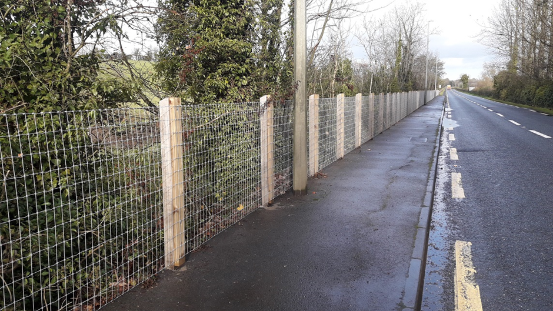
Progress To Date
8km of Concrete/Timber Post and Rail fencing identified
107 sites divided into:
48 Category 1 sites
59 Category 2 sites
Complete to Date:
19 Sites measuring 4.8km

Slide 3
Consider the Process
Step Sequence Taken:
Choice of Location
Landowner Engagement – ‘Early’
Site Surveys
In-House Design
TII approval
Contractor Engagement
TII Update
Landowner Update
Works & Close out

Slide 4
Landowner Engagement – ‘Early’
Monaghan County Council Approach

Slide 5
Landowner Engagement
Face to face contact
Background - retrofit requirement
Specification – livestock fencing or stud fencing
Design – Fencing extents and existing POST TYPE
Works timeframe
(No Promises)
livestock / silage –
Requirements to Consider
GDPR – Landowner contact details for contract
Correspondence – with Landowner
Notes:
Early contact improves inclusion of all matters into the design, & lessons impact on contract for change orders. Builds relationship between LA and landowner.
Landowners can still change their mind - be mindful of the implications on the contract, but may re-think position later.
Be prepared to be flexible in the approach to landowners.
Consultation at an early stage does not guarantee that the proposed works will be approved.

Slide 6
Correspondence with Landowner
Currently a 3-Step Process:
Post Meeting:
Confirm Date of Meeting & Overview of Fencing Retrofit Programme
Comment on Consent (if Applicable)
Confirm Works will not Proceed without TII Approval
Confirm that Fence Maintenance will Remain with the Landowner (if Applicable)
Provide Advice on Process
Specification & Map
Contact Details (for further information)
At Contractor Appointment:
Confirm TII Approval Granted
Confirm Appointment and Name of Contractor
Confirm Expected Works Timeline
Pre-Works:
Request Written Approval to Provide Contact Details to Named Contractor
Note: An additional letter may be required at the outset if a meeting in person is not possible.

Slide 7
IN-HOUSE DESIGN
TII FRP_Design Process Template Version V02

Slide 8
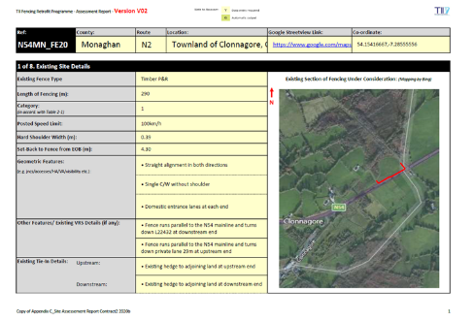
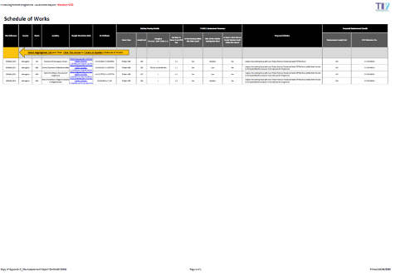
Three documents outputted
Appendix C – ‘Individual Site Assessment Reports’
Appendix A – ‘Schedule of Works’
Appendix B – ‘Schedule of Sites Referred to TII RSI Programme’

Slide 9
First Collect the Data
Site Dimensions & Features
Photographs
Departure from Standards (If Applicable)
Roadside Hazards (DN-REQ-03034 – Section 2.1)
Collision Rate & Sinuosity (KMZ File on TII Open Data Portal & Google Earth Pro)
Notes:
Collision Rate Data from TII Portal – One option is KMZ (Google Earth) format.
1. Twice Above Expected Rate = Red
2. Above Expected Rate = Yellow
3. Below Expected Rate = Green
4. Twice Below Expected Rate = Blue.

Slide 10
‘Site_Template’

Slide 11
‘Schedule of Works’

Slide 12
‘Schedule of RSI Sites’

Slide 13
Worked Example
N54 – County Monaghan

Slide 14
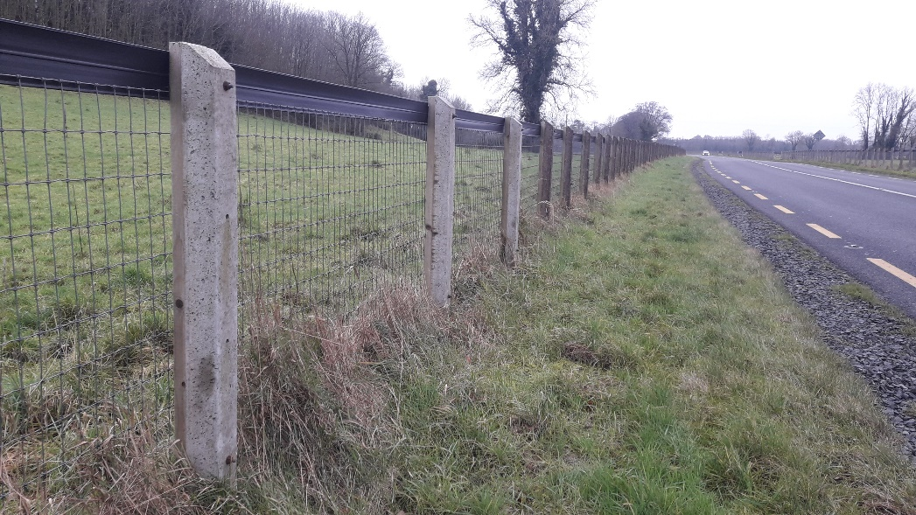
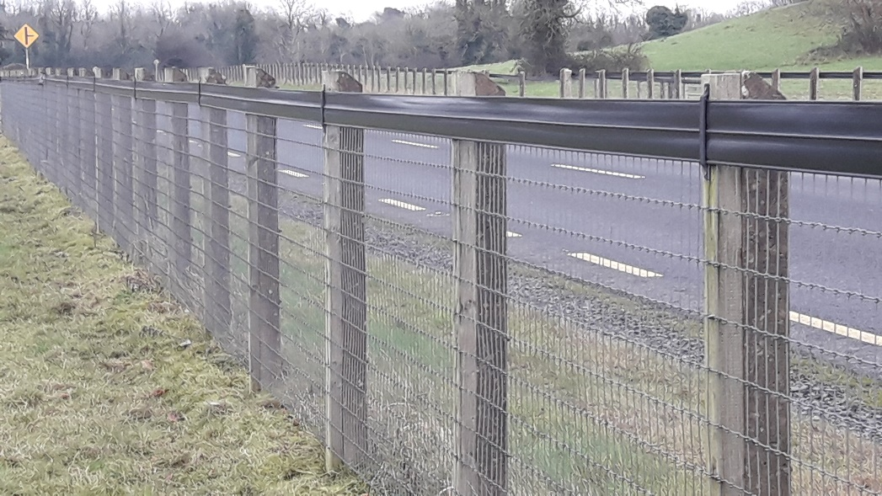
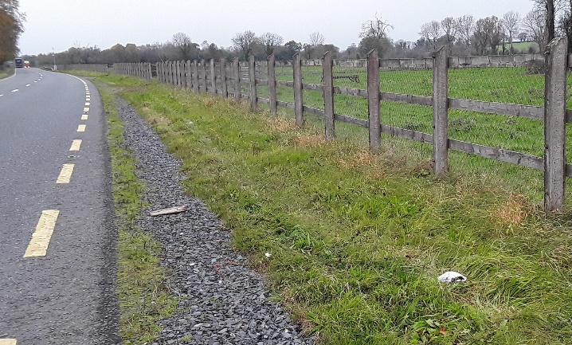
Sample Location (Note: Existing Concrete Posts Retained)
Existing Post & Rail

Slide 15
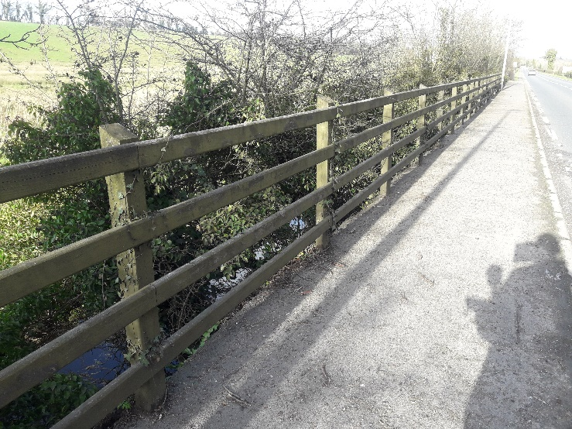
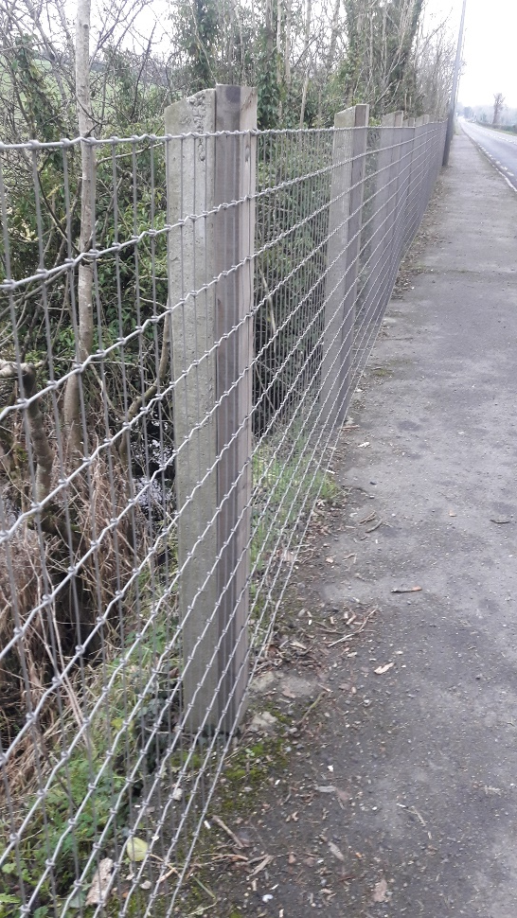
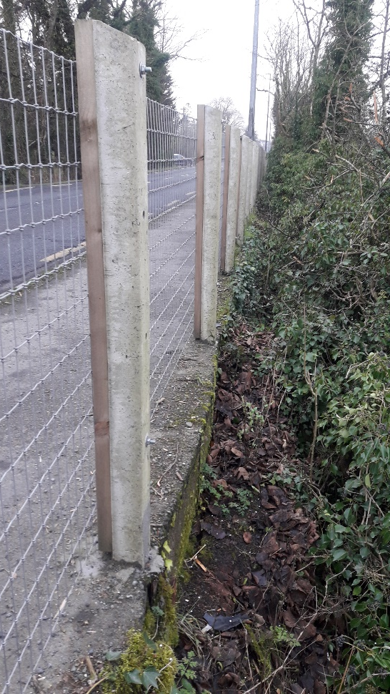
Worked Example Location (Note: Concrete Posts - In Place of Timber Posts)
Existing Post & Rail

Slide 16
Site Template - Appendix C (Page 1 of 6)

Slide 17
Site Template - Appendix C (Page 2 of 6)

Slide 18
Site Template - Appendix C (Page 3 of 6)

Slide 19
Site Template - Appendix C (Page 4 of 6)

Slide 20
Site Template - Appendix C (Page 5 of 6)

Slide 21
Site Template - Appendix C (Page 6 of 6)

Slide 22
‘Schedule of Works’ - Appendix A
Duplicate Data - By Not Selecting ‘Orange’ Cell before Updating (Delete contents of Cells in Column A)

Slide 23
‘Schedule of RSI Sites’ – Appendix B
Duplicate Data - By Not Selecting ‘Orange’ Cell before Updating (Delete contents of Cells in Column A)

Slide 24
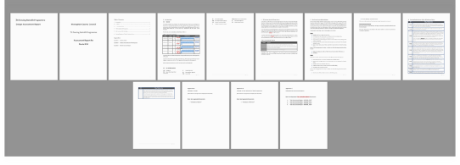
TII approval Documentation
Submit a Design Assessment Report to TII for review and approval – Four Document Types:-
TII FRP_Template Design Assessment Report
Appendix A – ‘Schedule of Works’
Appendix B – ‘Schedule of Sites Referred to TII RSI Programme’
Appendix C – ‘Individual Site Assessment Reports’

Slide 25
Contractor ENGAGEMENT
General Comments on Experience To Date

Slide 26
Items to Consider Post Procurement
Contract Documentation
- Insurance
- Traffic Management Plans
- Risk Assessments & Method Statements
- Programme
Materials Availability
On-Site Supervision
On-Site Compliance with TMP
Contractor Engagement with Landowners
Snagging

Slide 27
Some Positives Experienced
Growing Expertise of Local Contractors
Costs coming down
Good Interaction between Contractors and Landowners

Slide 28
Thank You

