Slide 1
Road Safety Audit Update
Lucy Curtis
TII Regional Road Safety Engineer
Notes:
Hello, I’m Lucy Curtis. I’m one of the 6 RRSEs and I’m based in the Kerry office. I also manage all the road safety audit approvals & monitor the auditing that’s going on, Which is why I’m here now.

Slide 2
17 years of Road Safety Audit
Latest statistics
Updates on the standard & guidelines
Sample reports
FAQ
Notes:
I have no particular subject for this talk. I’ll just run through the latest statistics, update on the standards, including a quick loook at the new sample reports in the guidelines, and then go through a few of the issues that keep coming up.

Slide 3
Latest statistics

Slide 4
242 Auditors registered on RSAAS since 2010
Notes:
First of all auditors. As you know we’ve been doing auditing since 2000, but it was only in 2010 that registering went online. Since we started that there have been 124 people approved as Leaders and 118 as Members. Adds up to 242.

Slide 5
166 Auditors currently active
Notes:
People come & go, or do fewer audits, or don’t keep up with changing requirements. So at the moment there are only 59 with up to date approval as Leader. 107 who qualify as Members, half of whom are lapsed Leaders. This adds up to 166, leaving 75 or so who are no longer on the radar.

Slide 6
Over 2000 Audits done since 2000
Notes:
Since we started in December 1999, over 2000 audits have been approved. 2024 up to last week. Unfortunately there have always been, and are still, audits being done on national roads that have not been approved. So I cannot say for sure how many audits in total have been done over these years.

Slide 7
Completed Audits 2010 - 2017
Notes:
Since the system went online we have been able to track completion of audits. This shows how many have been closed out. Not nearly enough. There are an awful lot of audit reports out there that need to be uploaded to the system. It’s the Project Manager’s job to do this, not the audit team’s. So all you project managers who have not done your close-outs can expect some correspondence from me about this in the near future.

Slide 8
Latest standard & guidelines

Slide 9
Update on latest standard & guidelines
New name
Standard GE-STY-01024 (previously HD19)
Guidelines GE-STY-01027 (previously HA19)
Include date when referencing – Dec 2017
Notes:
Main change is the new TII naming and categorising system. RTS. The date is no longer included in the document number, such HD19/15. But it does appear in the header of each page, so whenever you are referring to the standard, such as in the introduction to your road safety audit report, you should include the date of publication. Which is currently Dec 2017.

Slide 10
Update on latest standard & guidelines
Standard
Stage 1&2 recognised as a real stage
Flow chart rearranged
Notes:
Apart from the name, very little has changed in the standard. Stage 1&2 is now recognised as a real stage in its own right, rather than a variation on either stage 1 or stage 2. At design stage you can either do 2 audits - stage 1 and stage 2, or you can do 1 audit – a stage 1&2. Normally the stage 1&2 would be for smaller schemes. And I now expect you to have a clear understanding of which way you are going to go before you look for approval, which OF COURSE is before the audit is done. If your scheme has had a stage 1, you cannot later on decide that it was really a stage 1&2 and go straight to stage 3, the system will throw up alarm bells.

Slide 11
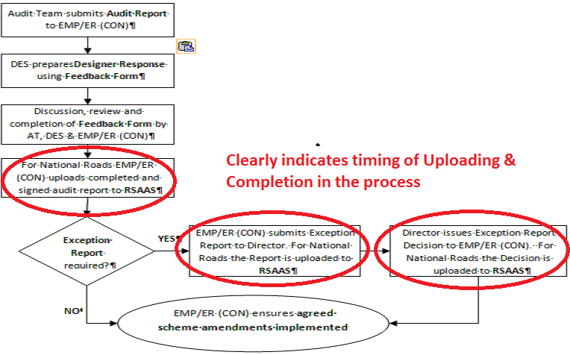
Report uploading & completion
Notes:
Also the flow chart has been rearranged to better illustrate the business of uploading reports to RSAAS and completing. If you have uploaded all necessary reports – which in most cases is just one report including feedback form filled in and everything signed – you can then complete. Unless an exception report is necessary, in which case those 2 processes there need to be gone through before you can complete.

Slide 12
Update on latest standard & guidelines
Guidelines
Methodology rearranged
Pre-stage 3 procedure clarified
Stage F described
New sample audits in appendices
Stage F part 1
Typical design stage
Notes:
In the guidelines there are a few more changes.
The methodology of doing audits has been rearranged and updated, but is mostly to the same old principles.
The procedure for pre-stage 3 has been clarified – it is viewed as part of the stage 3 and must be done by the very same team that is doing the stage 3. No extra team approval is needed.
RTS last 2 points

Slide 13
Stage F
Method much the same as any design stage
Look at drawings, note potential problems, discuss
Do all this for each option
Report very different - 2 Reports
Stage F1 report is comparison of options
Stage F2 is usual Problem/Recommendation format, done after Option Selection, on only the Preferred Route
Stage F is not complete till both reports done & uploaded
Notes:
We have included a description of the stage F report, which has never been provided before.
RTS

Slide 14
Stage F1 Report
For each option list the potential problems
No recommendations
Same problems might arise in several options
Summarise the problems over all the options
Compare options and problems
using a table helps
giving weighting to each problem type might help
List options in order of preference
Notes:
In the stage F1 report ….RTS for 2 lines
Same problems might arise in several options…. But then again not every option will have all the problems, so you will usually end up making a table so that you can get an overall view of which option has which problems.
You should give an overall summary of the problems, and depending on the expected hazards arising from these you could give weighting to them so that you can judge how each option compares with the others.
The final conclusion of the report must give an overall ranking of the options in terms of road safety. Go back one slide to RTS last 2 points.

Slide 15
Sample reports
Notes:
2 new sample reports are provided in the appendices. For stage F and stage 2

Slide 16
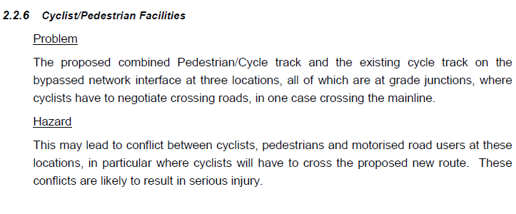
Sample Stage F1 report
Problem only. No recommendation
No Feedback Form needed
Notes:
This shows an example of a stage F part 1 individual problem. It describes the problem. It provides an explanation of why this is a problem. But no recommendation.
Because there are no recommendations in the report there is no need for a feedback form

Slide 17
Sample Stage F1 report
Variations in text in introduction
Stage F:
Other stages:
Notes:
… And this needs to be acknowledged in the introduction text, where often we would write….. This sentence is not needed in a stage F1

Slide 18
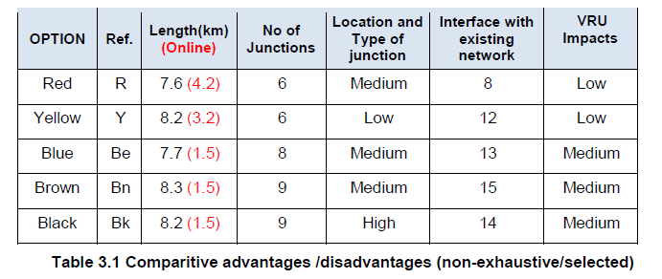
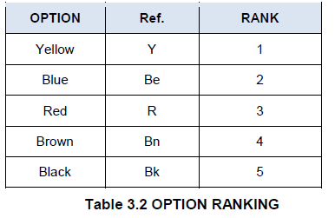
Sample Stage F1 report
Notes:
This is an example of the table I mentioned, that really is the only way to get your head around the variations in problems across the options. And the 2nd table shows the final ranking

Slide 19
Sample design stage audit report
Photos & drawings to help identification
Notes:
A sample stage 2 report is also given, and the main change here is that we now expect photos and drawings to help the reader identify the problems and their locations. Remember that it is not just the designer who reads the report. It is also interested parties who do not have the scheme drawings in front of them. Like me

Slide 20
Sample design stage audit report
Recommendations not too prescriptive
Describe the problem well & let the designer do the design
Notes:
The report also gives a little guidance on the type of recommendation expected. We, all of us, between us have a lot of experience in the audit process, and designers responses in feedback forms, and how the designer ACTUALLY responds by making amendments to the designs or changing what’s been constructed. And what we’ve learnt is that it is not helpful to be too detailed and prescriptive in your recommendation. It might be too vague to just say “fix it”, but a large degree of vagueness is required. RTS 2nd line.

Slide 21
FAQ
Notes:
I’ll finish off with a few things that are always cropping up, Questions I am asked on a regular basis.

Slide 22
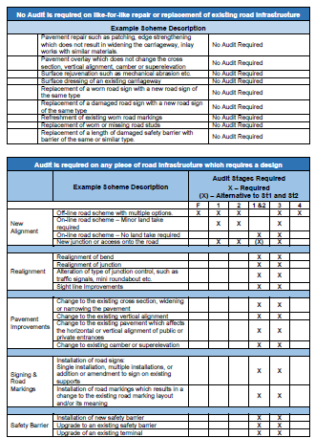
Need for audit
ALWAYS consult
GE-STY-01024 Appendix A
Not an exhaustive list, so consult with safety section if you’re still not sure
As with any standard, a departure request is always a possibility
No proposed work, no audit needed
Notes:
Firstly, what should have an audit?
RTS first 2 points. And if you ask us we will always go back to first principles: that RSA is to identify hazards that could affect the road user either by changing the behaviour of the road user or by changing the outcome of an incident. For instance a new bus shelter. It doesn’t alter the immediate road layout, but it may affect road user behaviour – attracting more bus users and thus more stopping vehicles, and if it is in a rural area it will very probably affect the outcome of an incident, as it could be a hazard in the case of a loss of control.
RTS last 2 points

Slide 23
Scope of the audit
Difficult to set down definitively in standard
Cannot be described geographically
Anything inside works or in surrounding area that could be influenced by the effects of the scheme
For example….
existing bend definition beyond scheme
existing hazards where risk might increase
Notes:
RTS
There might be a bend just beyond the limits of the scheme. The scheme is very likely improving the road, and thus increasing speed, which increases the speed at which vehicles approach that bend. It is affected by the scheme.
There might be existing hazards inside the scheme limits, such as sight distances at accesses, that have not been altered. The increased speed increases the risk at these hazards.

Slide 24
Always use most recent standard
Copy current Feedback Form
Follow current flow chart
Copy current Audit Team Statement from sample audits
Notes:
This is not strictly a Frequently Asked Question, but it’s a Frequently Occurring Error.

Slide 25
Comments
Problems are only items that could, in your opinion, increase the likelihood of a collision
Things that you consider incorrect, but would not realistically cause a collision as a result of the scheme, should not be included
Could be road markings, gradients, kerb height, speed limit…..
Note these separately in email or letter to the client
These items will still be recorded in your notes
Notes:
Finally, things you notice in the scheme that aren’t strictly problems.
RTS

Slide 26
Thank you
Lucy Curtis
TII Regional Road Safety Engineer
Kerry National Road Design Office
Lcurtis@kerry.nrdo.ie
Notes:
That was just a short precis of the state of road safety audit at the moment. If you need me, want to discuss queries or problems, just ring or email me.

