Slide 1
An evidence led initiative getting the right technology in the right place at the right time.
Scottish Safety Camera Programme

Slide 2
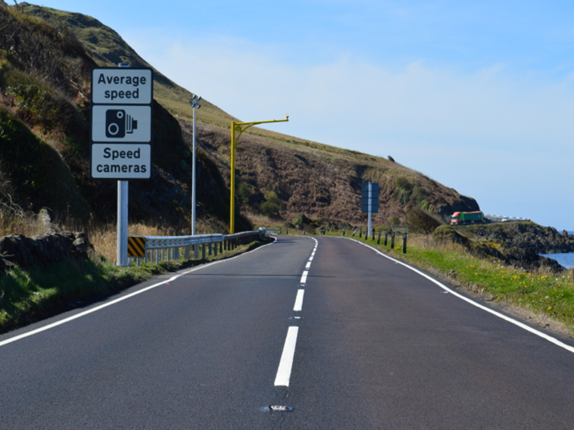
SCOTTISH SAFETY CAMERA PROGRAMME
Steven Feeney
Head of Programme

Slide 3
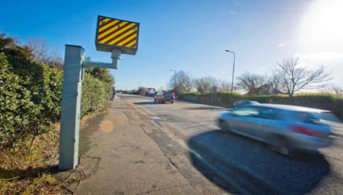
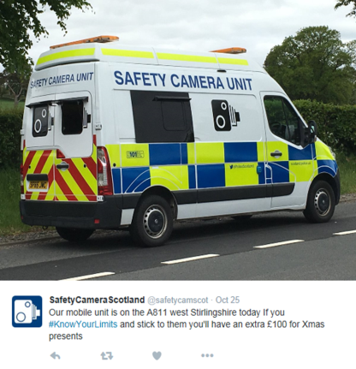
Safety cameras aim to encourage improved driver behaviour

Slide 4
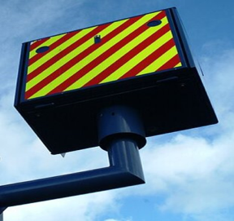
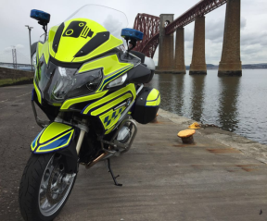
Programme Team
Manage Programme and performance on behalf of Scottish Ministers
Financial management - £4.4m Programme Grant
Ownership of, and ensure adherence to, Safety Camera Programme Handbook

Slide 5
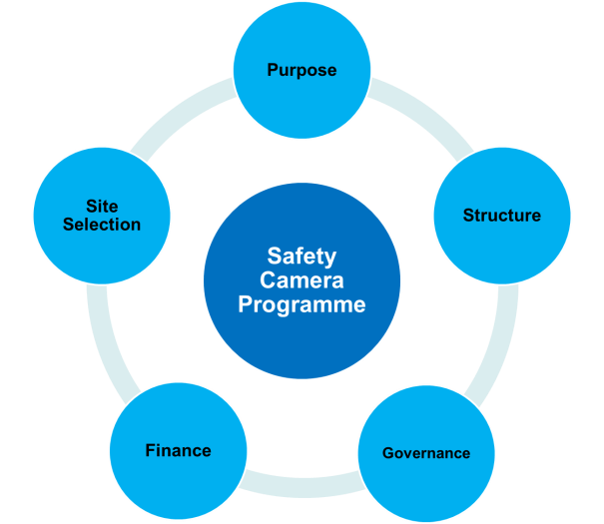
Programme Review

Slide 6
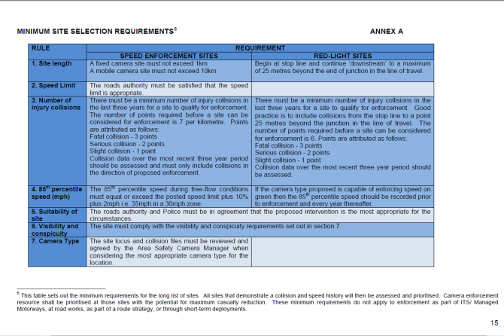
Site Selection - Criteria
  Evidence Collision and speeding profile
  Collaborate Seek input from Road Authorities and Police
  Prioritise Sites with greatest potential to reduce injury collisions

Slide 7
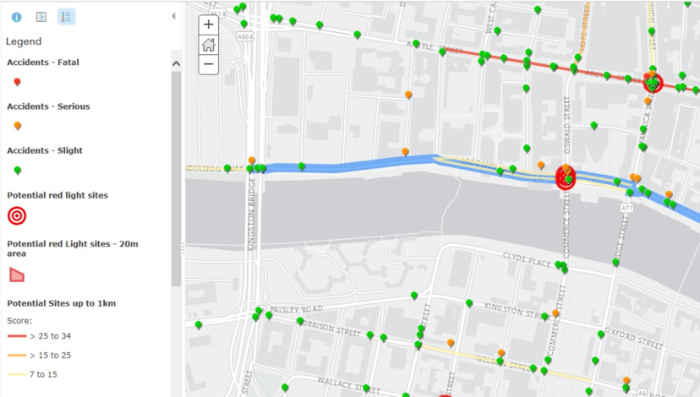
Collision Mapping Tool

Slide 8

COLLABORATION
Partnership working
Local governance and scrutiny
Satisfaction survey

Slide 9
Site Templates

Slide 10
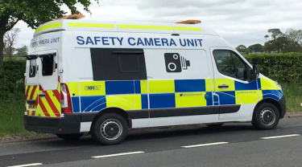

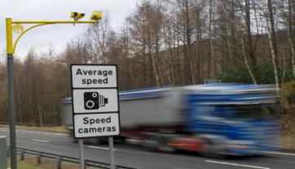
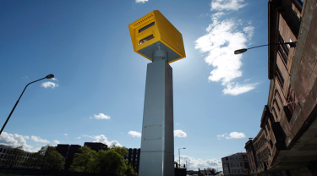
Current Enforcement Technologies

Slide 11
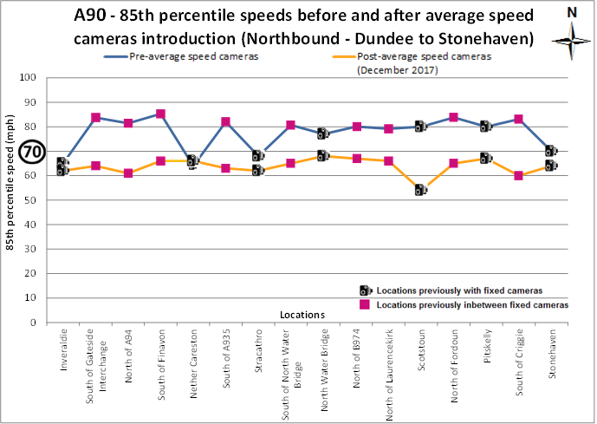
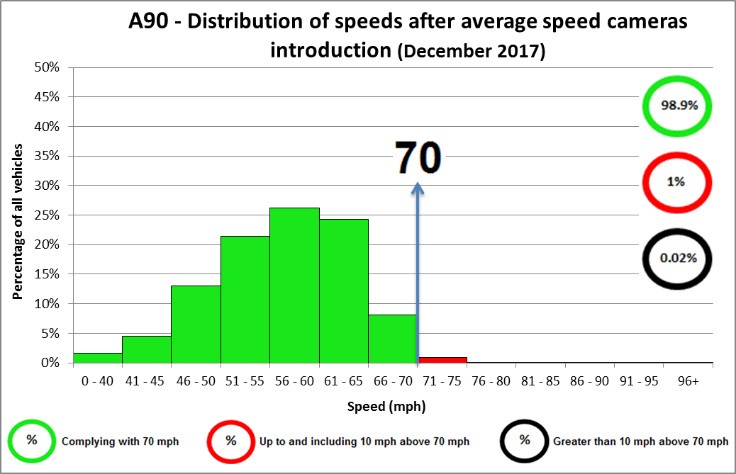
Average Speed Cameras
Impact (1)
Table 1
Table 2
More Information: www.A90Road.Info

Slide 12
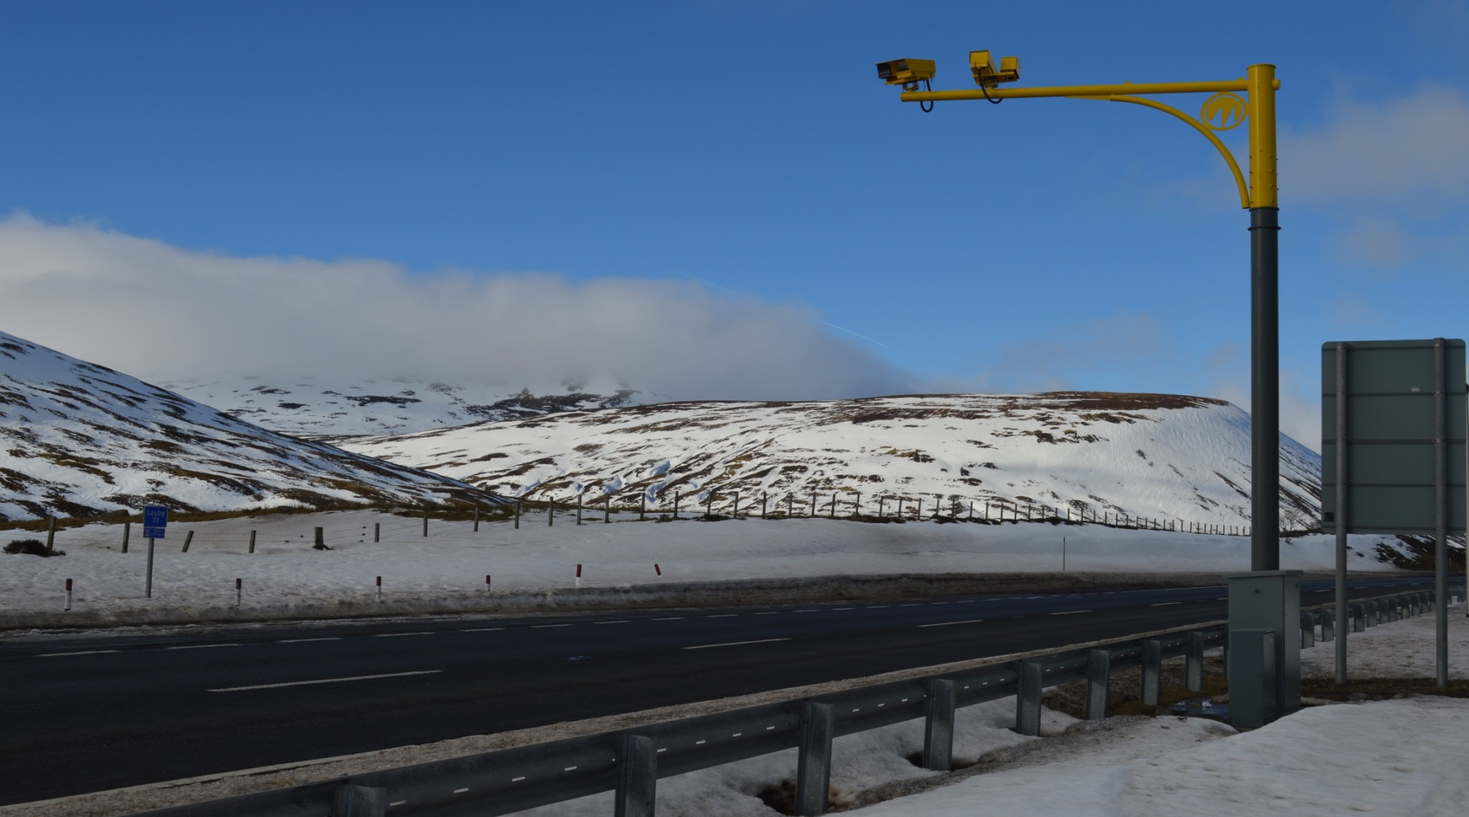
Average Speed Cameras
Impact (2)
A9 ASCs
October 2014 – Cameras installed
April 2018 - 3 years performance published
Substantial Safety Improvements
  10 fewer deaths
  16 fewer people seriously injured
  96 fewer slight injuries

Slide 13


Slide 14
Summary
Purpose of Programme
Process
Technology

