Slide 1
NRA HD 16
Inspections of Temporary Safety Measures
Alastair de Beer, Chartered Engineer, MIEI
NRA Project Manager (Safety)
April 2012

Slide 2
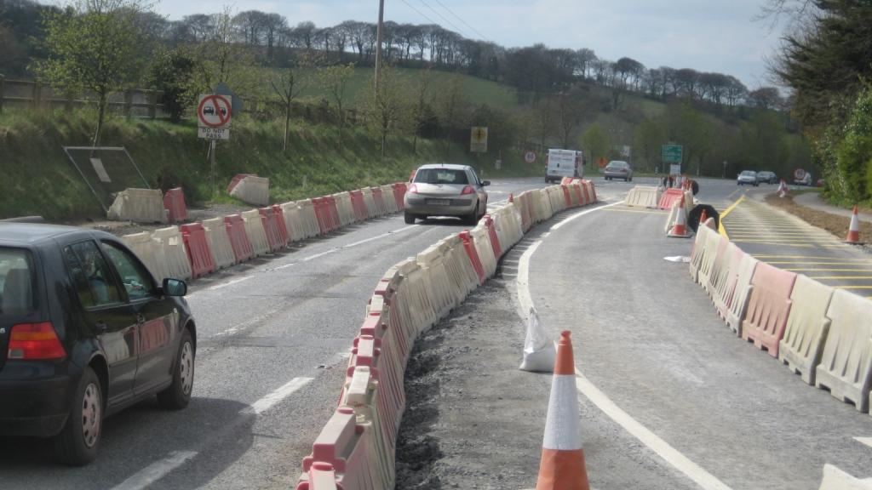
Inspections of Temporary Safety Measures
NRA HA 20 during consultation
Now NRA HD 16
What is NRA HD 16?
Why NRA HD 16?
Why Inspect?
Who does the Inspections?
Role of the Local Authority?
Role of the Utility Companies?
Role of the NRA?

Slide 3
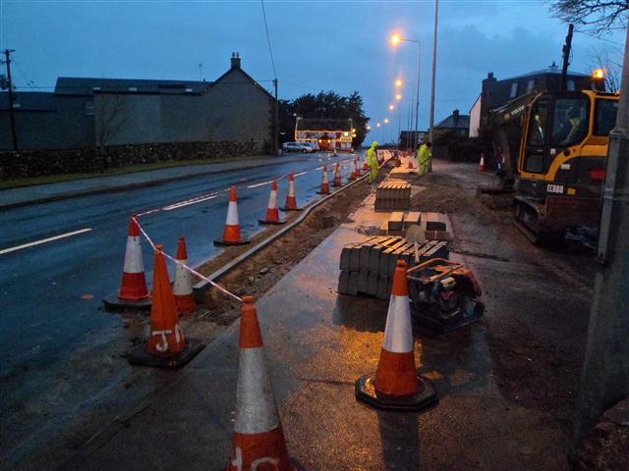
What is NRA HD 16
Temporary Safety Measures Inspections
In other words - Traffic Management Inspections by the Road Authority
Deals with Safety at Road Works for primarily road users and also road workers.

Slide 4
Why NRA HD 16?
Requirements in EU Road Infrastructure Safety Management Directive 2008/96/EC (S.I. No. 472/2011) that an inspection regime be established to ensure that the Guidelines are being implemented by Member States.
This Directive applies to roads which are part of the trans-European road network (TERN). However, the Authority will also apply the requirements of the Directive across all national roads.
Temporary Safety Measures Inspections are therefore required on all National Roads

Slide 5
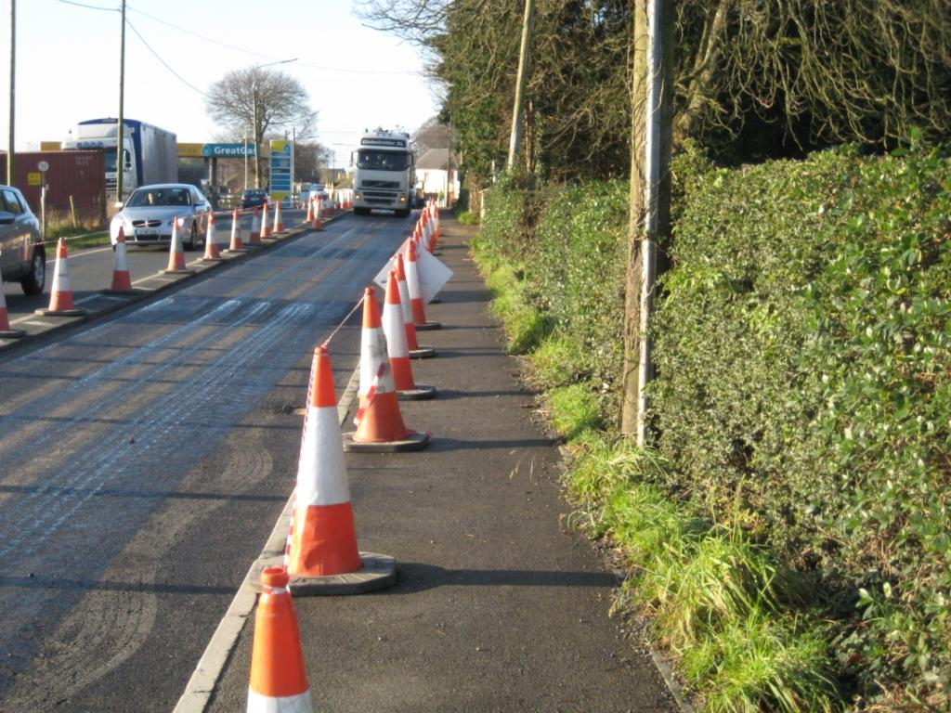
Why Inspect?
Compliance with Chapter 8 of the Traffic Signs Manual, and,
Guidance For The Control And Management Of Traffic At Road Works
(aka the Ashbourne document)

Slide 6
Who does the Inspections?
Temporary Safety Measures Inspections shall be undertaken by the relevant road authority as follows:
‘National Roads Authority will undertake inspection of Temporary Safety Measures on projects procured by the National Roads Authority.’

Slide 7
Who does the Inspections?
Temporary Safety Measures Inspections shall be undertaken by the relevant road authority as follows:
‘Local authority will undertake inspection of Temporary Safety Measures on projects sanctioned and/or procured by the local authority.’
.

Slide 8
Who does the Inspections?
Temporary Safety Measures Inspections shall be undertaken by the relevant road authority as follows:
‘Statutory undertaker/road operator will undertake inspection of Temporary Safety Measures on projects under their management.’

Slide 9
Role of the Local Authority?
Accordingly, it is responsibility of the local authority concerned to ensure that periodic inspections of temporary safety measures at roadwork sites are carried out on all projects sanctioned and/or procured by them, to confirm that the Guidelines are being implemented.

Slide 10
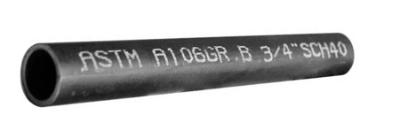
Role of the Local Authority
and Utility Companies?
Local authorities should also advise any person or body undertaking roadworks on their roads (eg. Road Opening Licensee), that this Directive is now in place
Utilities to inspect their own sites in accordance with the Guidelines,
The local authority is also required to inspect the works periodically to ensure that the requirements of the Guidelines are being implemented.

Slide 11
Role of the NRA?
The National Roads Authority will carry out random inspections of local authority and statutory undertaker’s Temporary Safety Measures inspection systems to verify that inspections are being carried out in accordance with these Guidelines.

Slide 12
How to Notify the NRA?
Details of all roadworks on national roads, by any person and/or body sanctioned by the local authority should, accordingly, be notified to the NRA prior to commencement of the works.
Pro-forma web-based document for this purpose.

Slide 13
Pro-Forma Notification
form to contain:
ROADWORKS LOCATION COORDINATES:
ROUTE NUMBER
ROAD AUTHORITY
CONSTRUCTION START AND ESTIMATED END DATE
CONTRACTOR (incl TM Designer)
PSCS
PSDP
CONTACT DETAILS

Slide 14
Frequency of Inspections
Duration of Road Works | % of sites to be inspected per annum | Frequency of Inspection
Exceeding 1 year in duration | 100% of sites to be inspected | Quarterly
1 week to 1 year in duration | 30% to 40% of sites to be inspected | Quarterly
Greater than 1 day, less than 1 week | 10% to 20% of sites to be inspected | Single Inspection
1 day in duration | Random | Single Inspection

Slide 15
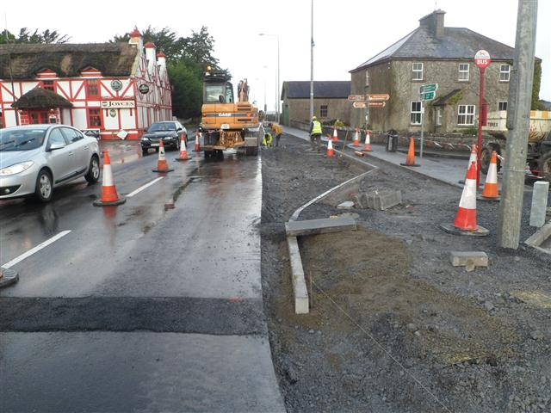
Email: adebeer@nra.ie
Tel: 01-6658842
Comments and Queries

