Slide 1
Road Safety Impact Assessment
KERRY COUNTY COUNCIL
KERRY NATIONAL ROAD DESIGN OFFICE
The Island Centre,
Castleisland,
Co. Kerry.
NRA RSA
17-04-2012

Slide 2
Road Safety Impact Assessment
Road Safety Impact Assessment
Case Study – N69 Listowel Bypass
Ms Tracy Smith BE C. Eng MIEI
Kerry NRDO
NRA RSA
17-04-2012

Slide 3
Road Safety Impact Assessment
Presentation Overview
Legislative Requirements
NRA Guidelines
Case Study – N69 Listowel Bypass
NRA RSA
17-04-2012

Slide 4
Road Safety Impact Assessment
Legislation & Guidelines
EU Directive 2008/96/EC Road Safety Infrastructure Management - Applies to Trans European Network
Irish Law - European Communities (Road Safety Infrastructure Management) Regulations 2011
NRA Circular No. 13/2011 of October 2011 - Authority will also apply the requirements of the Directive across all national roads
Project Management Guidelines 2010
Draft Standard - HD 18/12 (Part of HD 14/12)
NRA RSA
17-04-2012

Slide 5
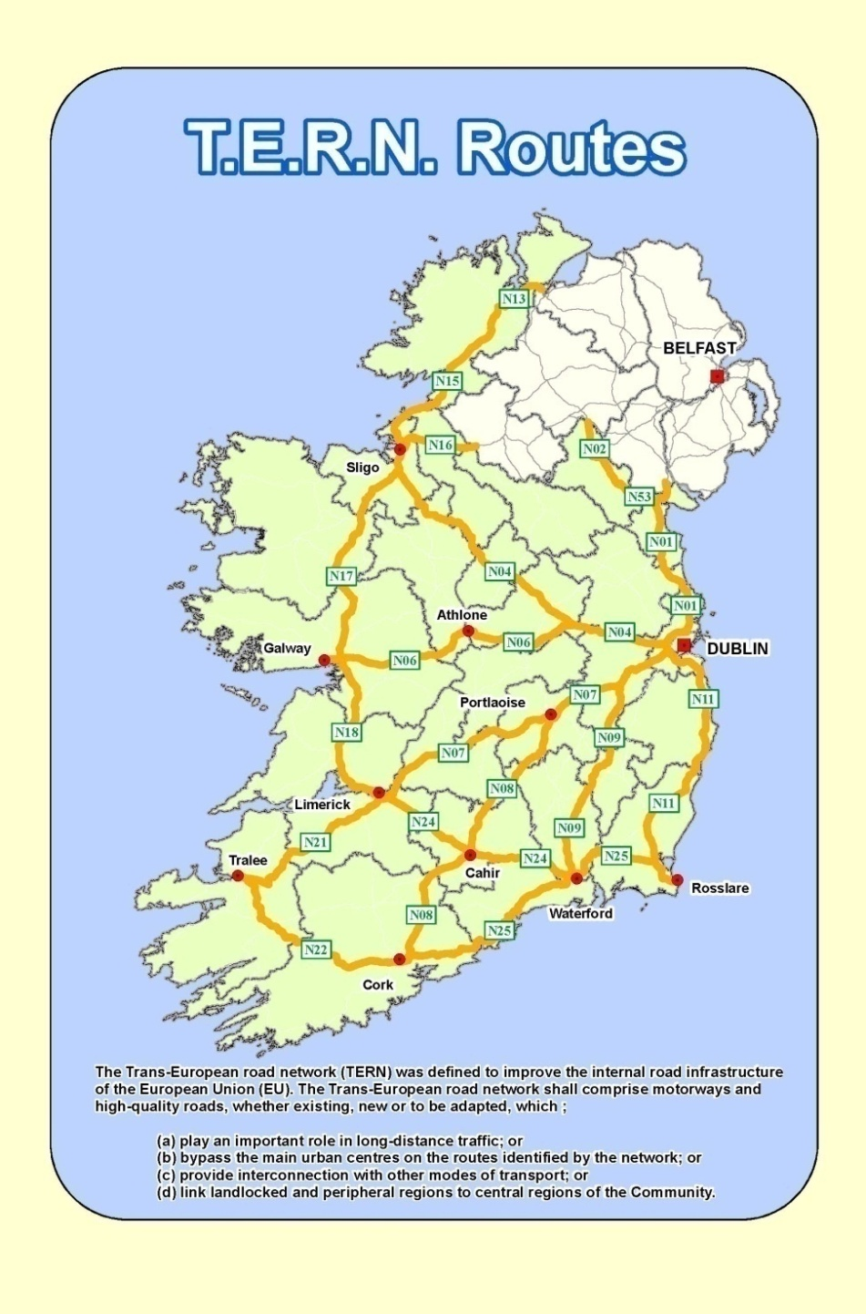
Road Safety Impact Assessment
Legislation
Road Safety Impact Assessment (RSIA) - a strategic comparative analysis of the impact of a new road or a substantial modification to the existing road network on the safety performance of the road network;
Trans-European Road Network” (TERN) - the road network identified in section 2 of Annex 1 to Decision No. 661/2010/EU of the European Parliament and of the Council of 7 July 2010² .
NRA RSA
17-04-2012

Slide 6
European Communities (Road Safety Infrastructure Management) Regulations 2011
Road Safety Impact Assessments
4. (1) Any person or body undertaking an infrastructure project shall ensure that a road safety impact assessment is carried out for that project, in accordance with guidelines issued by the Authority.
(2) The road safety impact assessment shall be carried out at the initial planning stage of the infrastructure project, before—
submitting a scheme to An Bord Pleanála, or submitting an application for consent for the infrastructure project under the Planning & Dev Act 2000
Road Safety Impact Assessment
NRA RSA
17-04-2012

Slide 7
European Communities (Road Safety Infrastructure Management) Regulations 2011
Road Safety Impact Assessments
(3) Any road safety impact assessment being carried out shall—
(a) indicate the road safety considerations which contribute to the choice of the proposed solution, and
(b) provide all relevant information necessary for a cost-benefit analysis of the different options assessed.
(4) In issuing guidelines referred to in paragraph (1), the Authority shall endeavor to meet the criteria set out in Annex 1 to the Directive.
Road Safety Impact Assessment
NRA RSA
17-04-2012

Slide 8
EU Directive Road Safety Infrastructure Management
ANNEX I - ROAD SAFETY IMPACT ASSESSMENT FOR INFRASTRUCTURE PROJECTS
1. Elements of a road safety impact assessment:
(a) problem definition;
(b) current situation and "do nothing" scenario;
(c) road safety objectives;
(d) analysis of impacts on road safety of the proposed alternatives;
(e) comparison of the alternatives, including cost-benefit analysis;
(f) presentation of the range of possible solutions.
2. Elements to be taken into account:
(a) fatalities and accidents, reduction targets against "do nothing" scenario;
(b) route choice and traffic patterns;
(c) possible effects on the existing networks (e.g. exits, intersections, level crossings);
(d) road users, including vulnerable users (e.g. pedestrians, cyclists, motorcyclists);
(e) traffic (e.g. traffic volume, traffic categorisation by type);
(f) seasonal and climatic conditions;
(g) presence of a sufficient number of safe parking areas;
(h) seismic activity.
Road Safety Impact Assessment
NRA RSA
17-04-2012

Slide 9
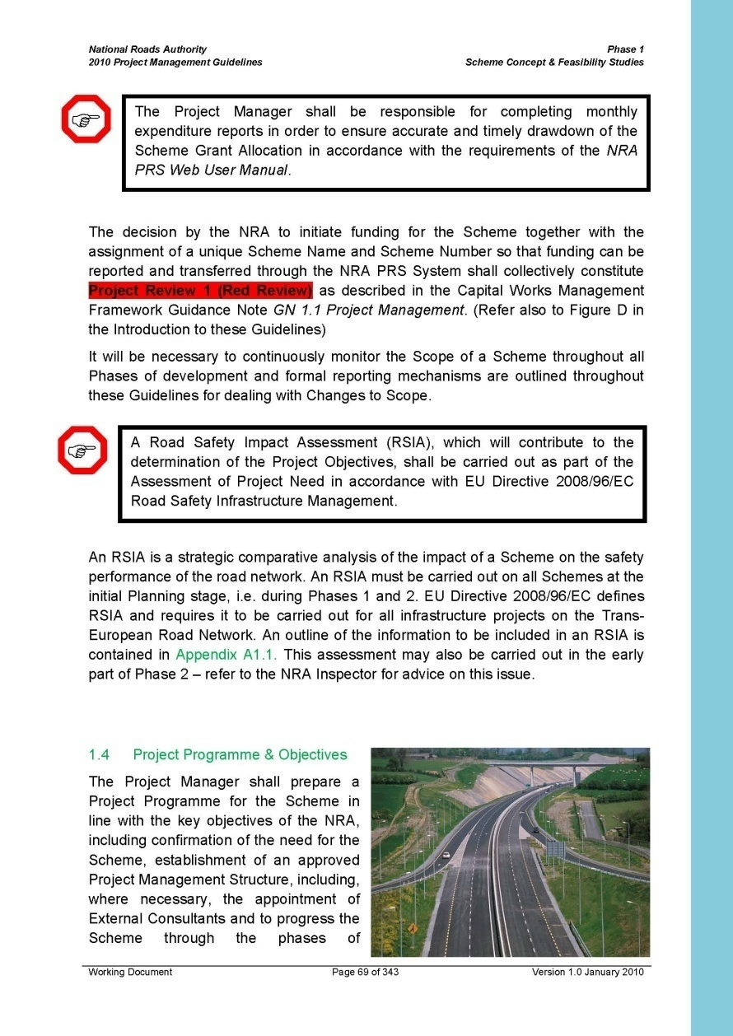
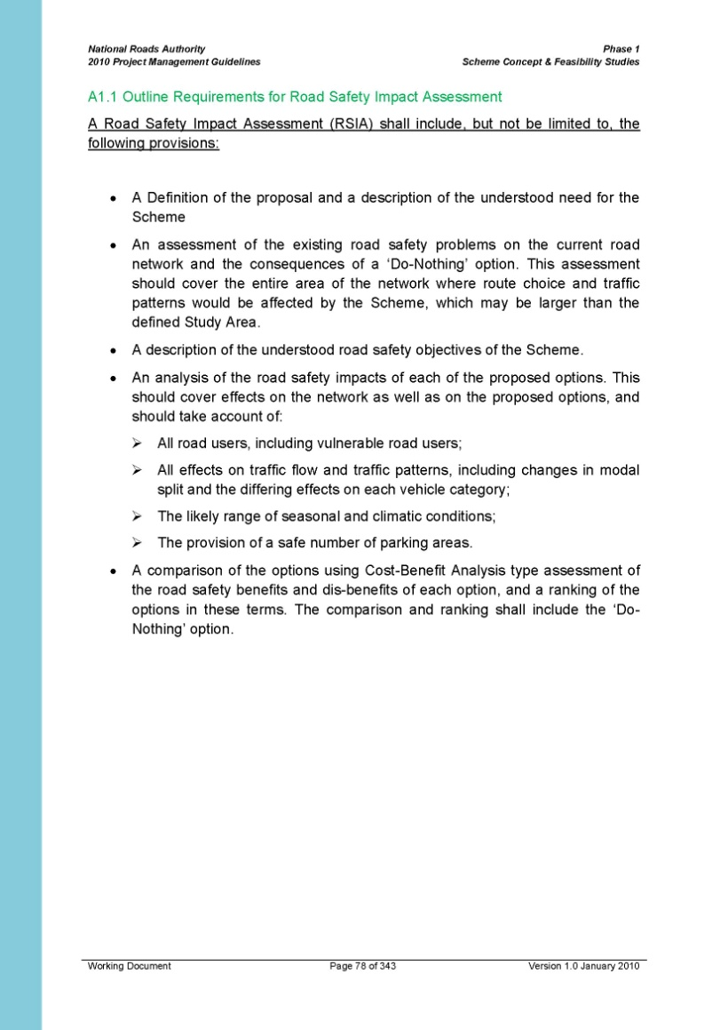
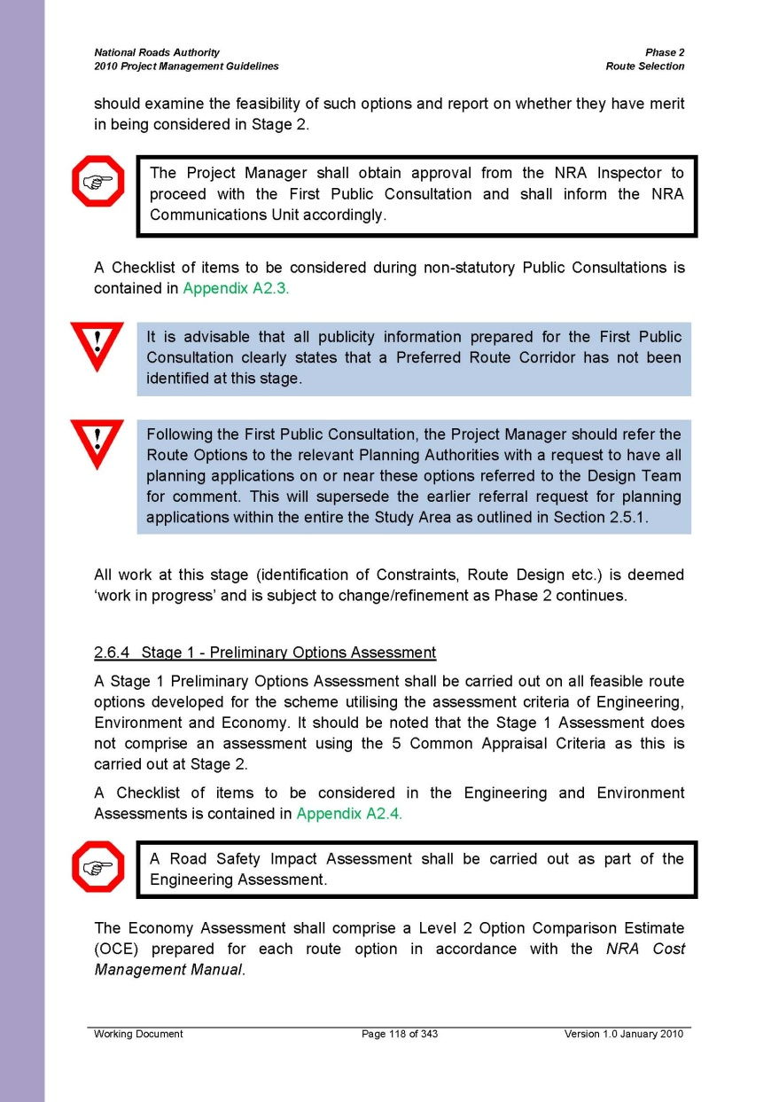
Road Safety Impact Assessment
Project Management Guidelines
NRA RSA
17-04-2012

Slide 10
HD 14/12 Road Safety Management Procedures for National Roads in Ireland
Appendix F – HD18/12 Road Safety Impact Assessment
Complies with requirements of EU & Irish Law
Defines RSIA as per EU & Irish Law
Carried out at the initial planning stage of a project and shall be continually reviewed through the design phases until scheme approval.
Assess impact of the scheme on all road users including vulnerable road users.
Provide all relevant information necessary for the selection of the solution, including :
a comparative analysis of the road safety implications of each alternative considered and
an evaluation of the road safety benefits and disbenefits arising from each alternative
Road Safety Impact Assessment
NRA RSA
17-04-2012

Slide 11
Road Safety Impact Assessment
HD 14/12 Road Safety Management Procedures for National Roads in Ireland
Road Safety Impact Assessment Team appointed from within the Design Team.
Current NRA training and experience requirements for Road Safety Impact Assessment Teams will be downloadable on NRA website. www.nra.ie/Publications/RoadSafety
RSIA Team produce a written report, which shall cover all road safety impact assessments done throughout the planning and design stages of the project. This report shall be forwarded directly to the Design Project Manager who shall copy the report to the NRA Road Safety Section. Used to inform route selection process
NRA RSA
17-04-2012

Slide 12
HD 14/12 Road Safety Management Procedures for National Roads in Ireland
Section 3.8 outlines items to be included in the RSIA Report
• Problem definition, defining the objectives of the scheme
• Road Safety Objectives of the proposed scheme,
• The date and weather at the time of the site visit & Team members;
• Extents of the entire area of the road network where route choice and traffic patterns would be affected by the proposed scheme;
• Existing road safety problems on the current road network within the defined extents;
• Analysis of the collision history for at least five years;
• Road safety consequences of a ‘Do Minimum’ scenario;
• Description of each alternative proposal;
• Assessment of impacts on road safety of the proposed alternatives;
• Comparison of alternatives, including cost benefit type analysis from a safety perspective;
• The NRA strategy for provision of safe rest stops should be consulted;
• Ranking of route options.
Road Safety Impact Assessment
NRA RSA
17-04-2012

Slide 13
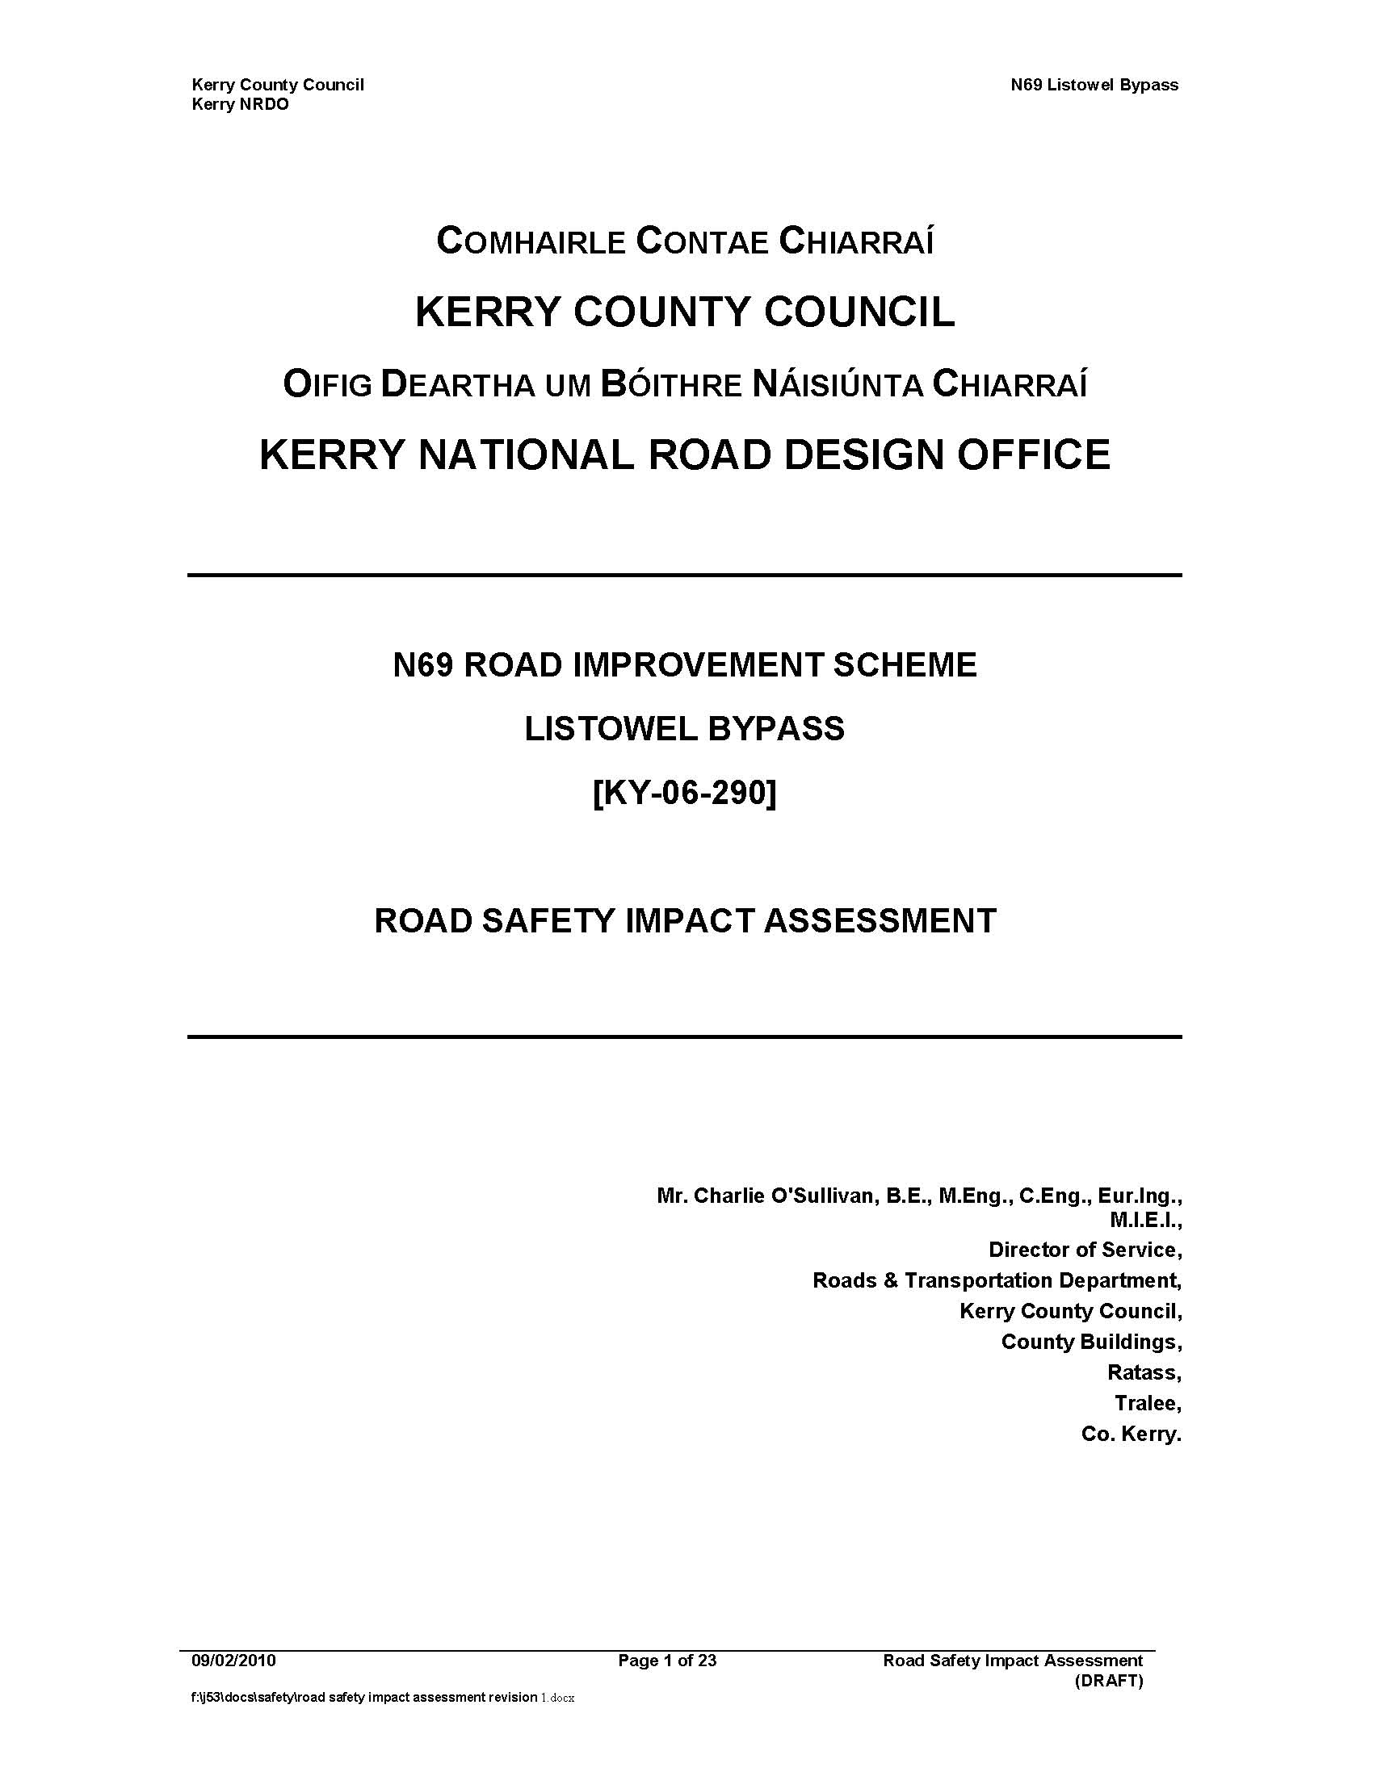
Road Safety Impact Assessment
Sample Report
Listowel Bypass
February - 2010
PMG Guidelines
NRA RSA
17-04-2012

Slide 14
Structure of Report
Need for the scheme
Existing Road safety issues
Road Safety Objectives of Proposed Scheme
Description of proposals
Road Safety Assessment of each route option, including effects on existing network
Option Comparison – Quantitative Assessment
Conclusion
Road Safety Impact Assessment
NRA RSA
17-04-2012

Slide 15
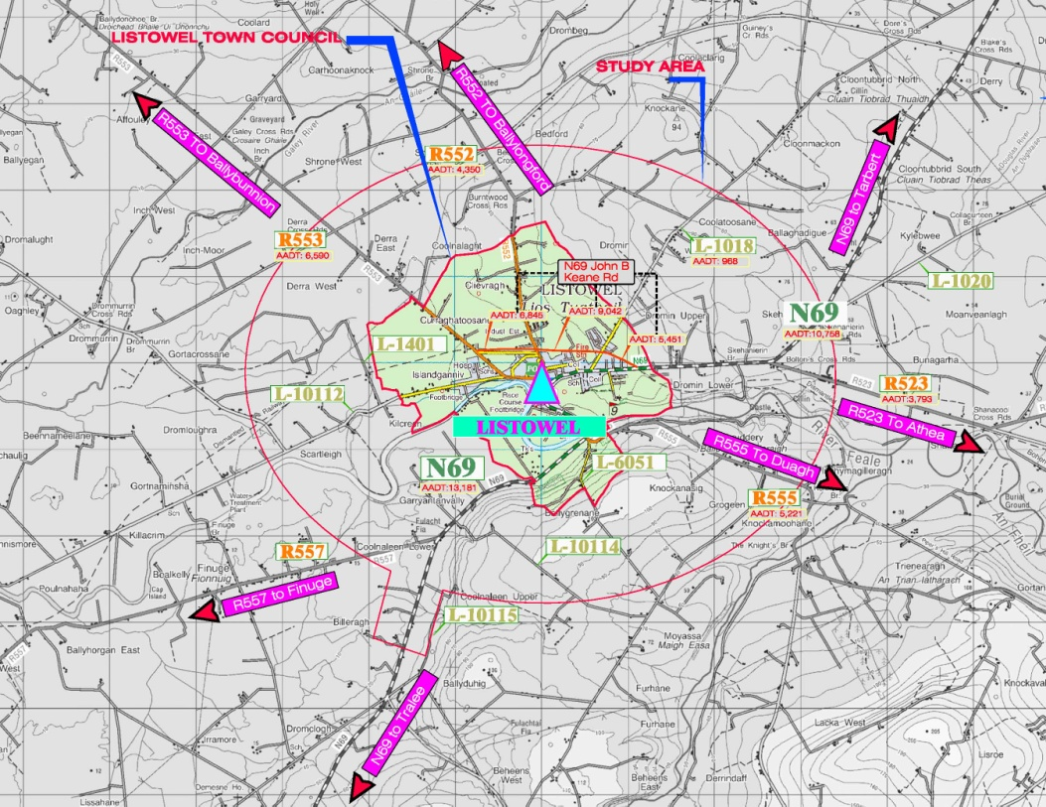
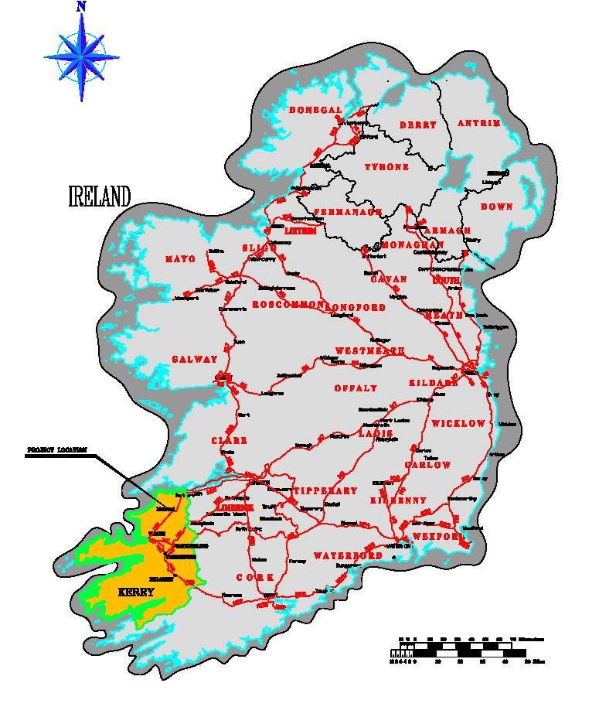
Road Safety Impact Assessment
Study Area
NRA RSA
17-04-2012

Slide 16
Need for the scheme
Established in Feasibility Report as follows: -
a) Local and National policy documents – NDP, T21, NSS
b) Traffic Counts - AADT on the N69 increased by over 25% since 2003.
c) Census records 2002 – 2006 - Population in Listowel Urban Area increased by 7.9% and in Listowel Rural Area by 10.2%.
d) Journey Time Assessment - Average speed is 39.2km/h
e) Origin-Destination Survey - Bypass would benefit 47% of N69 traffic
f) Safety Review - Serious deficiencies in the existing N69 infrastructure
The provision of a bypass would address all of these issues.
Road Safety Impact Assessment
NRA RSA
17-04-2012

Slide 17
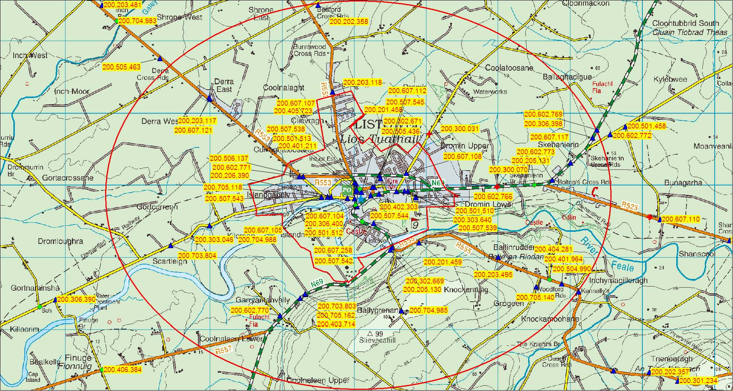
Existing Road Safety Issues
Accident Records
Road Safety Impact Assessment
55 WITHIN STUDY AREA
26 WITHIN URBAN AREA
1/3 involving pedestrians
2 FATALITIES
N69 WITHIN STUDY AREA
32 Accidents
RURAL AREA - CLUSTERS
NRA RSA
17-04-2012

Slide 18
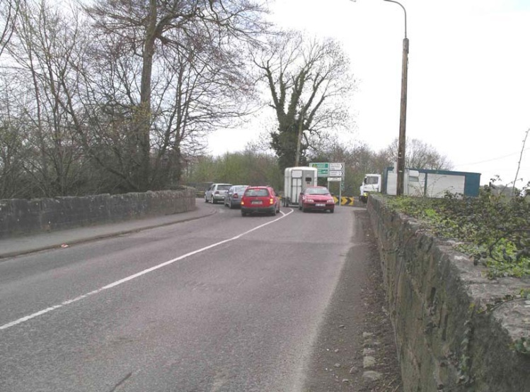
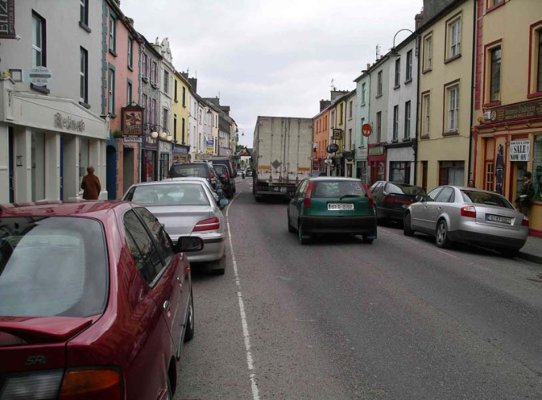
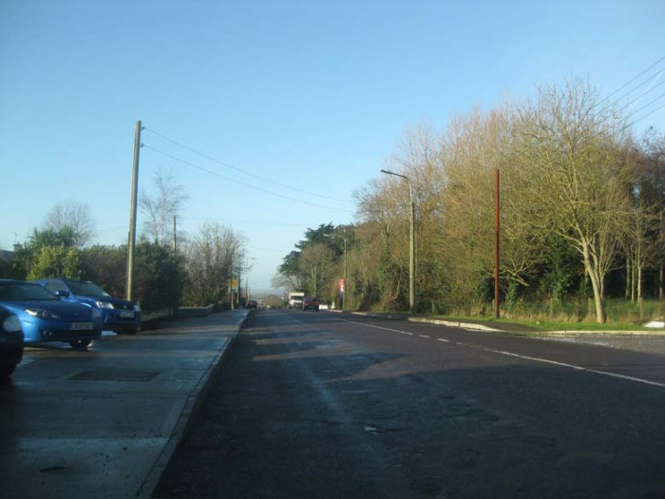
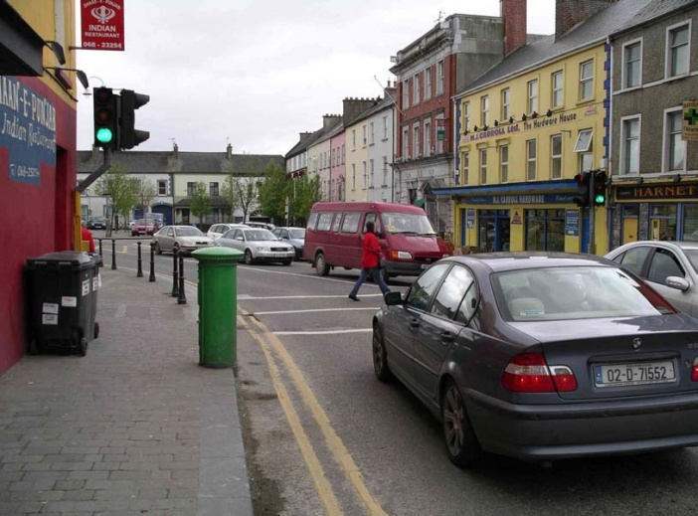
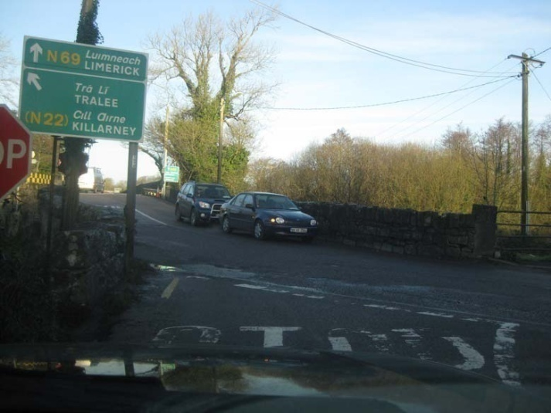
Existing Road Safety Issues
Road Safety Review N69
Poor & misleading junction layout
Pedestrian activity in town centre
Parking and congestion
Road Safety Review Listowel Town
Poor junction layout on N69
Safety review of John B Keane Road
N69 east of Listowel – excessive width
Road Safety Impact Assessment
NRA RSA
17-04-2012

Slide 19
Road Safety Impact Assessment
Existing Road Safety Issues
Do Nothing Option
Increasing congestion
Existing sub-standard junctions remain
Existing accident pattern will continue.
Accident frequency and severity likely to increase
NRA RSA
17-04-2012

Slide 20
Road Safety Objectives
The Road Safety Objectives of the proposed scheme are to:
• Standardised layout – no unexpected or substandard layouts
• Reduce number of direct accesses on the route, particularly in rural area.
• Reduce town centre traffic to provide a safer environment for all users (incl. Vulnerable Road Users)
Road Safety Impact Assessment
NRA RSA
17-04-2012

Slide 21
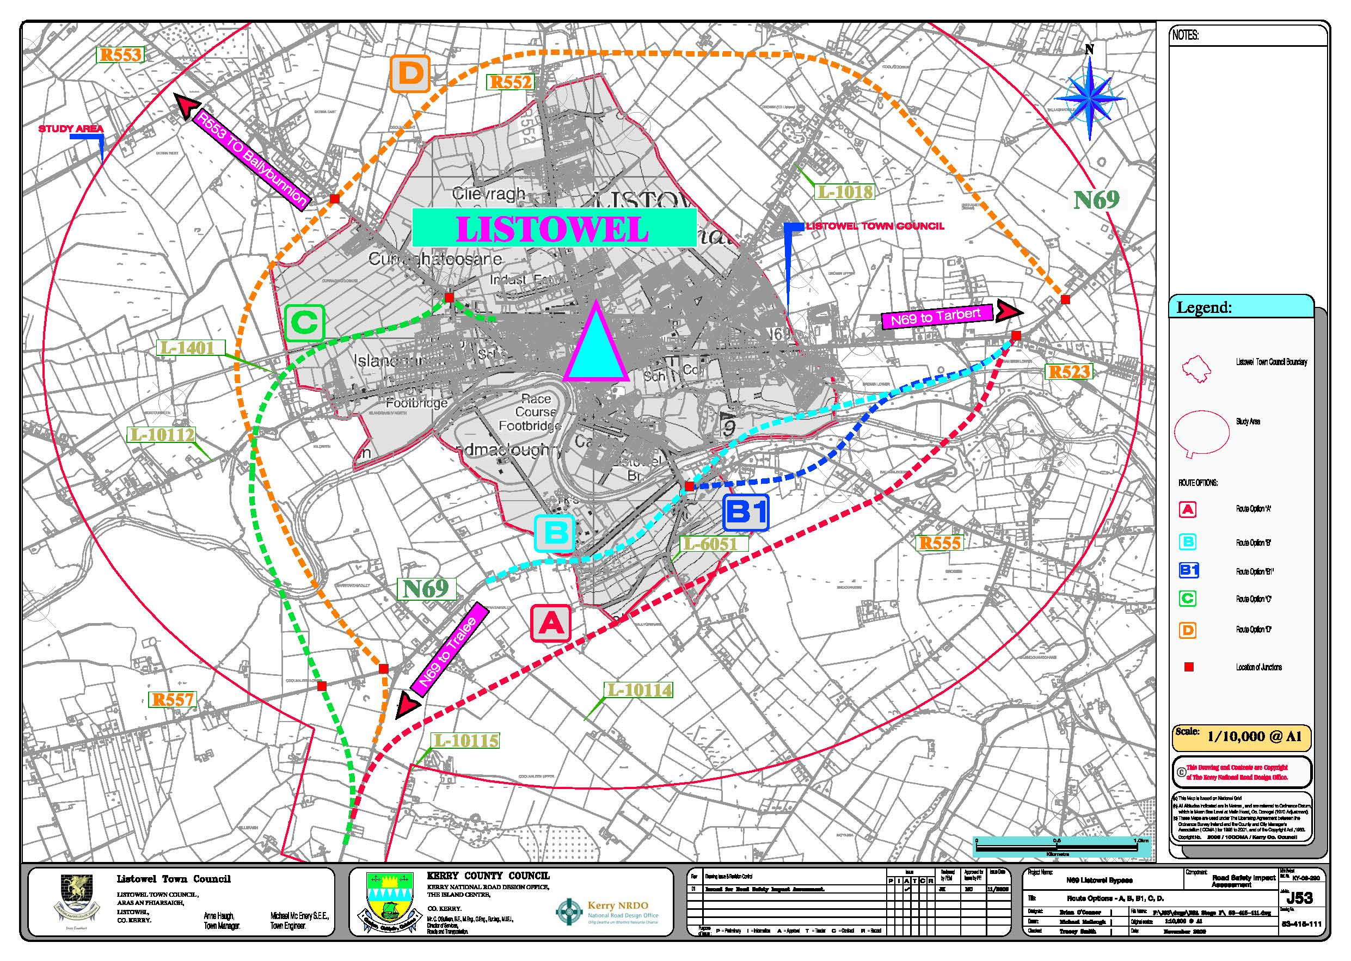
Road Safety Impact Assessment
Description of proposals
NRA RSA
17-04-2012

Slide 22
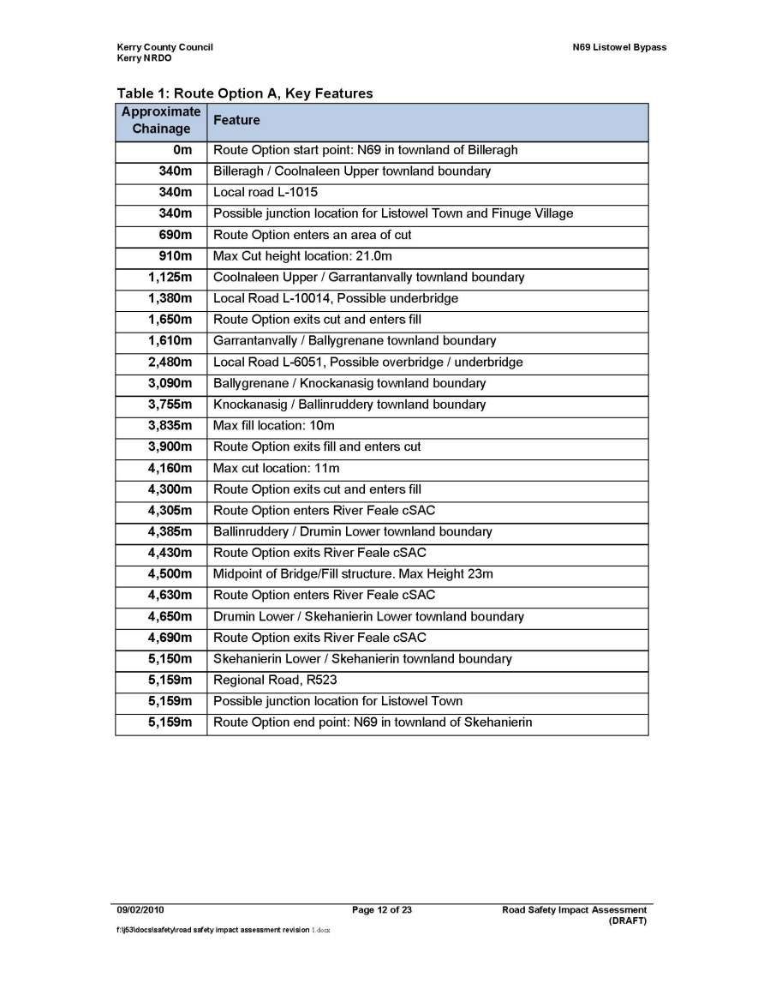
Road Safety Impact Assessment
Description of proposals
Describe main features of each route option
Horizontal & vertical
Junctions – no & layout
Structures
Cut/Fill
NRA RSA
17-04-2012

Slide 23
Road Safety Assessment of each route option, including effects on existing network
Assessment of effects on all road users, including vulnerable road users
Effect on existing accident clusters
Pedestrian facilities
Improved alignment
Improvement/Reduction in number of junctions
Upgrade of John B Keane Road
Tie-in locations
Road Safety Impact Assessment
NRA RSA
17-04-2012

Slide 24
Assessment of effects on traffic flow and traffic patterns
50% of N69 traffic removed from town centre
Increased ease of access for bus transport to town centre
Reduced congestion – improved environment for VRUs
Modal split – no change
Road Safety Impact Assessment
NRA RSA
17-04-2012

Slide 25
Road Safety Impact Assessment
Assessment of the likely range of seasonal and climatic conditions
Increased summer traffic – tourist route
No extreme climatic factors
Assessment of the provision of a sufficient number of safe parking areas
Not required on Bypass – insufficient length
NRA RSA
17-04-2012

Slide 26
6.0 COBA Type Assessment
COBA headings
• Travel time
• Vehicle Operating Cost
• Accidents
Appendix 8 of the NRA Project Appraisal Guidelines 2008
2002-2007 accident records
2006 AADT of 5860 (O_D study)
Possible to compare the route options in terms of accident rate and severity & compare to do-nothing option.
Does not take into account of factors such as alignment, junctions
Road Safety Impact Assessment
NRA RSA
17-04-2012

Slide 27
COBA Type Assessment - Example
Road carriageway type – S2
Table A17: Link and Junction Combined Accident Rates
<60kph = 0.472 PIA/mvkm
>60kph = 0.142 PIA/mvkm
Table A18: Link and Junction Combined Accident Proportions
Modern S2 Road (2 Lane Single Carriageway) Fatal, Serious
<60kph = 0.045, 0.173
>60kph = 0.097, 0.246
Estimated AADT – 5860
Accidents per km in 6 years –
<60kph = 6.13 PIA/km
>60kph = 1.82 PIA/km
Option A – length – 5.9km all >60kph
Estimated accident rate – 10.8 in 6 years (1.1 fatal , 2.7 serious, 7.1 minor)
Road Safety Impact Assessment
NRA RSA
17-04-2012

Slide 28
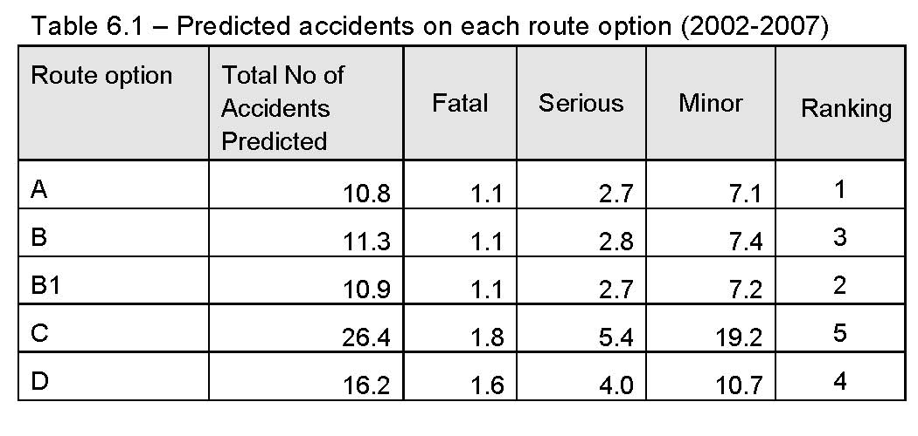
COBA Type Assessment
Road Safety Impact Assessment
Number and severity of accidents on any new route option would be less than on the existing N69. (32 accidents – 1 fatal, 4 serious, 27 minor)
Reduction in traffic volumes in the town centre - positive impact on the accident rate within the town centre.
All options will therefore improve the existing conditions with regard to road safety.
NRA RSA
17-04-2012

Slide 29
Conclusion
Rank the route options in terms of road safety
Consider:
Predicted accident rate & severity
Features of each route option.
Horizontal & vertical alignment
Number & layout of junctions
Traffic flows
Existing accident pattern
Width and gradient changes
Busy cross routes
Vulnerable road users - ped & cycle routes
Proximity of dwellings, schools etc
Road Safety Impact Assessment
NRA RSA
17-04-2012

Slide 30
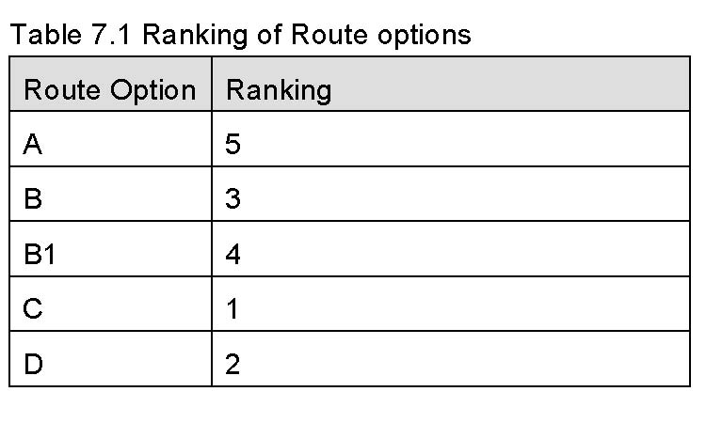
Conclusion
Road Safety Impact Assessment
NRA RSA
17-04-2012

Slide 31
Road Safety Impact Assessment
Issues:
Qualification of team
Subjective – RSIA Team part of Design Team
Quality assessment of RSIA Report
‘Live’ Document
NRA RSA
17-04-2012

Slide 32
Road Safety Impact Assessment
THE END
NRA RSA
17-04-2012

