Slide 1
How big is the Road Crash Problem ?
Dr. Jack Short
Trinity College Dublin
15 May 2018

Slide 2
The measurement issue
Main measure is number of fatalities
But there are also many injuries
( officially, 40 for each fatality)
And many collisions not involving injuries
( officially,5 for each injury collision)
Data on fatalities is pretty reliable but not on injuries or collisions

Slide 3
Injuries Matter
They are numerous
They are costly for society ( social costs are higher than for fatalities )
Trends are different (fatalities have declined faster than injuries in many Countries)
Essential to understanding traffic risks (fatal collisions few and increasingly random)
Appropriate policies may not be the same

Slide 4
Injuries : Data Sources
Police (official data)
Hospitals
Injuries Board
Accident and Emergency units
General Practitioners
Insurance
Ambulance data

Slide 5
Data Obtained
73,000 Police records from 2005-2013
50,000 Hospital records from 2005-2013
70,000 Injury Board records from 2010-2013
2014 police data available only in June 2017
Anonymised datasets but with common variables
age, gender, date, county, mode

Slide 6
Total injuries: injuries board, police, hospitals

Slide 7
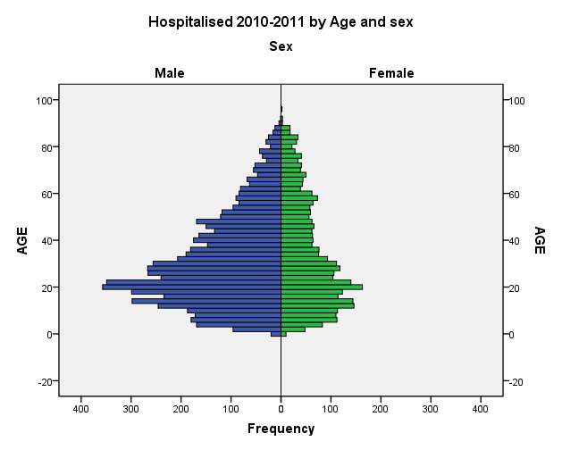
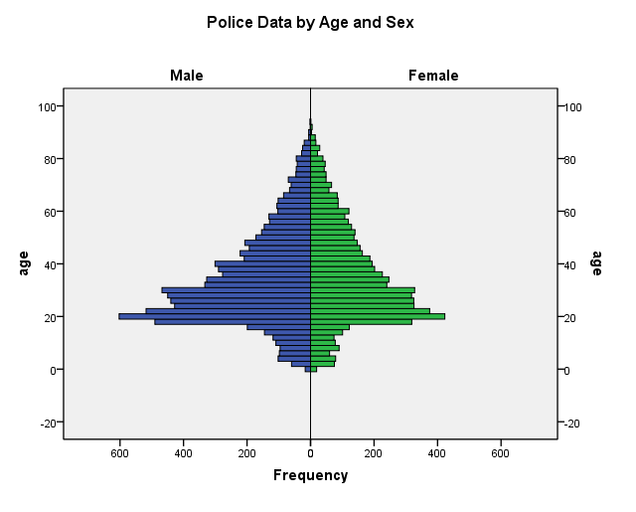
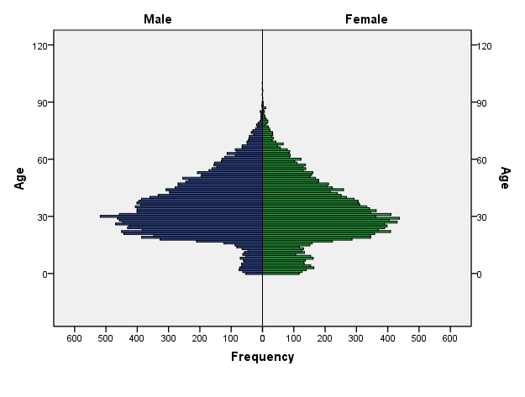
Age and Gender Structure
Hospitals
Police
Injuries Board
Notes:
Note the male dominated hospital data Police data less so and IB about even. For age very prominent peaks at younger ages. Injury risk rates are 4 times higher for young people.
Police data also male dominated but
IB is about 50/50

Slide 8
Serious injuries: police and hospitals

Slide 9
Serious by Mode; Police and Hospitals
 | Serious Injuries |  | Ratio (H/P)
Mode | Hospital (MAIS3+) | Police-reported
Pedestrian | 1,252 | 857 | 1.5
Cyclist | 1,152 | 133 | 8.6
MotorCyclist | 949 | 415 | 2.3
Vehicle Occupant | 4,314 | 3,890 | 1.1
Total | 7,667 | 5,295 | 1.4

Slide 10
How many Injuries annually?
Police 8,000, Hospitals 5,000 and IB 18,000
Therefore between 18,000 and 31,000

Slide 11
Record linkage
Police, Hospital, Injuries Board data linked
Police-Hospitals 2005-2013
Police-Hospital-Injuries Board 2010-2013
5 Variables; age, sex, county, date of incident, mode

Slide 12
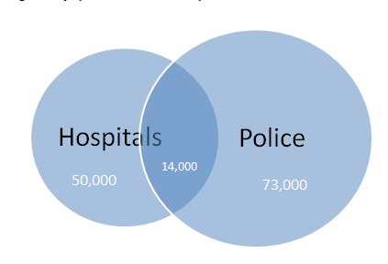
Police and Hospital data 2005-2013
Total
109,000

Slide 13
Police – Hospital Matching
20% of police-reported are matched with a hospital entry.
28% of hospital patients are matched with a police reported injury. Only 9% for cyclists
Over the 9 years about 36,000 hospitalised not recorded by police including over 6,000 with clinically serious injuries (MAIS3+) not recorded by police.

Slide 14
Matching: Severity summary
A police-reported serious injury is as likely to be clinically serious as not
A clinically serious injury is more likely to have been reported by the police as a minor rather than a serious injury
These have changed over time
So Police severity assessment is neither accurate nor consistent
Notes:
These have changed over time means that it is now increasingly likely that a clinically serious injury has been reported by the police as a minor injury.
Now move to matching of the three datasets

Slide 15
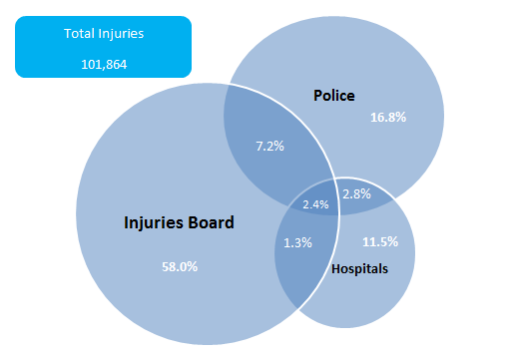
Record linkage of 3 sources 2010-2013

Slide 16
How many injuries in all ?
Police
?
Insurance
Total: 25 000
?
GPs
?
A&E
Hospitals
Injuries Board
20 000 ?

Slide 17
Costs for Society
Social Costs of Injuries underestimated by more than Euros 500 million annually
Injuries cost significantly more for society than fatalities
Costs of Material Damage collisions underestimated maybe by several hundred million
This means that problem is much greater than shown in official figures
Implies that more measures are cost effective than previously thought
Especially measures for vulnerable users

Slide 18
AGS /RSA;2014 and 2013 compared
 | 2013 | 2014 | % Change
Fatalities | 188 | 193 | 3
All Injuries | 6,880 | 8,079 | 17
Material Damage | 22,000 | 35,000 | 54
Serious Injuries | 508 | 755 | 48
Pedestrian | 97 | 180 | 86
Cyclist | 50 | 106 | 112
Motorcyclist | 47 | 87 | 85
Car occupant | 270 | 344 | 27
Other | 44 | 38 | -13.6
Notes:
Notice the very large increase in serious injuries. And the much larger increases for serious injuries among vulnerable users. The hospital or traffic figures show nothing like this. The RSA say that there are “enhancements in the validation process”

Slide 19
Conclusions: Data Issues
Crash Data needs review
- Definitions, processes, delays, availability
- New series needed in addition to police data (using other sources and linkage)
Serious injuries should not be assessed by police;
-alternatives for police need to be examined (like UK check lists)
Targets for serious injuries meaningless at present

Slide 20
Conclusions; economics/policy
Social Costs estimates need to adjust for underreporting
CBA needs to take specific account of injury impacts
Injury undercount figures in appraisal need to be corrected (to 3 for serious injuries)
Injury undercount should be mode specific
Injuries need to be given more attention

Slide 21
Thank you for your attention
Full paper on Statistical Society website
http://www.ssisi.ie/JackShort_Oct12th.pdf
shortj @tcd.ie

