Slide 1
Road Safety Inspection
Dermot Donovan
17th April 2012

Slide 2
Definitions
Road Safety Inspection is an ordinary periodical verification of the characteristics and defects of a road that require maintenance work for reasons of road safety.
  recommendations on remedial measures are not defined to be part of Inspection. The NRA will decide what remedial measures (if any) are to be provided.

Slide 3
RSI in Road Safety Management
Road Safety Inspection
Road Safety Audit
Road Safety Impact Assessment
Network Safety Management
 | New Road | Existing Road | Potential Collisions | Actual Collisions
RSI |  | √ | √
RSA + RSIA | √ |  | √
NSM |  | √ |  | √

Slide 4
Legislation
EU DIRECTIVE 2008/96/EC of 19 November 2008 on road infrastructure safety management
S.I. No. 472/2011, European Communities (Road Infrastructure Safety Management) Regulations 2011
“Once road sections with a high accident concentration have been treated and remedial measures have been taken, safety inspections as a preventive measure should assume a more important role. Regular inspections are an essential tool for preventing possible dangers for all road users, including vulnerable users, ....”

Slide 5
RSI Standards
NRA DMRB
  NRA HD 17 / 12 - Road Safety Inspection (the Standard)
  NRA HA 17 / 12 - Road Safety Inspection Guidelines
NRA Requirements
  Qualification Requirements for Road Safety Inspection Team Members

Slide 6
Inspection Periods
5 years for Motorways, Type 1 and Type 2 dual carriageways;
3 years for other roads;
  Motorways need less frequent inspections than single carriageways because:
They are designed to a high standard.
They are access controlled - no roadside development.
They are controlled in respect of statutory undertakers.
Their layout is not frequently changed.
They have lower collision rates than other roads.

Slide 7
Periodic Assessments – Why?
Road materials deteriorate or become damaged;
Standards for road design and road safety improve;
New products and technology which improve road safety become available;
Road layout changes arise from improvement works, such as road realignment or junction improvement;
Layout changes arise from works consented to in planning, such as additional roadside accesses;
Traffic flows increase, or traffic composition changes, again often arising from development;
Speed limits or other specific regulatory interventions change;

Slide 8
Context
The number of road fatalities per 10,000 licensed vehicles fell from 10 in 1970 to 1 in 2010.
Factors in collision occurrence

Slide 9
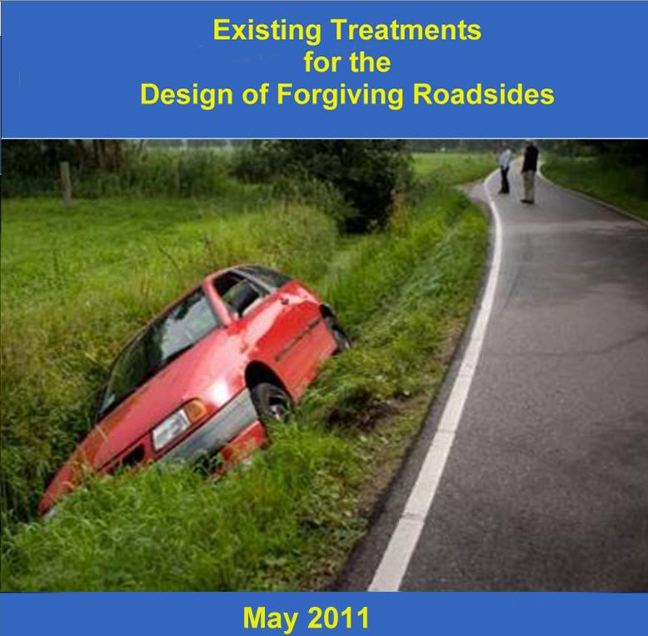
Self-Explaining Roads
Forgiving Roadsides
  A self-explaining road with forgiving roadsides should:
  Assist the driver in making the correct decision.
  Be forgiving of driver error.
  Lessen the consequences if a collision occurs.
CEDR Forgiving Roadsides 2011

Slide 10
Common Problems of Road Features (extract from listing in RSI Guidelines)
Feature | Safety Problem
Roadside
Poles, trees, walls | Collision - potentially high severity
Ditches | Steep slopes – inappropriate shape
Guardrails | Not present where required. Present where not required
Roadway
Overtaking provision - sight distance | Inadequate
Road curvature | Unexpected bends, hidden dips, absence of superelevation
Traffic signs | Not present where required. Too many present – confusing.
Road markings | Inadequate
Road lighting | Darkness is known risk factor
Junctions
Sightlines | Lack of visibility
Junction signage | Poor directional, warning and regulatory signage
Vulnerable Road Users | Poor crossing facilities

Slide 11
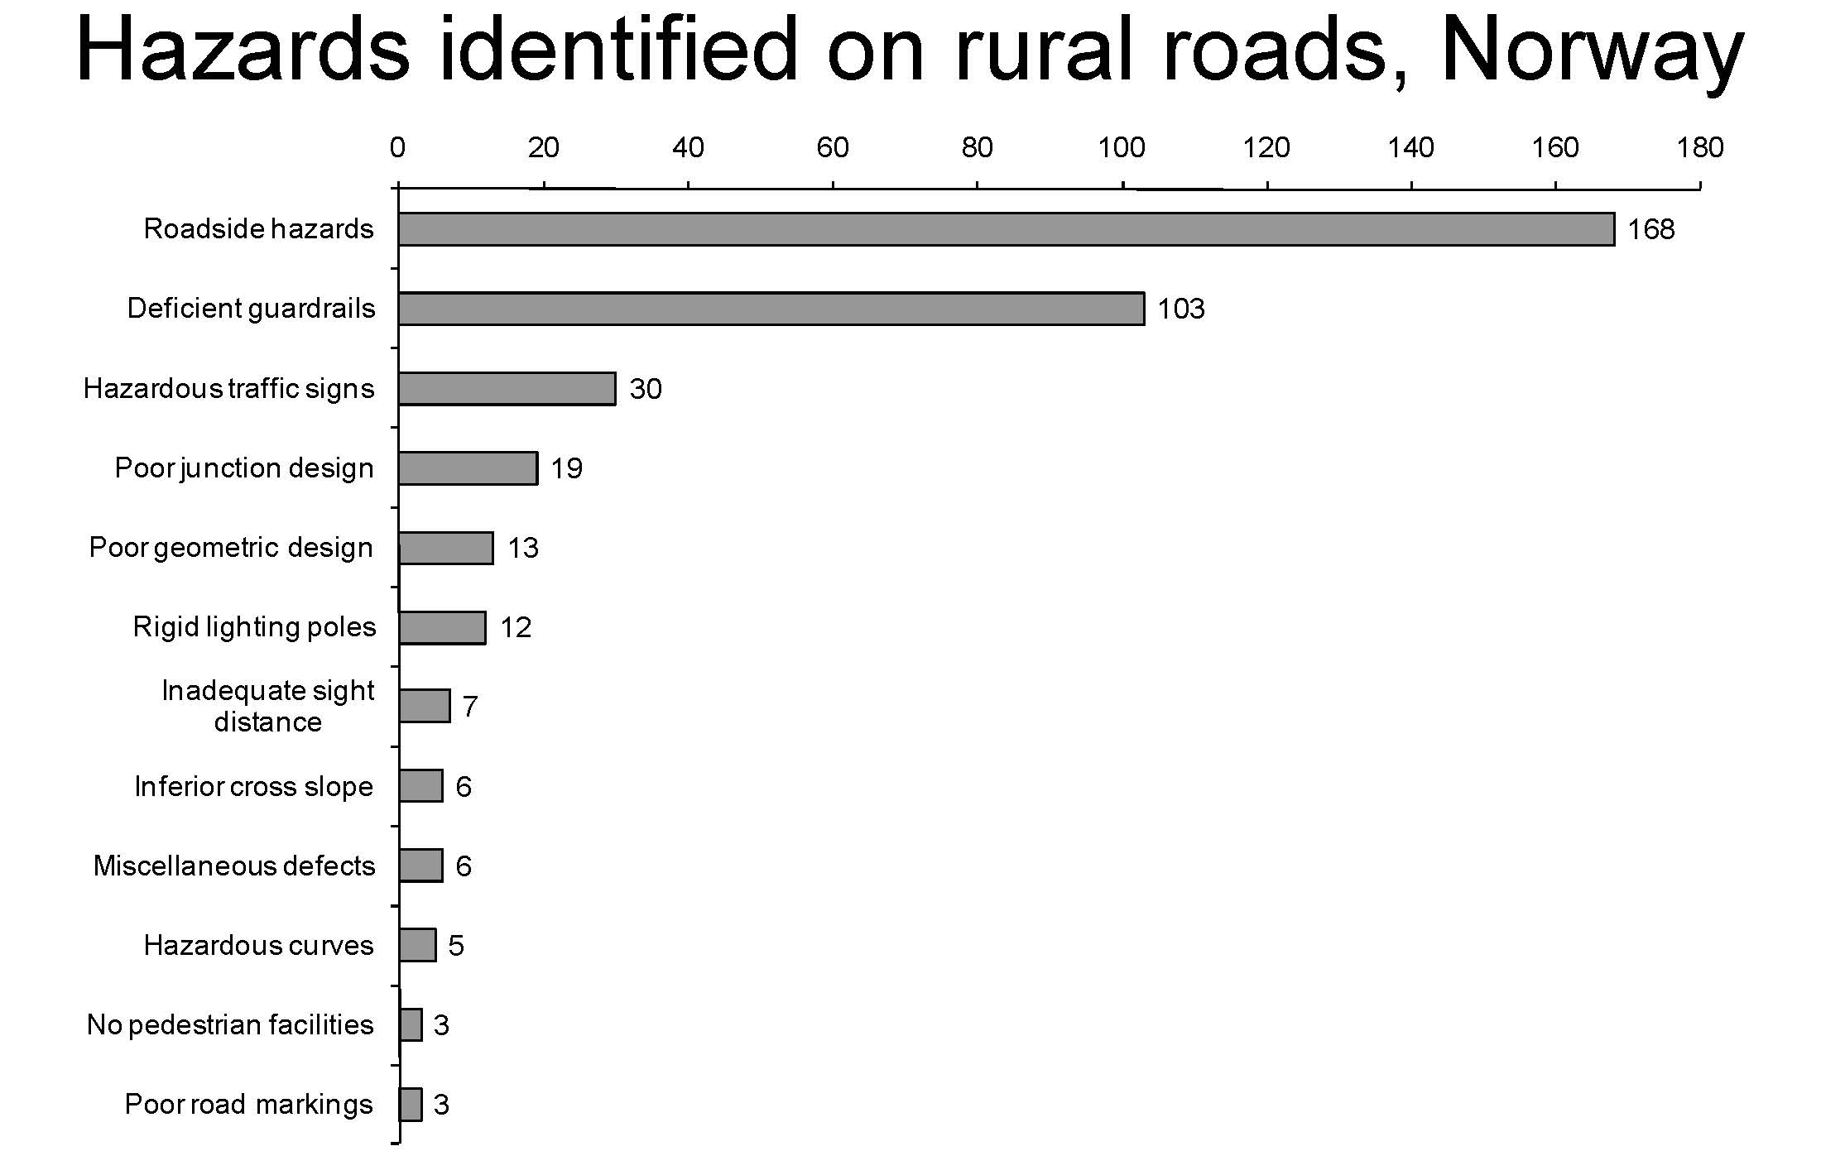

Slide 12
Measures and Effectiveness
(source: findings of Rune Elvik – Norway -2006; Ogden-Australia-1994)
 | % collision reductions
 | Ogden | Elvik
Relocate Roadside Poles | 30-80
Junction – provide turn lane | 15-55
Frangible (Passive) Roadside Poles | 30 | 27-75
Roadside Hazard – Guardrail | 10-30
Embankment – Guardrail |  | 40-50
Lighting | 7-22
Junction – Stagger | 80
Flatten side slopes |  | 5-25
Guardrail end treatment |  | 0-10
Signage of bends | 30 | 0-35

Slide 13
Inspection Team - Qualifications
The Inspection Team is appointed by the Authority and consists of a minimum of two Inspection Team Members, one of whom is also approved as Inspection Team Leader.
All team members shall be independent of the maintenance and operation of the road.
Team Leader | Team Member
Chartered Engineer
5 yrs road design | 3 yrs road design
2 yrs collision investigation and design of remedial
10 RSAs | 5 RSAs
Certificate of Competence in Road Safety Audit (recognised by an EU member state)*
* Accredited course acceptable pre December 2013

Slide 14
Pre-Inspection Desk Study
Mapping info
  towns, villages
  large developments,
  road numbers,
  speed limits,
  speed cameras,
  carriageway type
Collision info
Traffic info
Past inspections
Road speeds, SCRIM etc.
(Timelines are important)
Video Review
identify initial safety concerns (subject to confirmation on site),
plan site visit,
list items of a factual nature to be checked during the site visit,

Slide 15
Site Visit Equipment
  Mapping;
  Speed gun (if available);
  Tape measure and measuring wheel;
  Spirit level;
  Camera with video capability;
A handheld GPS;
Health and Safety important.

Slide 16
Site visit
  Roads should be driven in both directions;
  Each road section should be assessed from the point of view of all road users;
  Day visit and night visit should be undertaken;
  Junctions and other significant features should be inspected on foot, but only where it is safe to do so;
  The existing traffic flow, traffic composition and traffic speed (relative to speed limits) should be noted;
Excessive scrutiny of urban areas should be avoided; these areas are complex relative to rural areas and could take an inordinate portion of the inspection time;
  Photographs should be taken and, if necessary, short video clips;
  In some instances, measurements and sketches should be made to assist in describing the nature and extent of the safety issues identified;

Slide 17
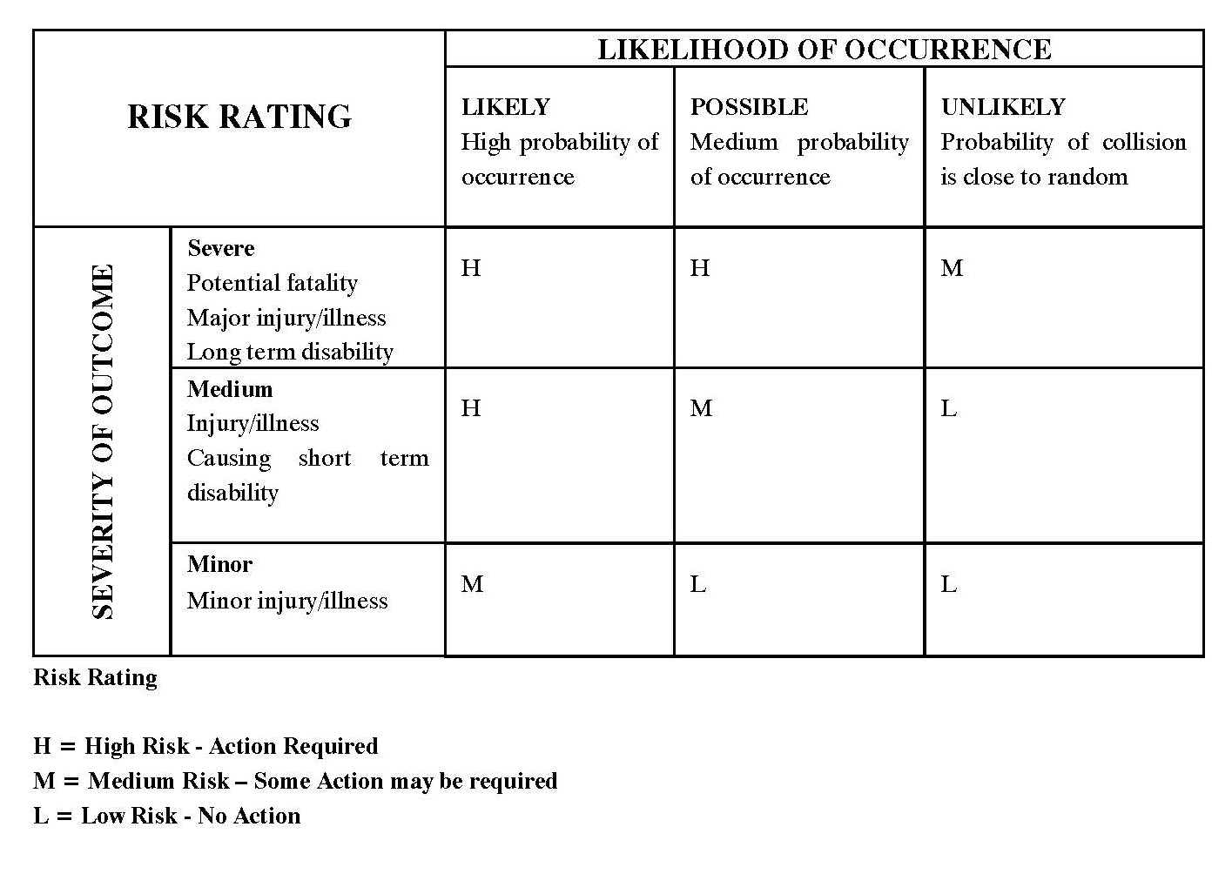
Risk Assessment

Slide 18
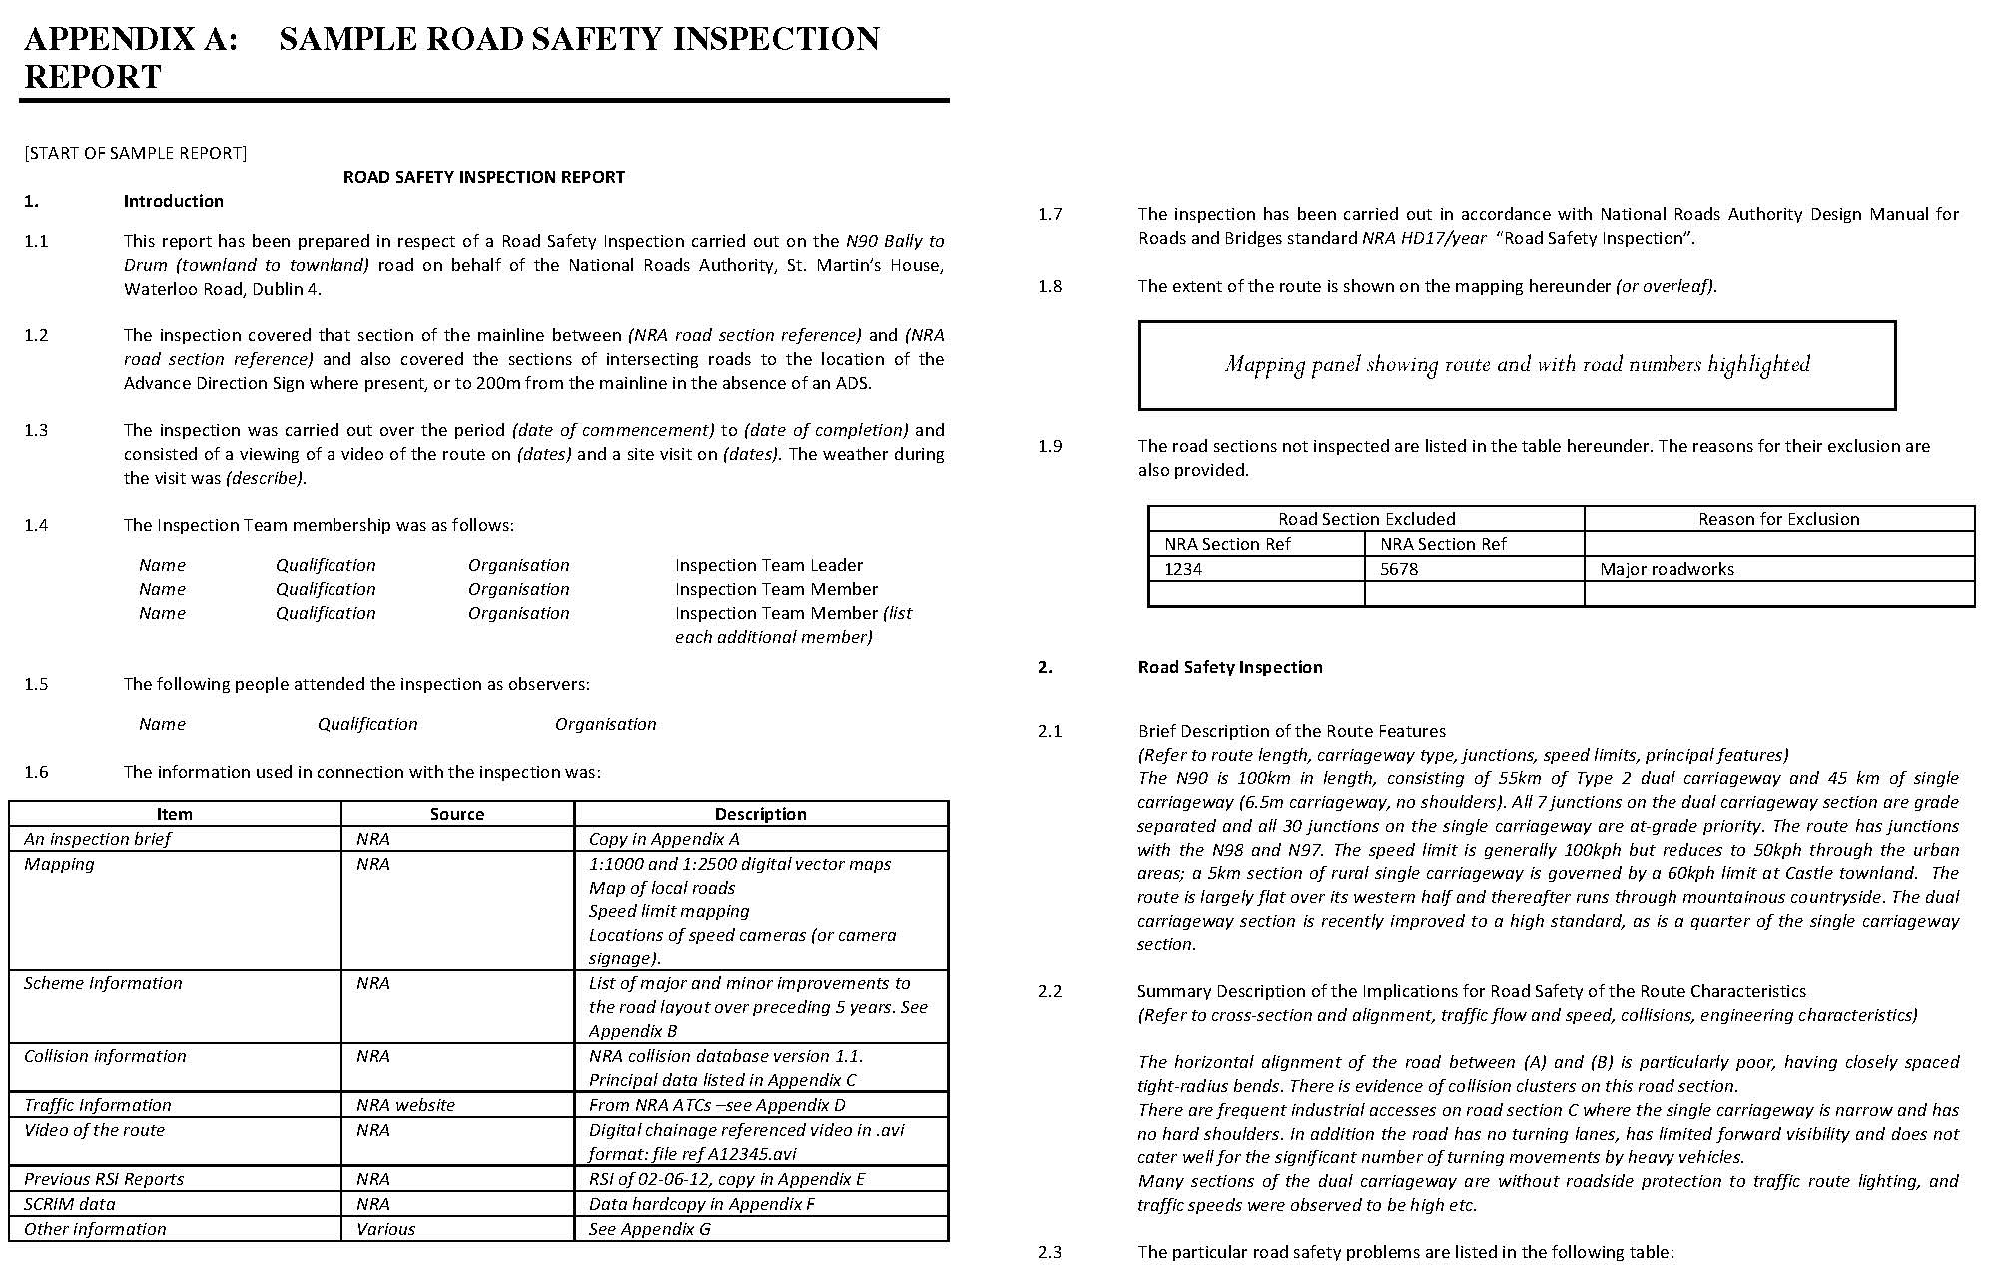
Sample RSI Report
Road name
Standard
Location
Map Panel
Date
Team
Excluded
Observers
Description
Information
Mapping
Scheme
Collision
Overview
Traffic
Video
Previous RSI
SCRIM
Other

Slide 19
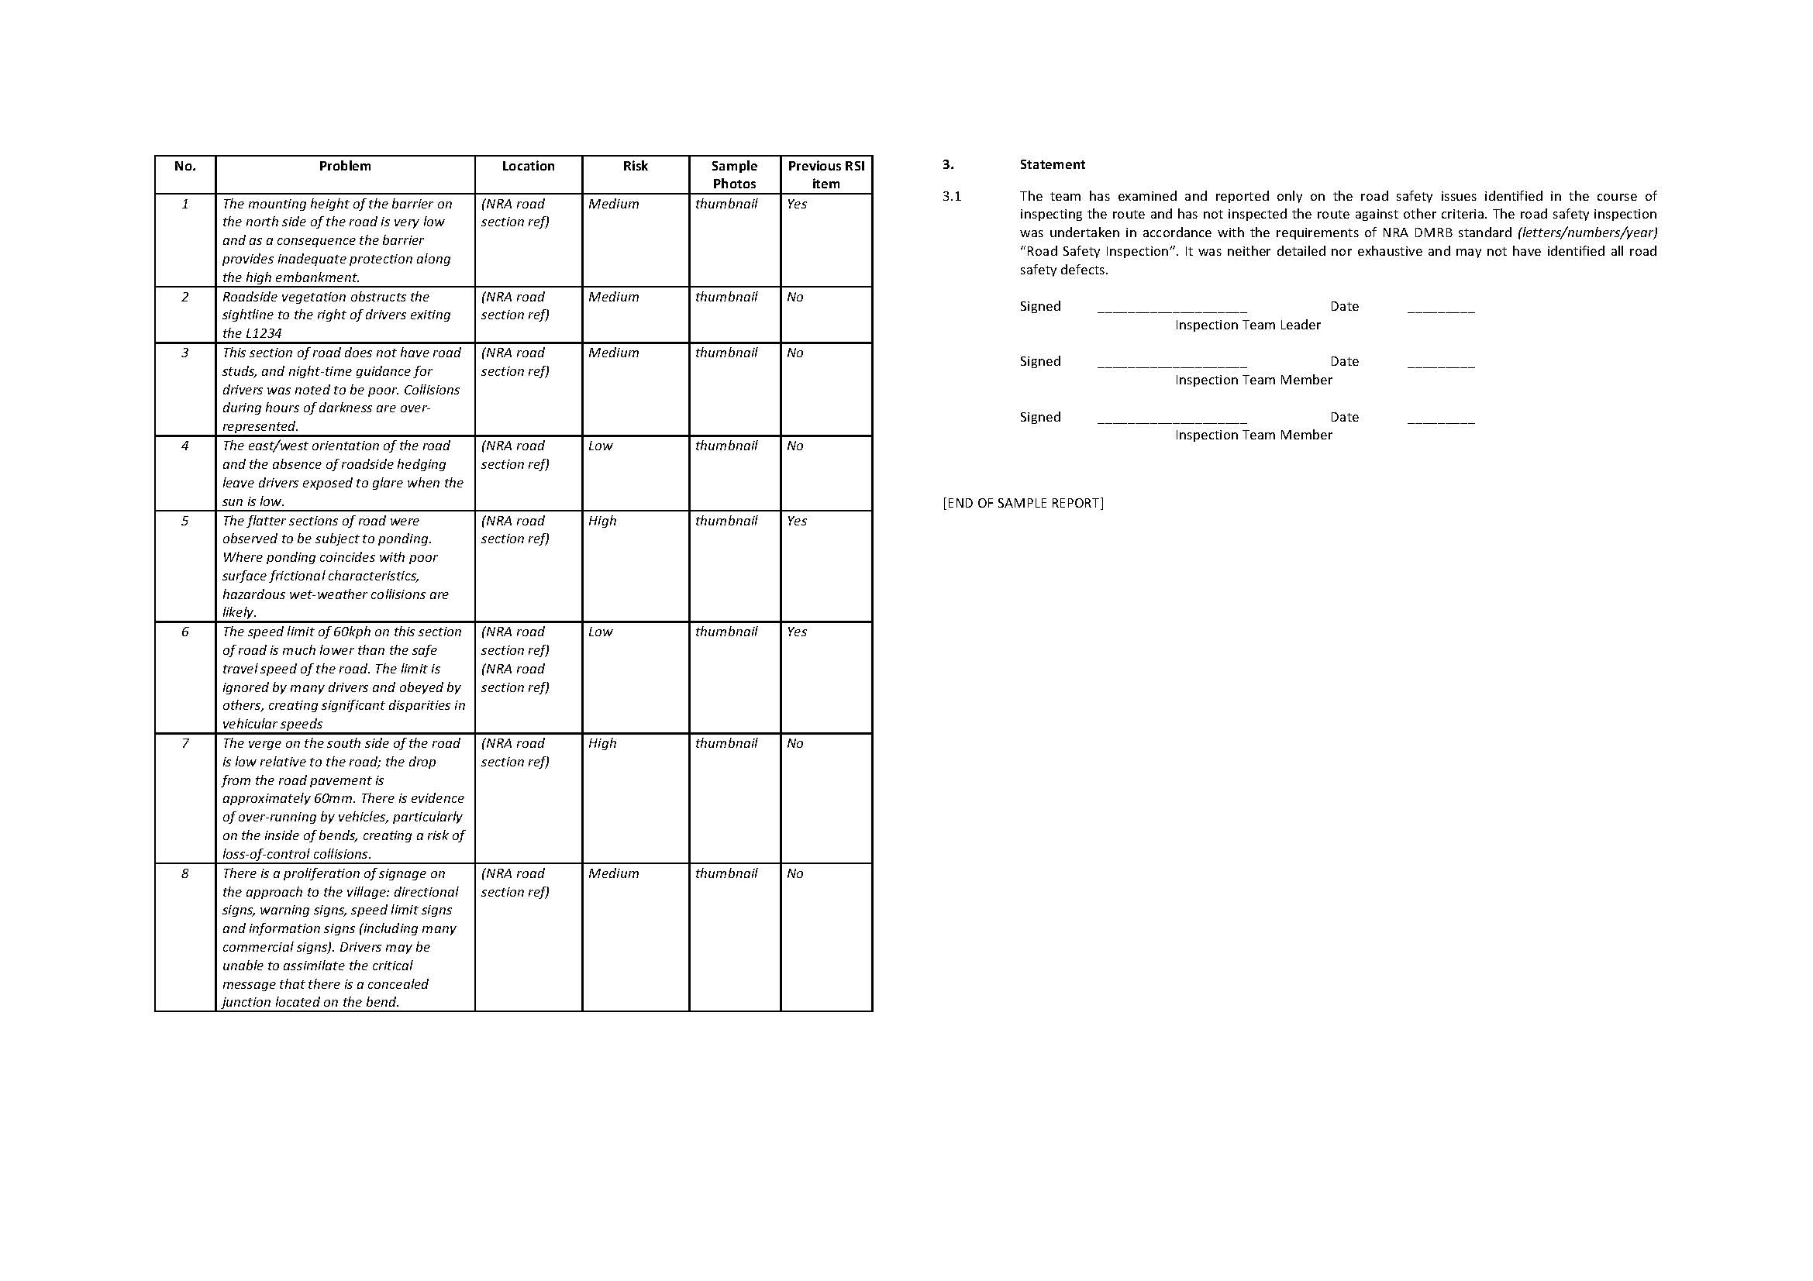
Sample RSI Report continued
Problems
Declaration

Slide 20
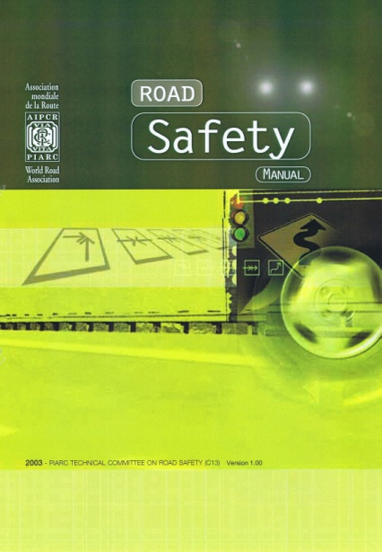
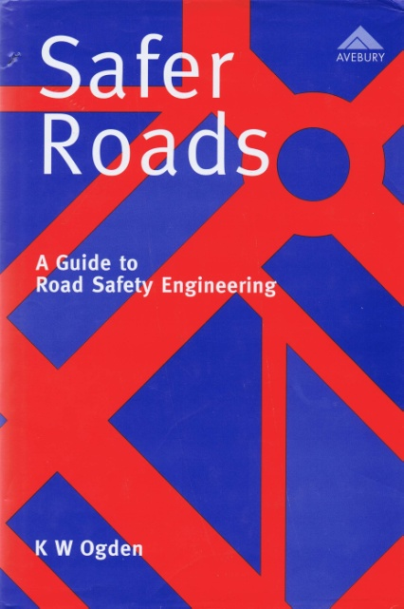
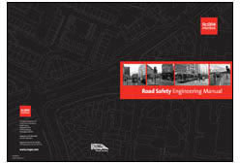
Information Sources
PIARC, The World Road Association, “Road Safety Manual”, France, 2003.
PIARC, The World Road Association, “Road Safety Inspection Guideline for Safety Check of Existing Roads”, 2007.
RoSPA, Road Safety Engineering Manual
CEDR (Conference of European Directors of Roads), “Existing Treatment for the Design of Forgiving Roadsides. State of the Art Report “, France, 2011.
Norwegian Public Roads Administration, “Road Safety Audits and Inspections”, Norway, 2006.
KW. Ogden, “Safer Roads: A Guide to Road safety Engineering”, Australia, 1996

Slide 21
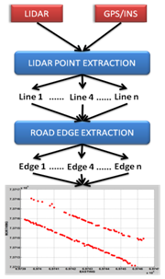
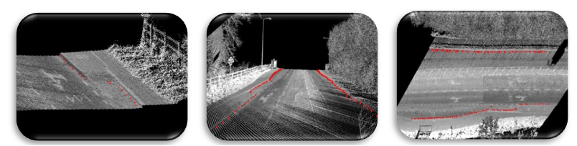
Future Directions
EuRSI Research Project:
Road mapping + inventory
Defect logging to replace manual RSI

Slide 22
Road Safety Inspection
Dermot Donovan
17th April 2012

