Slide 1

TII Fence Retrofit Webinar
Post and Rail fence retrofit-
Background and Standards
Fiona Bohane
03/02/2022

Slide 2

Presenters
Fiona Bohane, TII Regional Road Safety Engineer
David O Brien, Executive Engineer formally Roads – now Water Services, Kilkenny CC
David Hamill, Senior Executive Technician, Monaghan CC
John Carton, TII Regional Road Safety Engineer
Discussion/Questions Answers

Slide 3
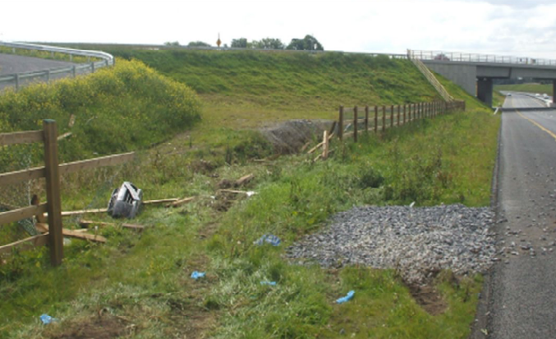
TII Fence Retrofit – Background and Standards
Introduction and background to P&R retrofit.
Pilot scheme
Identify the appropriate standards – Fencing & Forgiving Roadside
Legislation
New Fence type –specification
Sample documents , Design reports
and Tender Documents
Process Flow Chart

Slide 4
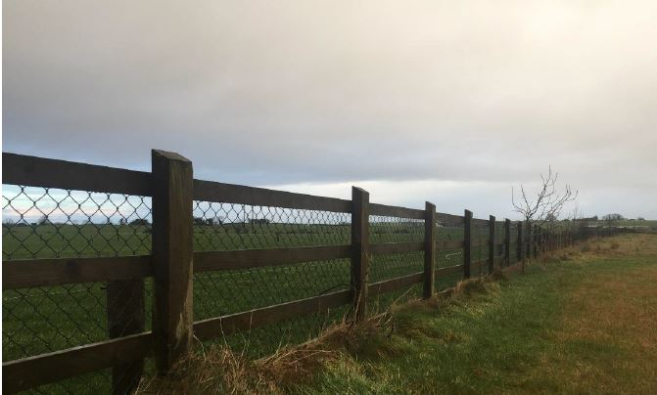
Why are we here?

Slide 5
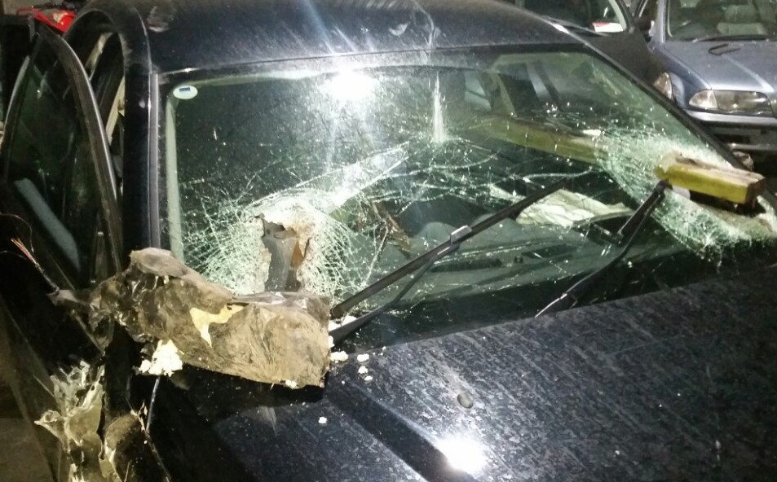
Post and rail fence entering vehicle

Slide 6
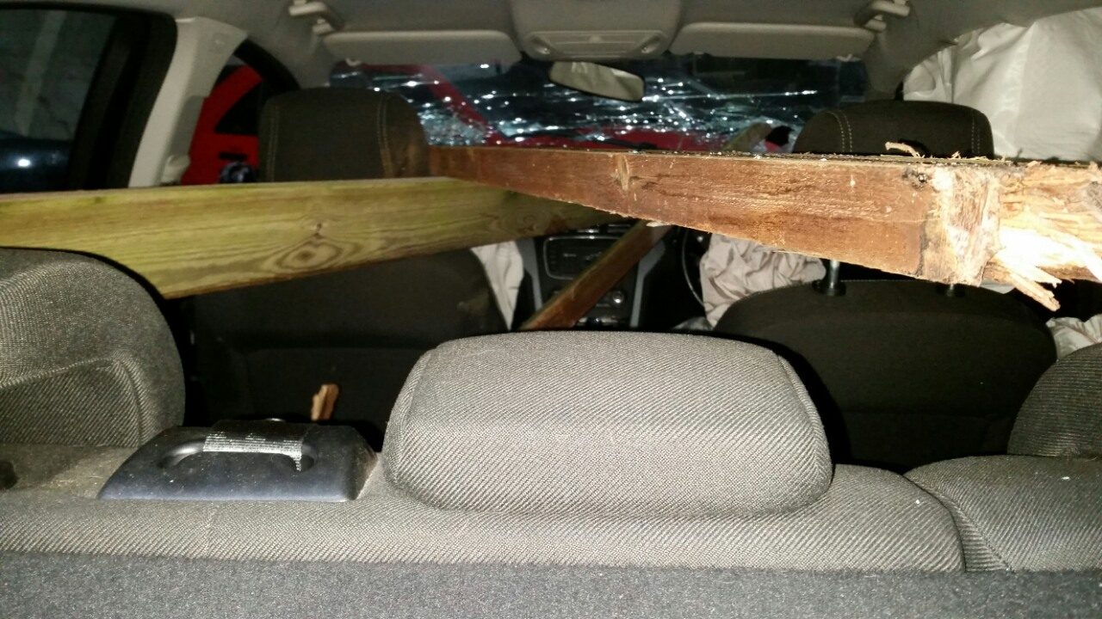
View towards front windscreen

Slide 7
Introduction & Background to Retrofit Program
Problem Identified
Data Collected –
  Number of SI/F collisions on network
  LA’s identified extent of retrofitting required
Research
Resulted in:-
Alteration to road collision information collection.
Requirement for new fence type , revision to TII Standards
TII does not generally retrofit.
Action where practical/ economically feasible

Slide 8

Pilot Schemes
“Driver has 'very lucky escape' after fence goes through van window”
In Tipperary/Mayo
Consultants RPS
Designed up a number of
locations for retrofit
Produced documents/templates
Works carried out by LA staff
Review and revise documents
as appropriate
Roll out to full network

Slide 9


Standards/specifications
SPW, GSW , SCD’d Updated to account for Timber Post and Tension Mesh Fence types
  CC-SPW-00300, CC-SPW-00300, SCD_00320/1/2
Other useful reference documents
  VRS Design – Relevant Standards
  DN-REQ-03034 / 03036 & 03079
Design Template to assist local authority staff in implementation of the retrofit process

Slide 10
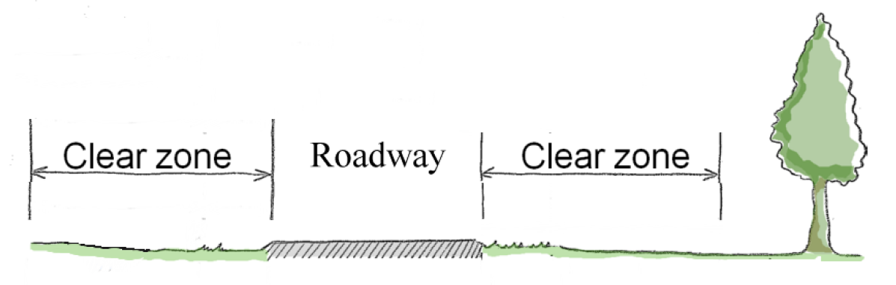
Forgiving Roadsides

Slide 11
Hazard Mitigation
Remove
Relocate
Re-design hazard (e.g. passive)
Revise road layout or cross section to lower risk
Reduce Impact Severity (e.g. breakaway features, flush profiles)
Provide suitable barrier
LAST RESORT

Slide 12
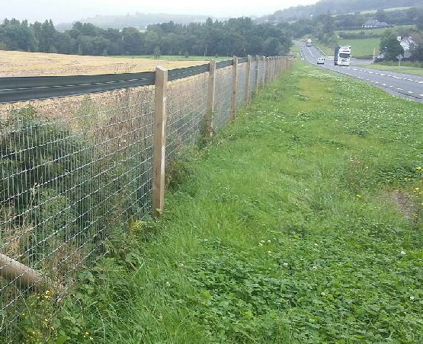
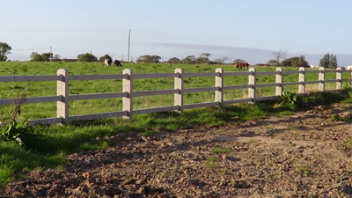

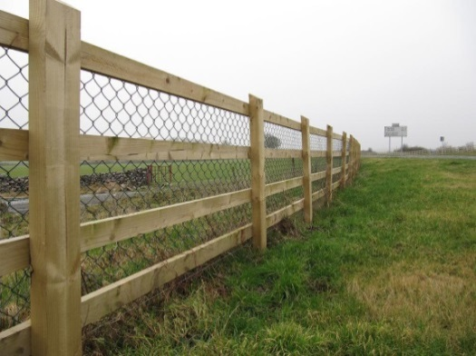

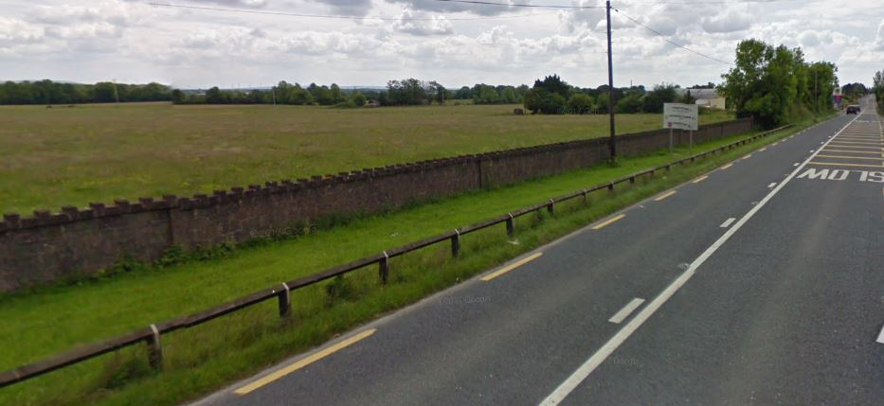
Hazard Mitigation
All fences with rails even if used as road boundary = Hazards

Slide 13
Legislation/Regulation/Standards
Roads Act - Section 70
(b) Where a structure…..is a hazard or potential hazard to persons using a public road or where it obstructs or interferes with the safe use of a public road…..a road authority may serve notice in writing on the owner…or occupier of any land on which the structure is situated to remove, modify….within the period stated in the notice.
Planning and Development Regulations
Article 9 relates to restrictions on specific exemptions (such as fencing around land) where…9(1)(iii)…such development would endanger public safety by reasons of traffic hazard or obstruction of road user…

Slide 14
Legislation//Regulation/Standards
National Standards Authority of Ireland Act 1996
Irish Standard 435-1:2017. Standard Specification for Roadside Fencing- Timber post and rail.
States :-
“ WARNING The user of this Irish Standard is advised that in accordance with TII requirements, the construction of roadside fencing with timber post and rails in not permitted within the clear zone of a National Road as defined in TII publication…..In situations where fencing is required within the clear zone…..only timber post and tensioned mesh fence may be permitted.”

Slide 15
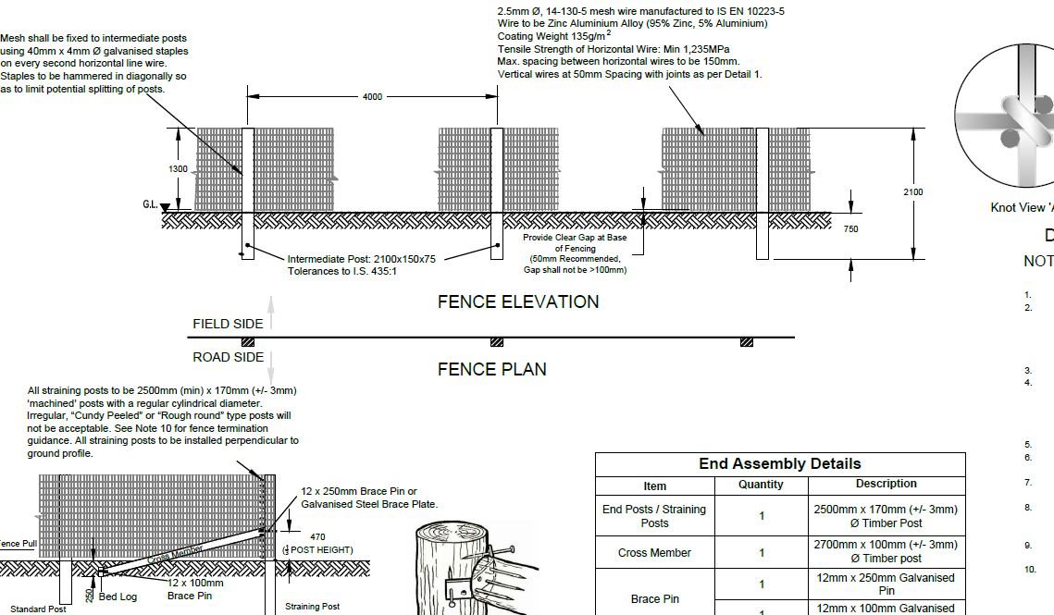
SCD-00320

Slide 16
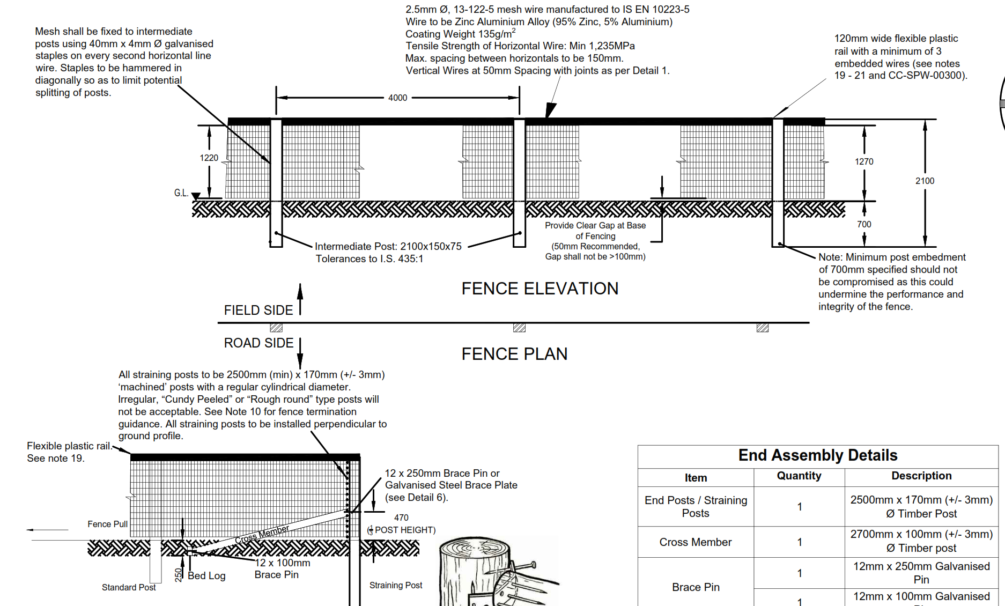
SCD-00321

Slide 17
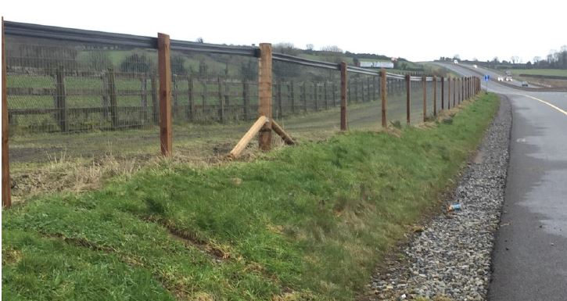
Tension Mesh Fence

Slide 18
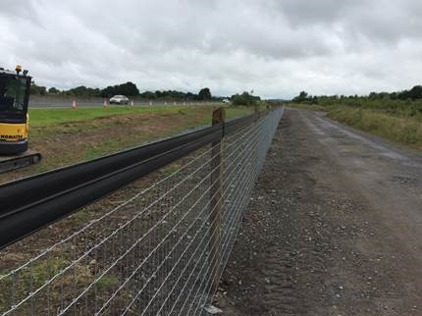
Tension Mesh Fence

Slide 19
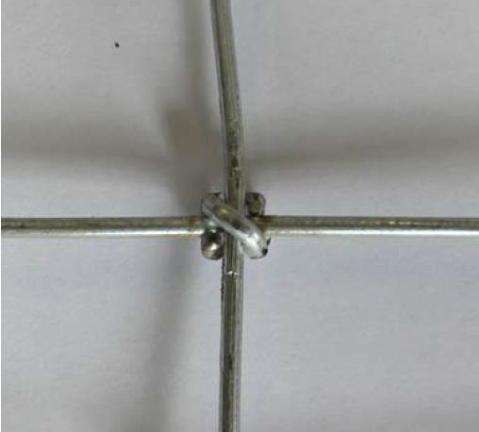
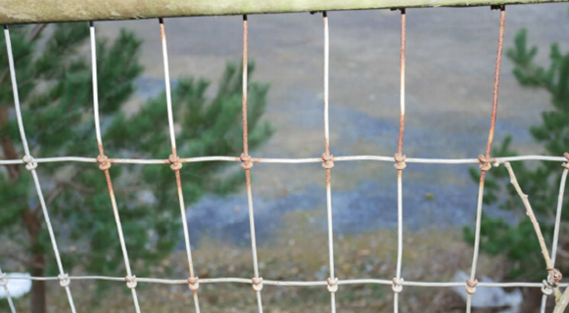
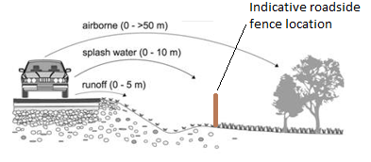
Materials – Wire Mesh specification
Wire to be Zinc Aluminium Alloy - 95% Zinc, 5% Aluminium (Galfan).
Coating Weight 135g/m².

Slide 20
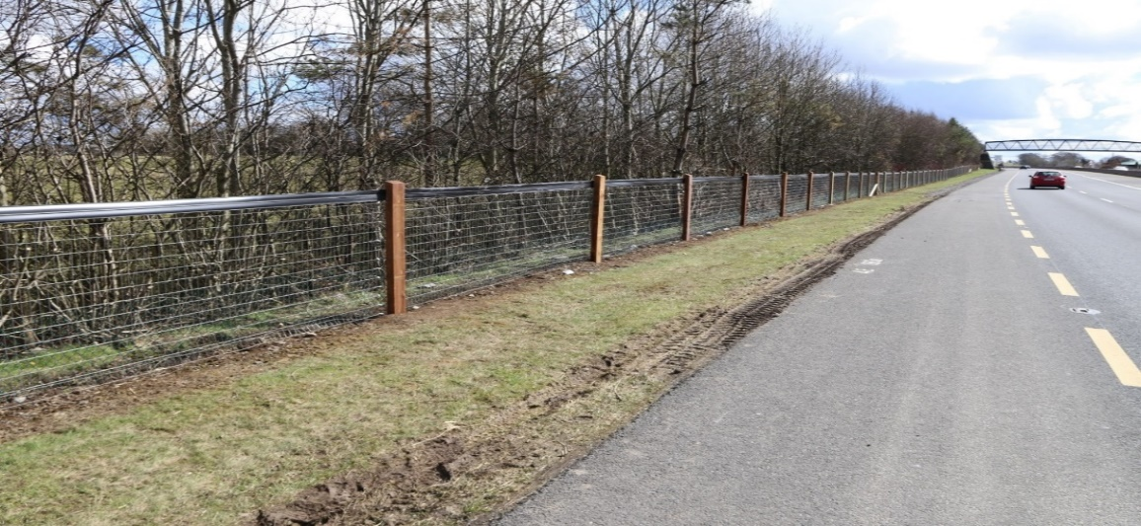
Sample documents
Also to assist local authority the following documents circulated in 2019
TII Circular dated 20 February 2018
Suggested Letter for Landowners Category 1 Sections of Fencing
Suggested Letter for Landowners Category 2 Sections of Fencing
TII FRP Retrofit Process Flow Chart
TII Circular dated 27 November 2018
TII FRP_Design Assessment Report
TII FRP_Design Process Version V02 (excel doc)
TII FRP_Sample Pricing Document
TII FRP_Sample Specification Appendices
Collisions rates and sinuosity maps available from http://data.tii.ie/Datasets

Slide 21
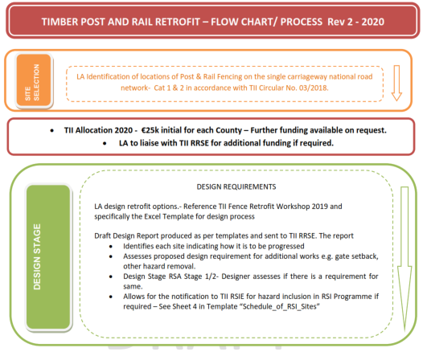
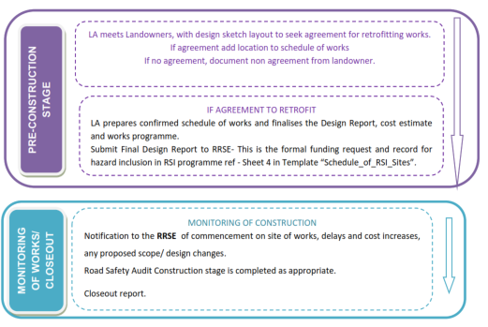
Flow Chart

Slide 22
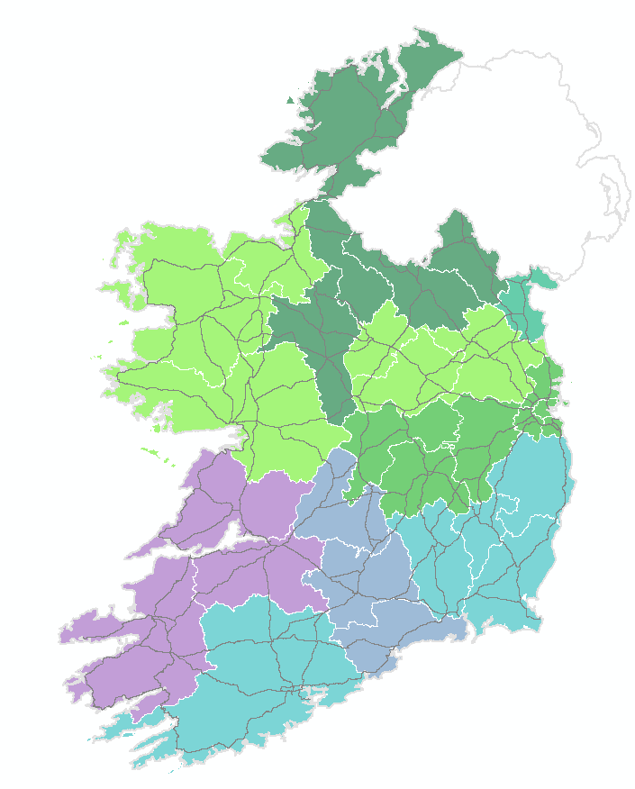
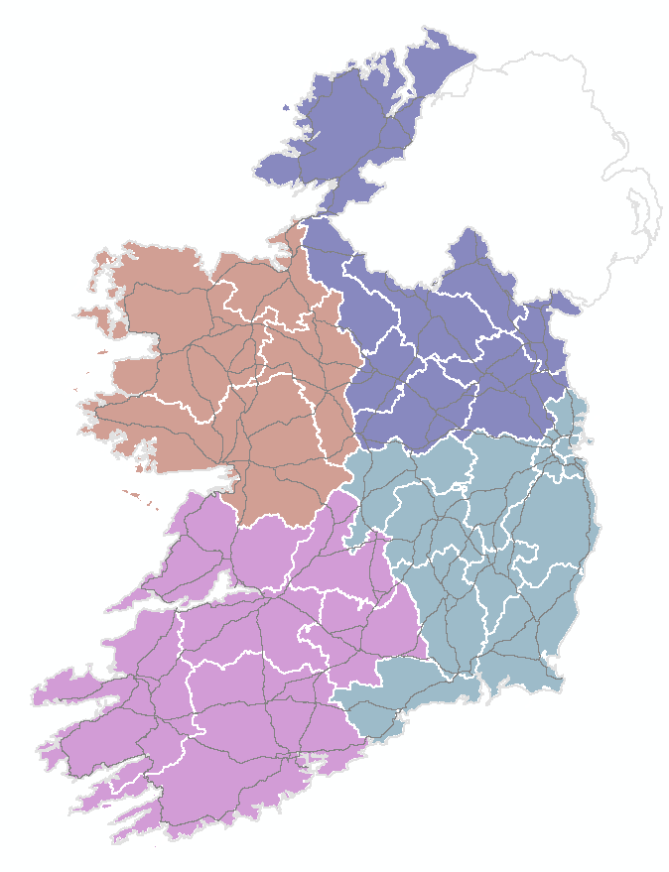
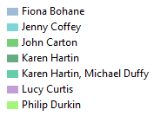

TII Safety Contact details
Email | Phone
Elizabeth.Kennedy@kerry.nrdo.ie | 086 8347732
fiona.bohane@corkrdo.ie | 086 8355196
JCarton@kildarenrdo.com | 087 9285742
jcoffey@thrdo.com | 086 8286836
jmcelhinney@roscommonnrdo.ie | 0877698434
karen.hartin@dnrdo.ie | 087 9273944
LCurtis@kerry.nrdo.ie | 087 3774238
michael.duffy@dnrdo.ie | 087 2621124
philip.durkin@tii.ie | 087 2888067
Road Safety Engineers
Road Safety Inspection Engineers

Slide 23

Thankyou

